Slide 1
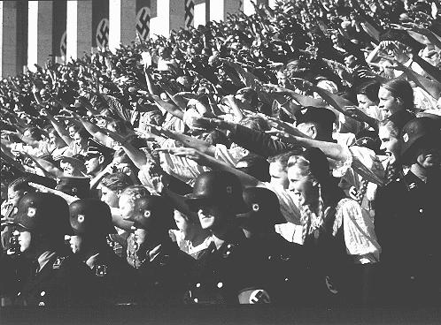
Propaganda
Deconstructing Nazi propaganda Images

Slide 2
What is Propaganda?
Biased information
Simplifies complex issues or ideas
Created to shape public opinion and behavior
True, partially true, or blatantly false information
Plays on emotions
Symbols, images, words, or music
Advertises a cause, organization, or movement and its opponents
Directs human action toward a given goal

Slide 3
Common Propaganda Techniques
Bandwagon
Testimonial
Plain Folks
Transfer
Fear/Card Stacking
Logical Fallacies
Glittering Generalities
Name-calling

Slide 4
Bandwagon
An appeal to the subject to follow the crowd
Tries to convince the subject that one side is the winning side and that winning is inevitable
Appeals to a person’s desire to be on the winning side

Slide 5
Testimonial
Quotations or endorsements which attempt to connect a well-known or respectable person with a product or ideal with the intent to better “sell” the product or ideal

Slide 6
Plain Folks
An attempt to convince the public that his or her views reflect those of the “common person”
The candidate tries to appear to be working for the benefit of the “common person”

Slide 7
Transfer
An attempt to make the subject view a certain item in the same way as they view another item
Used to transfer negative feelings for one object to another
In politics, this technique is often used to transfer blame or bad feelings from one politician to another or from one group of people to another

Slide 8
Fear/Card Stacking
Only presents information that is positive to an idea or proposal and omits information contrary to it
While the information presented is true, other important information is purposely omitted

Slide 9
Logical Fallacies
An argument that sounds as if it makes sense but the premises given for the conclusion do not provide proper support for the argument

Slide 10
Glittering Generalities
Uses words that have different positive meaning for individual subjects, but are linked to highly valued concepts
Words often used as glittering generalities are honor, glory, love of country, and freedom

Slide 11
Name-calling
Uses derogatory language or words that carry a negative connotation when describing an enemy
Attempts to arouse prejudice among the public by labeling the target something that the public dislikes

Slide 12
Common Propaganda Traits
• Uses truths, half-truths, or lies
• Omits information selectively
• Simplifies complex issues or ideas
• Plays on emotions
• Advertises a cause
• Attacks opponents
• Targets desired audiences

Slide 13
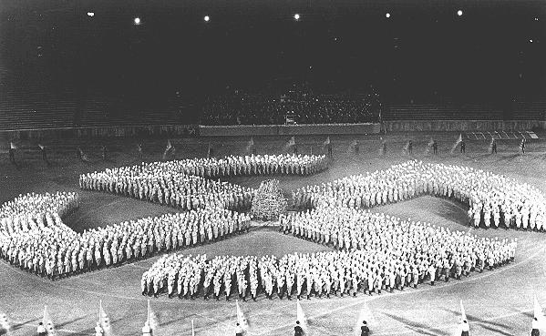
Nazi Propaganda Practices

Slide 14
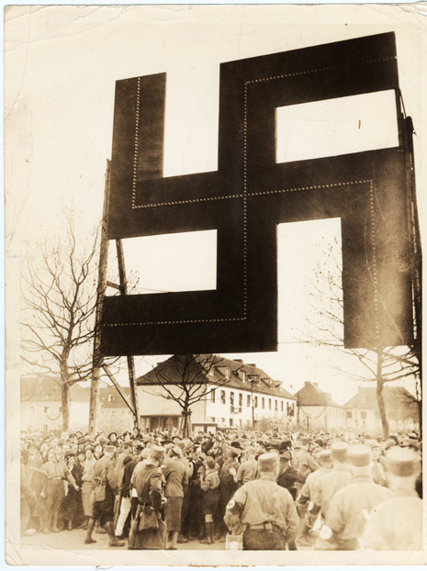
Volksgemeinschaft: “National Community”
A cornerstone of Nazi ideology and
propaganda
An organic, racial union
of all “Aryan” Germans
Political strife and dissension have
no place in National Socialist society
Contributing to the general welfare of the nation, not individualism
Nazi propaganda played a crucial role in selling the myth to Germans who longed for unity, national pride and greatness

Slide 15
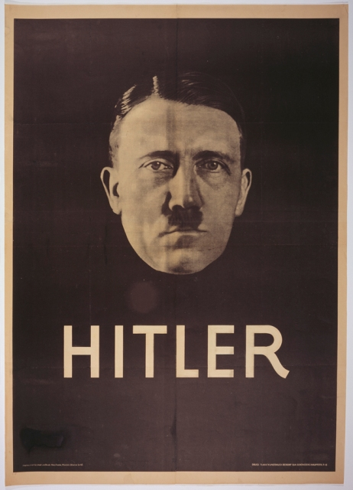
Making a leader
Nazi propaganda idolized Hitler as a gifted statesman who brought stability, created jobs, and restored German greatness
Under the Nazi regime, Germans were expected to pay public allegiance to the “Führer” in quasi-religious forms, such as giving the Nazi salute and greeting others on the street with “Heil Hitler!,” the so-called “German Greeting”
Faith in Hitler strengthened the bonds of national unity, while non-compliance signaled dissension in a society where open criticism of the regime, and its leaders, were grounds for imprisonment
Modern techniques of propaganda -- including strong images and simple messages -- helped propel Austrian-born Adolf Hitler from being a little known extremist to a leading candidate in the 1932 German presidential elections. The style of this poster is similar to some of film stars of the era. Election poster, 1932; photo by Heinrich Hoffmann

Slide 16
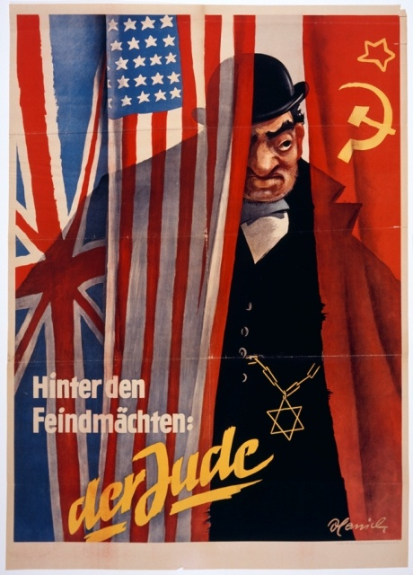
Defining the Enemy
One crucial factor in creating a cohesive group is to define who is excluded from membership
Nazi propagandists contributed to the regime's policies by publicly identifying groups for exclusion, inciting hatred or cultivating indifference, and justifying their pariah status to the populace
Propaganda helped to define who would be excluded from the new society and justified measures against the “outsiders”:
Jews
Sinti and Roma (Gypsies)
homosexuals
political dissidents
Germans viewed as genetically inferior and harmful to “national health”
Nazi propaganda often portrayed Jews as engaged in a conspiracy to provoke war. Here, a stereotyped Jew conspires behind the scenes to control the Allied powers, represented by the British, American, and Soviet flags. The caption reads, "Behind the enemy powers: the Jew." Circa 1942.

Slide 17
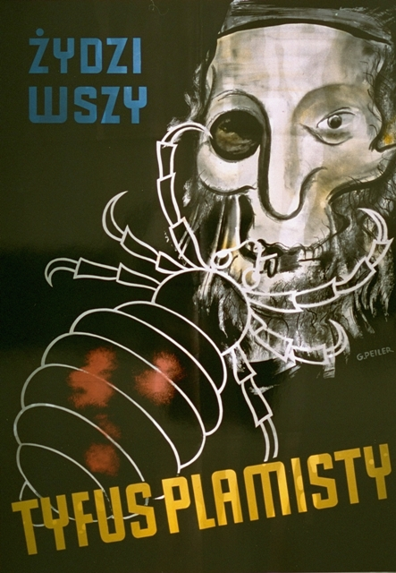
Deceiving the Public
Propaganda served as an important tool to win over the majority of the German public who had not supported Adolf Hitler and to push forward the Nazis' radical program
A new state propaganda apparatus, headed by Joseph Goebbels, sought to manipulate and deceive the German population and the outside world
Propagandists preached an appealing message of national unity and a utopian future
An antisemitic poster published in Poland in March 1941. The caption reads, "Jews are lice; They cause typhus." This German-published poster was intended to instill fear of Jews among Christian Poles.

Slide 18
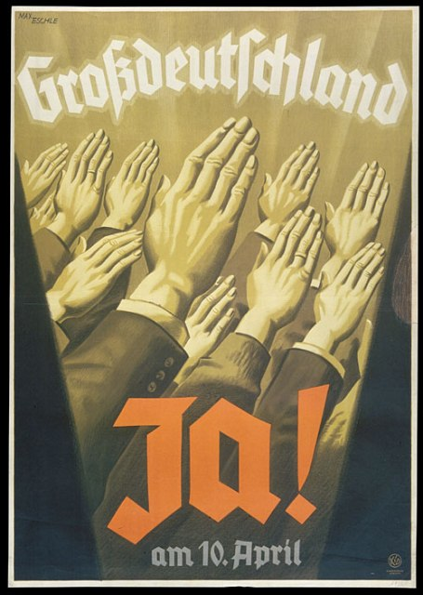
Rallying the Nation
The Nazi Party dramatically increased its public support by advertising itself as a protest movement against the corruption and ineffectiveness of the Weimar “system”
Throughout World War II, Nazi propagandists disguised military aggression aimed at territorial conquest as acts of ethnic self-defense necessary for the survival of “Aryan civilization”
Nazi propaganda frequently stressed the power of a mass movement to propel the country forward, subtly underscored by the upward angle of the hands
This poster typifies the propaganda strategy of using simple confident slogans, with bold graphics often using the characteristic Nazi colors of red, black, and white.
"Greater Germany: Yes on 10 April" (1938). This election poster emphasizes the message of jumping on the Nazi political bandwagon, as represented by the hands raised in a unified Nazi salute.

Slide 19
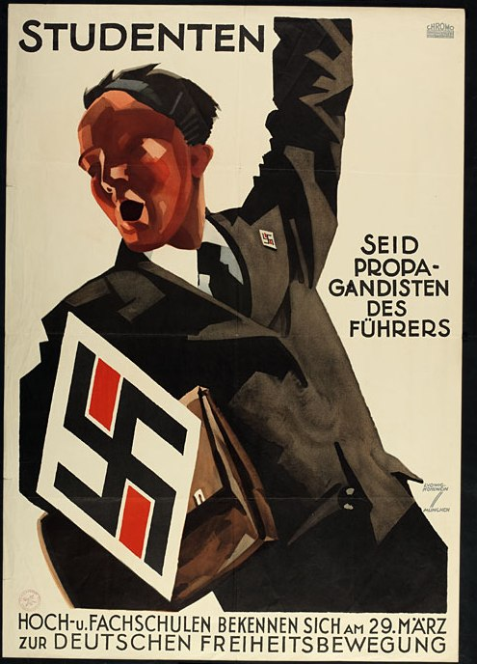
Indoctrinating Youth
From the 1920s onwards, the Nazi Party targeted German youth as a special audience for its propaganda messages
These messages emphasized that the Party was a movement of youth:
dynamic
resilient
forward-looking
hopeful
Millions of German young people were won over to Nazism in the classroom and through extracurricular activities
"Students/Be the Führer's propagandists." With militant appeals to nationalism, freedom, and self-sacrifice, the Nazi Party successfully recruited students disenchanted with German democracy and their current student organizations.

Slide 20
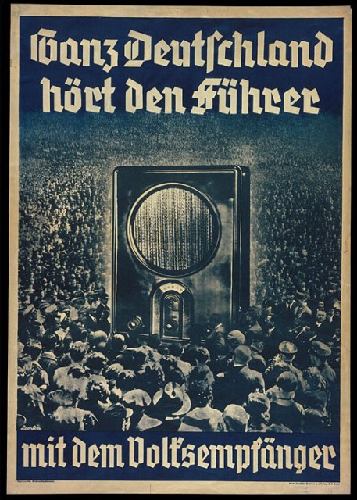
Writing the News
Der Stürmer was the most notorious, antisemitic newspaper in Germany
The newspaper, headed by Julius Streicher, published lurid tales of Jewish “ritual murder,” sex crimes, and financial malfeasance
The Nazis understood the power and attraction of emerging technologies, such as film, loudspeakers, radio, and television, in the service of propaganda
These technologies offered the Nazi leadership a means for mass dissemination of their ideological messages and a vehicle for reinforcing the myth of the National Community through communal listening and viewing experiences
"All of Germany Listens to the Führer with the People's Radio." The poster depicts a crowd surrounding a radio. The radio looms large, symbolizing the mass appeal and broad audience for Nazi broadcasts.

Slide 21
The Nazi Plan
Film from the Steven Spielberg Film Archive showing the Opening of the Official Anti-Semitic Campaign, 1 April 1933. Also in this clip is Minister for Popular Enlightenment and Propaganda, Joseph Goebbels addressing a cheering crowd in Berlin Lustgarten, the boycott of Jewish shops, a truck filled with Nazis moving through streets, chanting: "Germans, protect yourselves. Don't buy from the Jews,“ book burning and more. [00:05:48]

Slide 22
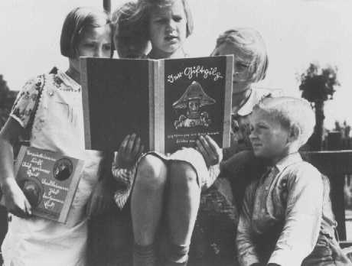
Please use your corresponding worksheets with the next set of slides

Slide 23
“A New People”
Calendar cover,
“A New People 1938,”
Nazi Party Office of Racial Politics
USHMM, source unknown

Slide 24
“The Eternal Jew”
Exhibition poster,
“The Eternal Jew,” Munich, 1937
USHMM, courtesy of Julius Goldstein

Slide 25
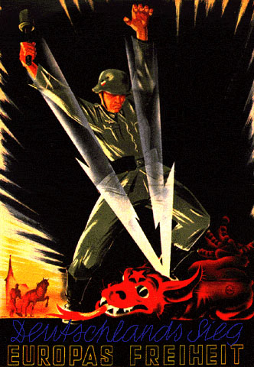
“Germany’s Victory Europe’s Freedom”
Wartime poster,
“Germany’s Victory Europe’s Freedom”, 194?
USHMM, source unknown

Slide 26
