Slide 1
VOICES ON
ANTISEMITISM
MICHAEL CHABON

Slide 2
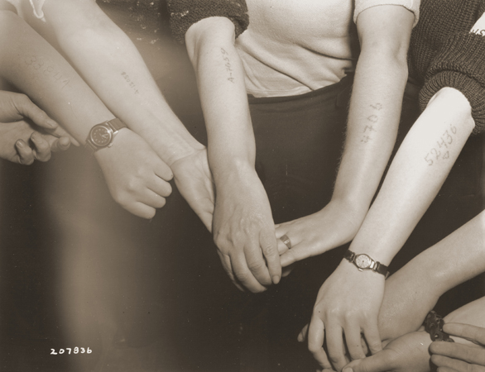
“One of the clearest, sharpest images that I retain—in a way my only truly firsthand sense of the Holocaust—was an aunt of mine who had been interned as a child had her arm tattooed.”
Photo credit:
U.S. Holocaust Memorial Museum Photo Archive #66201

Slide 3
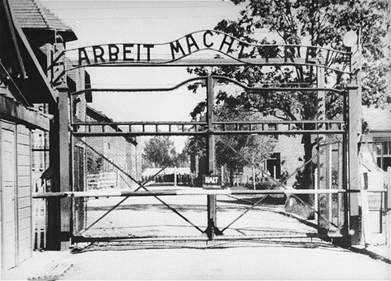
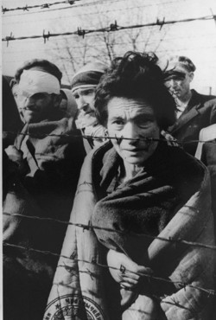
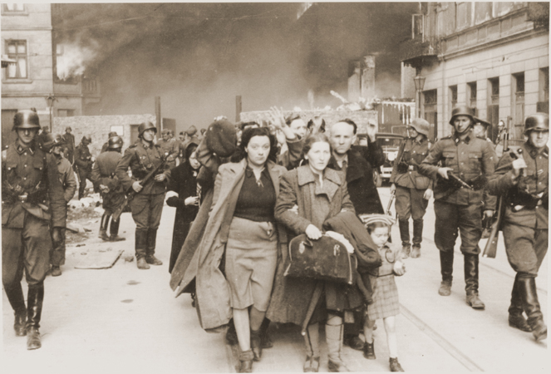
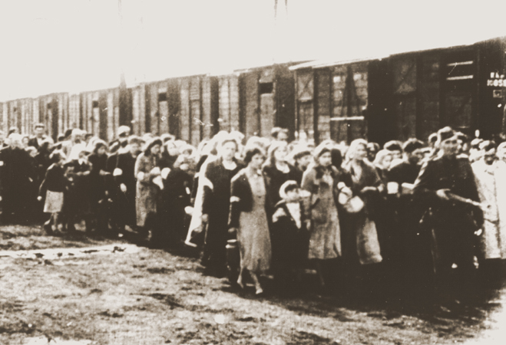
“…I had this desire, even as a child, to somehow know what it all meant. I don't mean "know" in an intellectual way, but to feel the force, even in this tiny infinitesimal way, to just get some kind of direct, clear sense of what the Holocaust was.”
Photo credits:
U.S. Holocaust Memorial Museum Photo Archive #00001, #36128, #18192, #05554

Slide 4
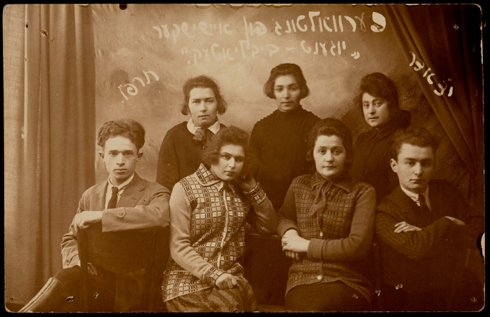
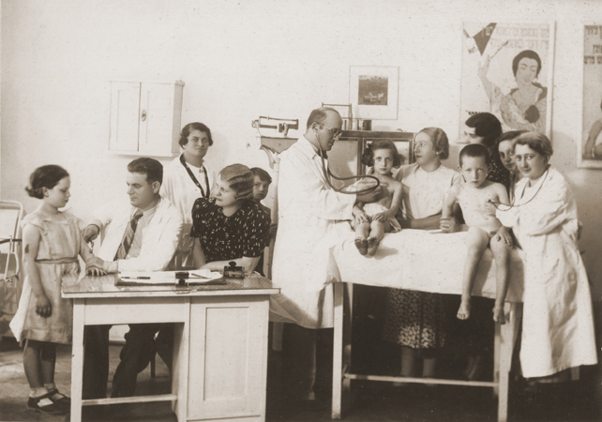
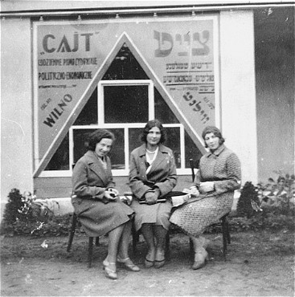
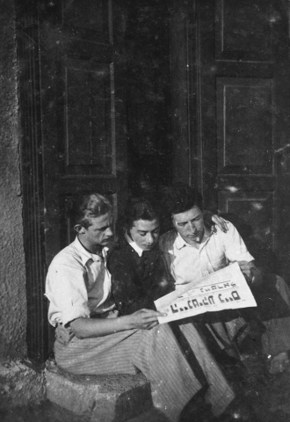
“…I wrote an essay trying to come to terms with the idea of a phrase book for travelers in Yiddish. Trying to address the question of where would you go with such a book? Where could you take it? To what destination would you travel with a Yiddish phrase book that told you how to do things…”
Photo credits:
U.S. Holocaust Memorial Museum Photo Archive #39633, #16425, #89353, #21314

Slide 5
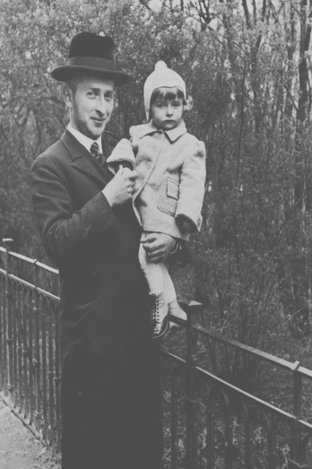
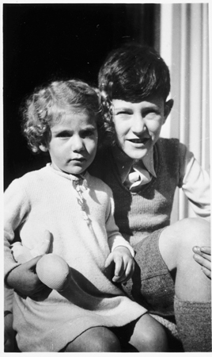
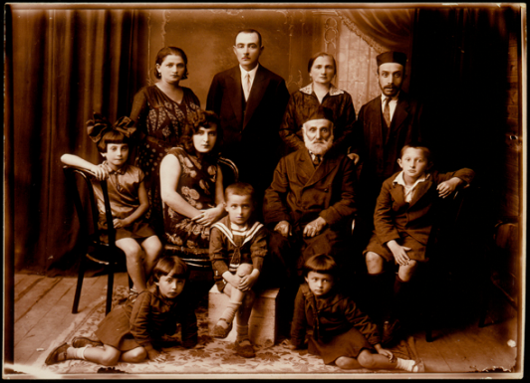
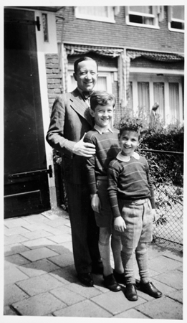
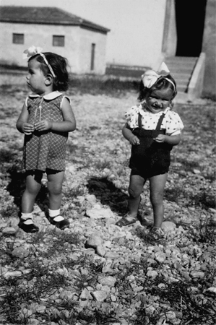
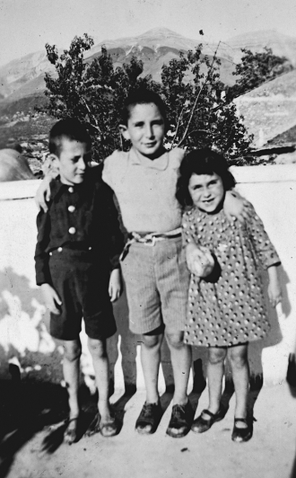
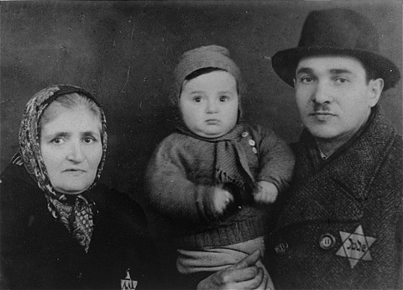
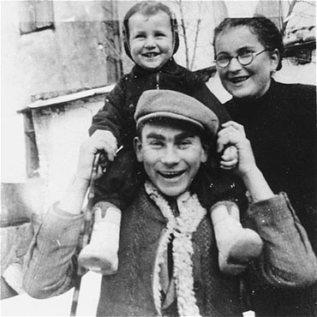
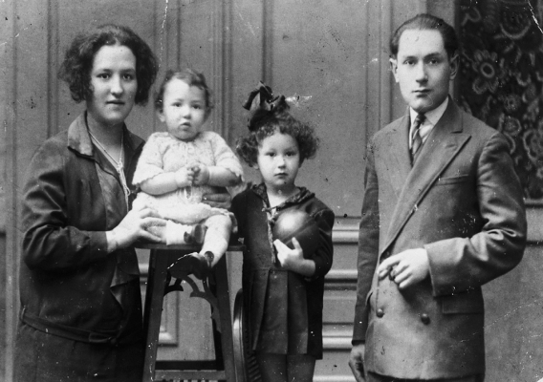
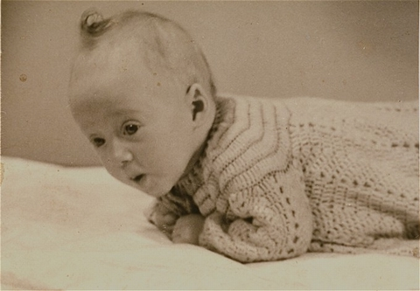
“…I speculated on the possibility that if the Holocaust had not happened, then all of those unmurdered Jews would have stayed where they were possibly and reproduced, and had grandchildren and great grandchildren.”
Photo credits:
U.S. Holocaust Memorial Museum Photo Archive #74955, #49135, #39336, #49138, #62438, #69525, #08806, #67220, #57905, #19277

