Slide 4
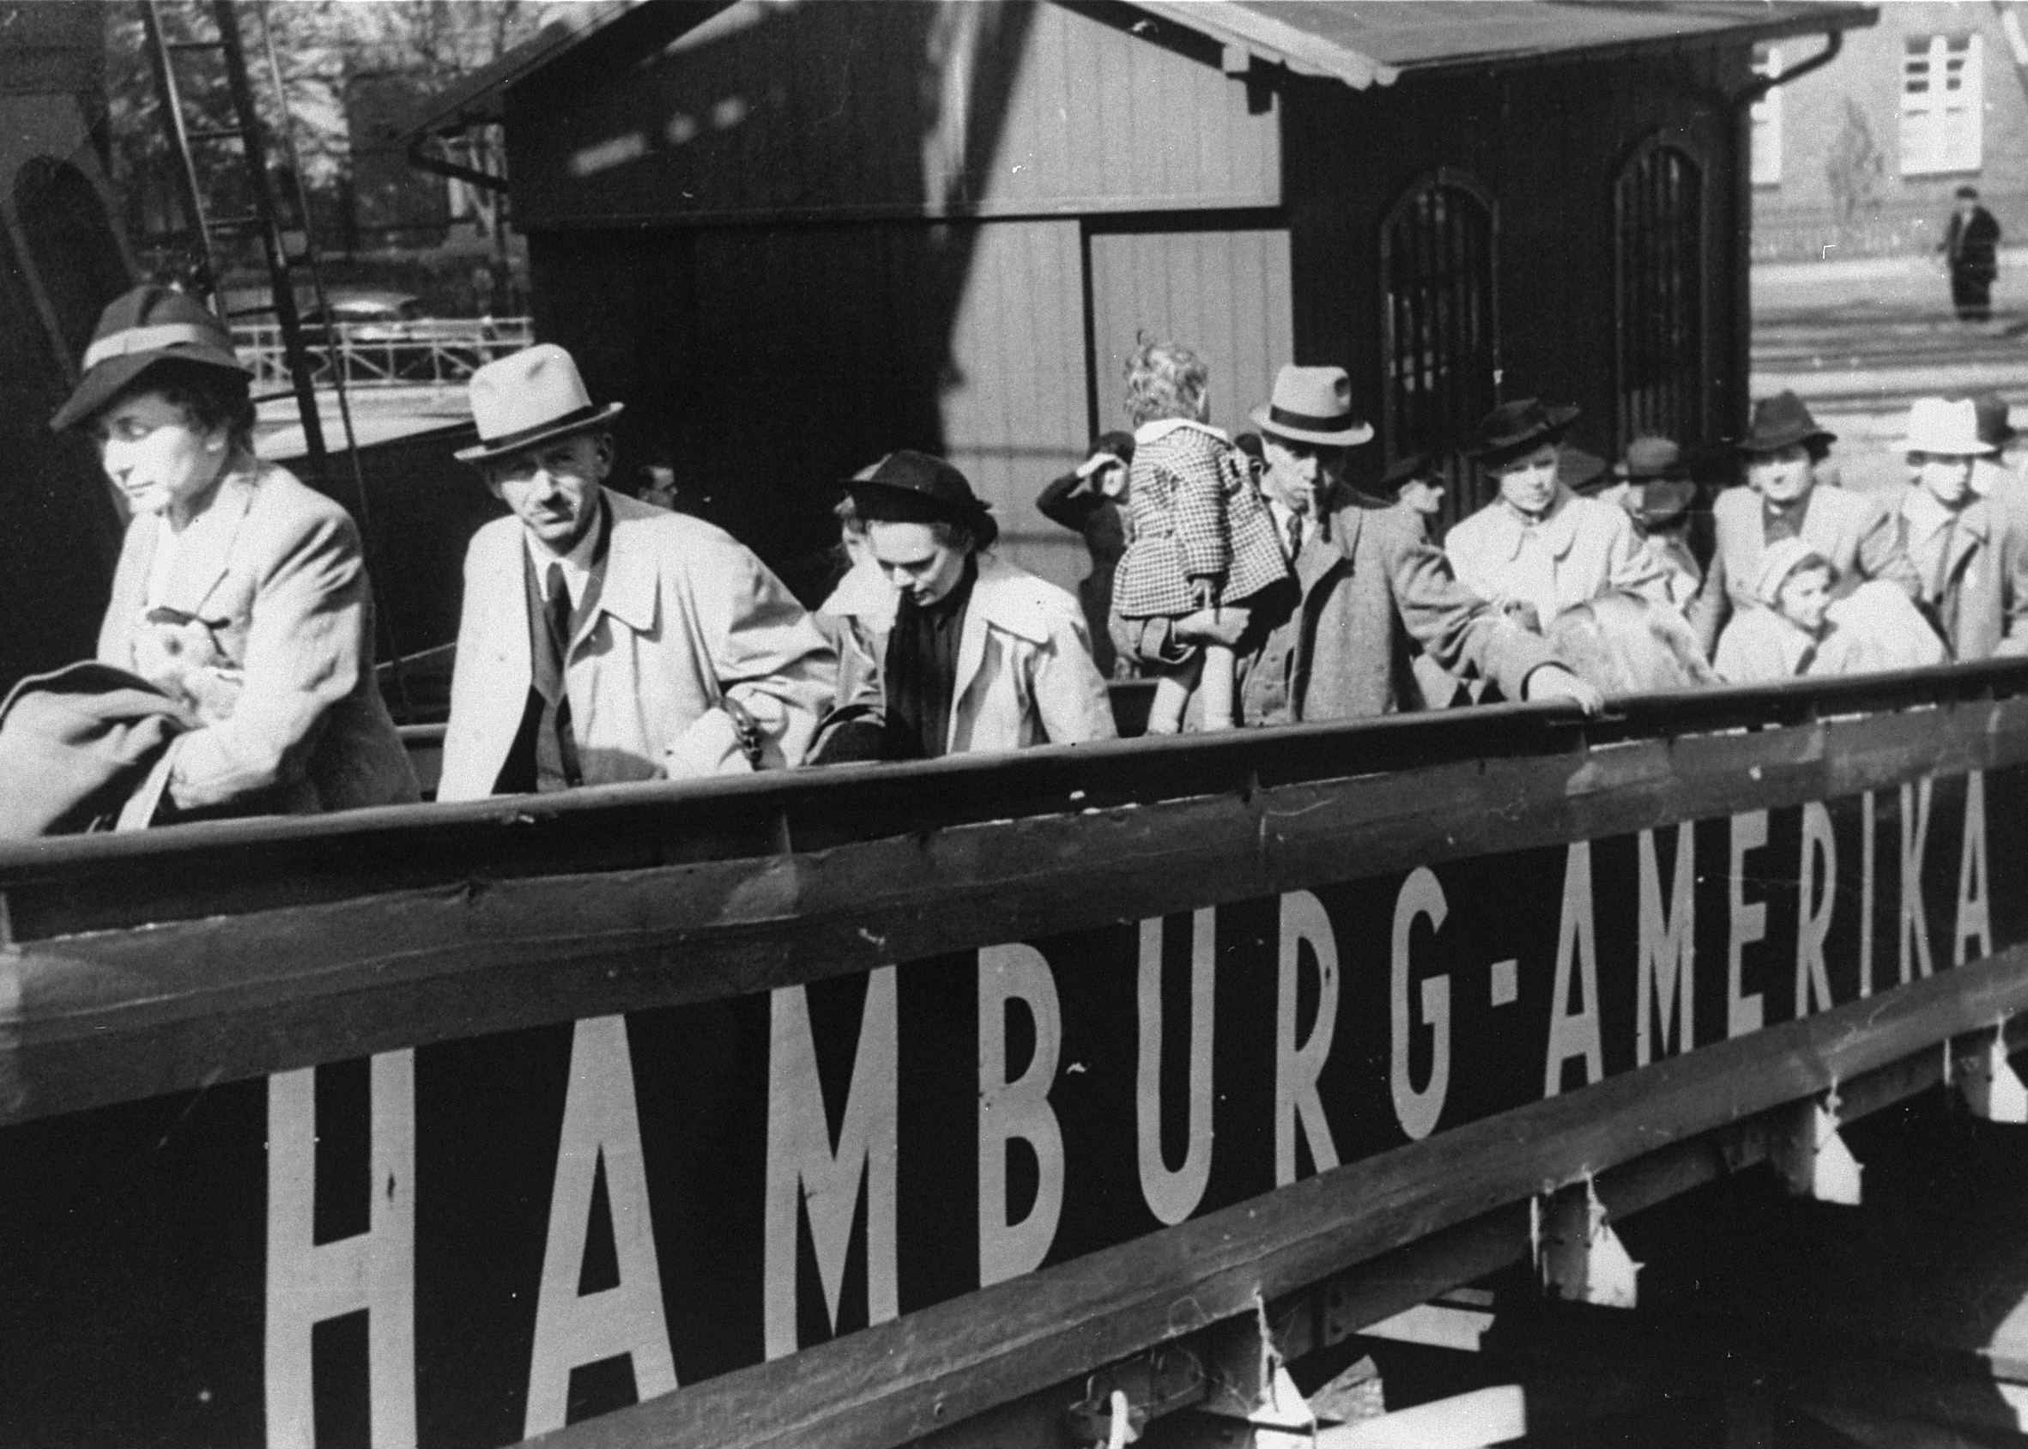
AMERICAN RESPONSES
Jewish refugees board the MS St. Louis in Hamburg, Germany, in May 1939.
What can we learn today from American action and inaction in the face of the refugee crisis in the spring of 1939 and the deportation of Hungarian Jews five years later? Looking back at these two events in Holocaust history raises questions about the responses of the United States to the widespread persecution and mass murder of the Jews of Europe.
Notes:
Collection of Walter Karliner, Museum of Jewish Heritage—A Living Memorial to the Holocaust, New York

Slide 5
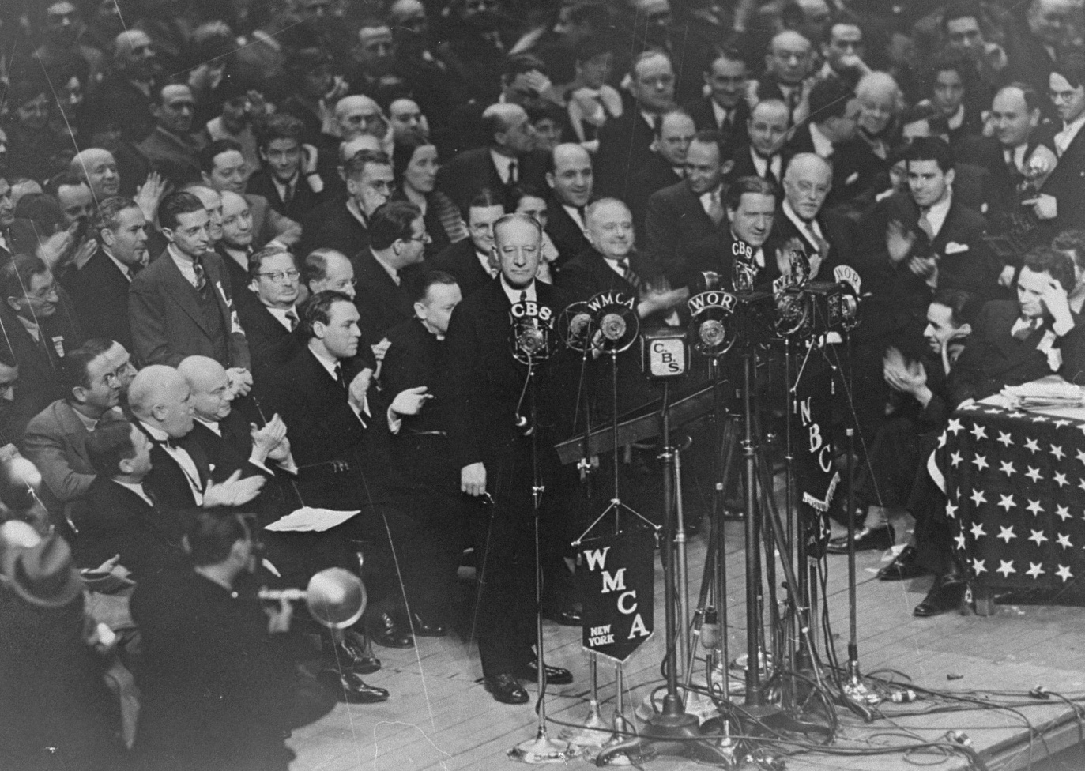
As the Nazis increasingly persecuted Germany’s Jews in the 1930s, many Jews sought refuge in other countries. In the United States, the Depression’s economic hardships intensified antisemitism and xenophobia.
AMERICAN RESPONSES
Former New York Governor Alfred E. Smith addresses the crowd at a demonstration held in Madison Square Garden to protest the Nazi persecution of German Jews. March 27, 1933.
The United States in the 1930s
Notes:
National Archives and Records Administration, College Park, Maryland

Slide 6
The US State Department enforced restrictive immigration laws limiting the issuance of visas, making it difficult for Jews to enter the United States. While Americans participated in rallies opposing Nazi persecution, an overall sentiment of isolationism pervaded American attitudes and policy.
AMERICAN RESPONSES
Former New York Governor Alfred E. Smith addresses the crowd at a demonstration held in Madison Square Garden to protest the Nazi persecution of German Jews. March 27, 1933.
The United States in the 1930s
Notes:
National Archives and Records Administration, College Park, Maryland

Slide 7
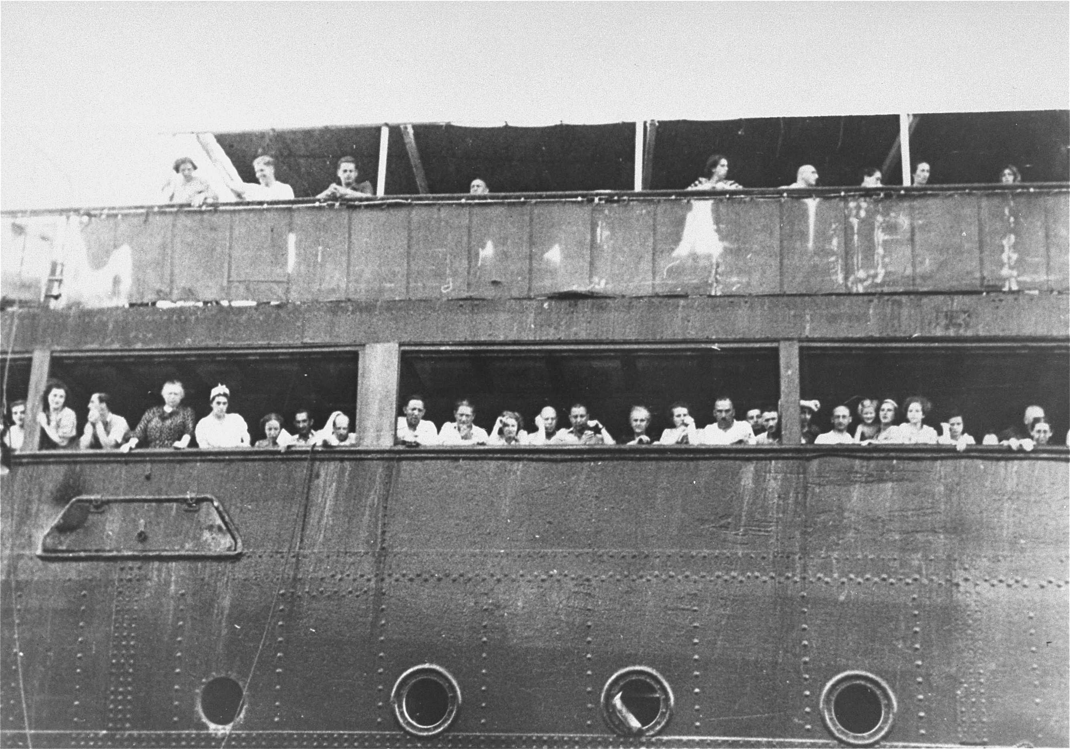
In the face of a European refugee crisis caused by increasing anti-Jewish violence, the United States experienced a public challenge to its immigration policies. Over 900 Jewish passengers left Germany aboard the MS St. Louis in May 1939 seeking refuge in Cuba.
AMERICAN RESPONSES
Jewish refugees aboard the MS St. Louis attempt to communicate with friends and relatives in Cuba, who were permitted to approach the docked vessel in small boats.
The Plight of Refugees
Notes:
National Archives and Records Administration, College Park, Maryland

Slide 8
Arriving in Havana harbor, passengers were refused entry because the Cuban government had invalidated their travel papers. Fearing a return to Germany, yet with no place to go, the passengers and the ship waited near the US coast as alternate havens were sought.
AMERICAN RESPONSES
Jewish refugees aboard the MS St. Louis attempt to communicate with friends and relatives in Cuba, who were permitted to approach the docked vessel in small boats.
The Plight of Refugees
Notes:
National Archives and Records Administration, College Park, Maryland

Slide 9
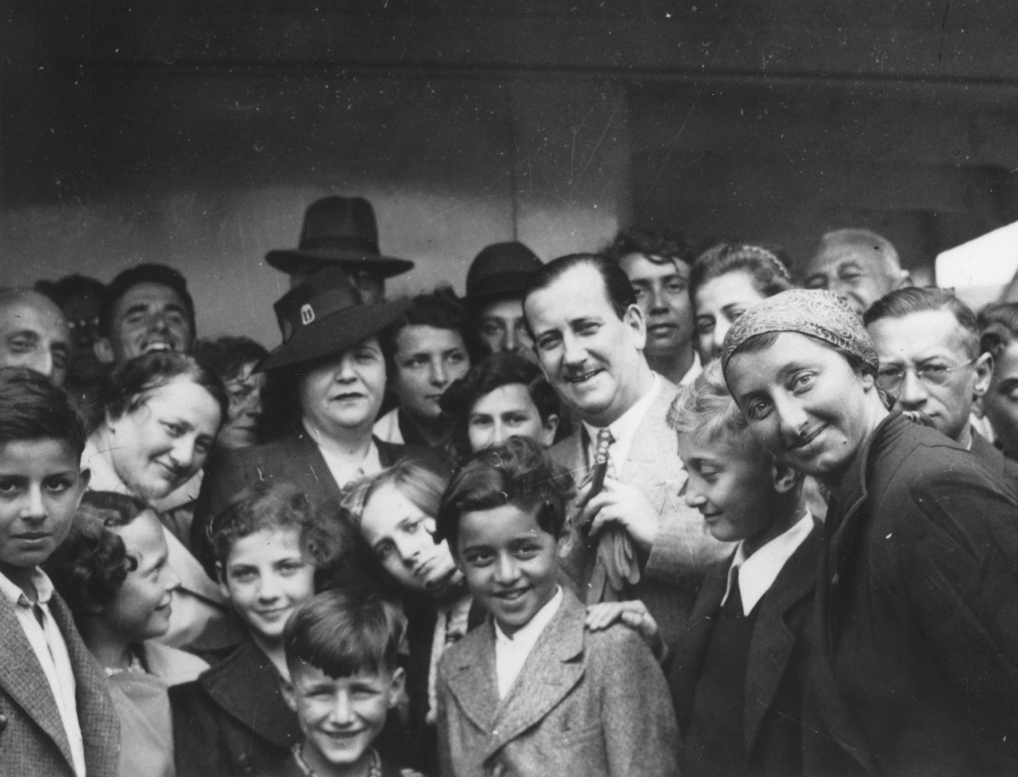
Despite US newspapers’ generally sympathetic portrayal of the passengers’ situation, only a few journalists suggested that the refugees be admitted into the United States. The US government refused to admit the passengers until their quota numbers were called.
AMERICAN RESPONSES
Mr. and Mrs. Morris Troper (center) pose with Jewish refugees on the deck of the St. Louis.
US Response to the St. Louis
Notes:
US Holocaust Memorial Museum, courtesy of Betty Troper Yaeger

Slide 10
Wanting to aid the passengers, the American Jewish Joint Distribution Committee (JDC) took action. Morris Troper, an American lawyer working for the JDC, played an essential role in negotiating with the governments of Belgium, the Netherlands, France, and the United Kingdom, which ultimately provided refuge to the passengers.
AMERICAN RESPONSES
Mr. and Mrs. Morris Troper (center) pose with Jewish refugees on the deck of the St. Louis.
US Response to the St. Louis
Notes:
US Holocaust Memorial Museum, courtesy of Betty Troper Yaeger

Slide 11
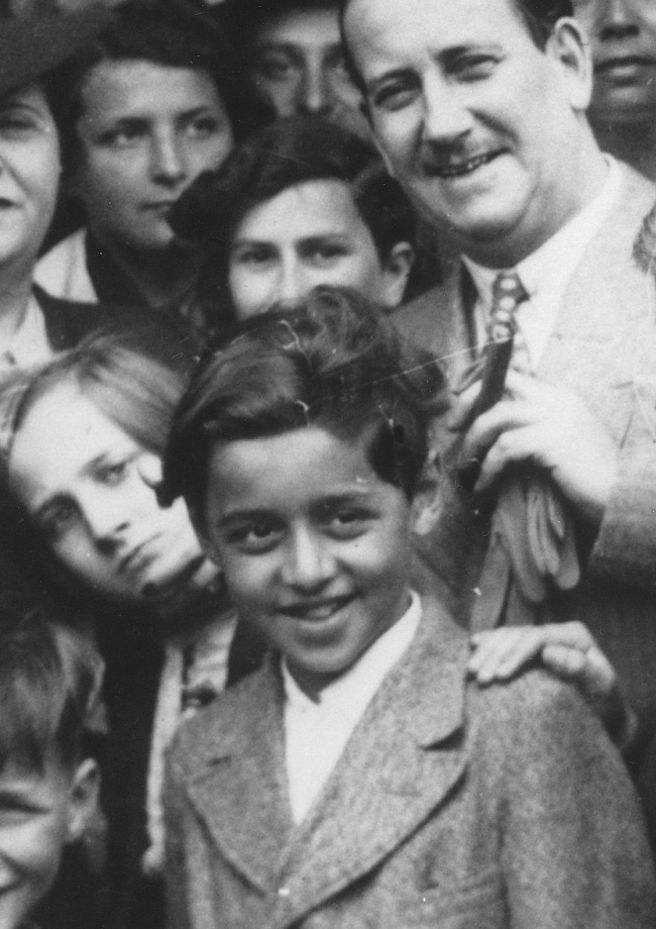
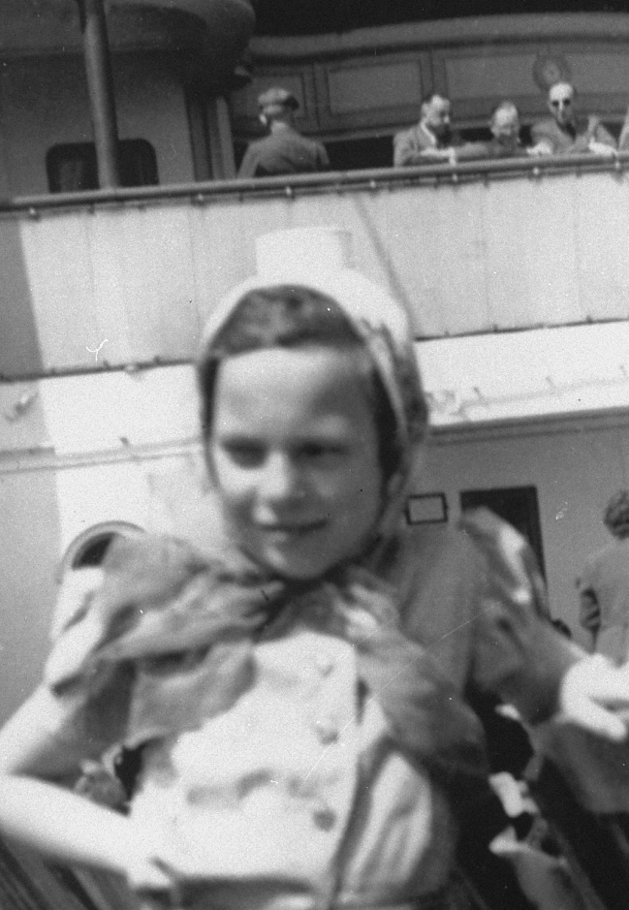
In 1939, securing safe haven for the St. Louis passengers in Europe was deemed a diplomatic success. Subsequent wartime Nazi occupation of western Europe, however, meant that many former passengers once again faced Nazi persecution.
AMERICAN RESPONSES
Henry Goldstein (Gallant) and Ruth Karliner on the deck of the St. Louis.
Safe Haven?
Notes:
Left photo: US Holocaust Memorial Museum, courtesy of Betty Troper Yaeger. Right photo: US Holocaust Memorial Museum, courtesy of Herbert and Vera Karliner

Slide 12
Some passengers such as Henry Gallant (above left) managed to survive. Other passengers, such as Ruth Karliner (above right), died in German killing centers or concentration camps. In the end, almost one-third of the St. Louis passengers died in the Holocaust.
AMERICAN RESPONSES
Henry Goldstein (Gallant) and Ruth Karliner on the deck of the St. Louis.
Safe Haven?
Notes:
Left photo: US Holocaust Memorial Museum, courtesy of Betty Troper Yaeger. Right photo: US Holocaust Memorial Museum, courtesy of Herbert and Vera Karliner

Slide 13
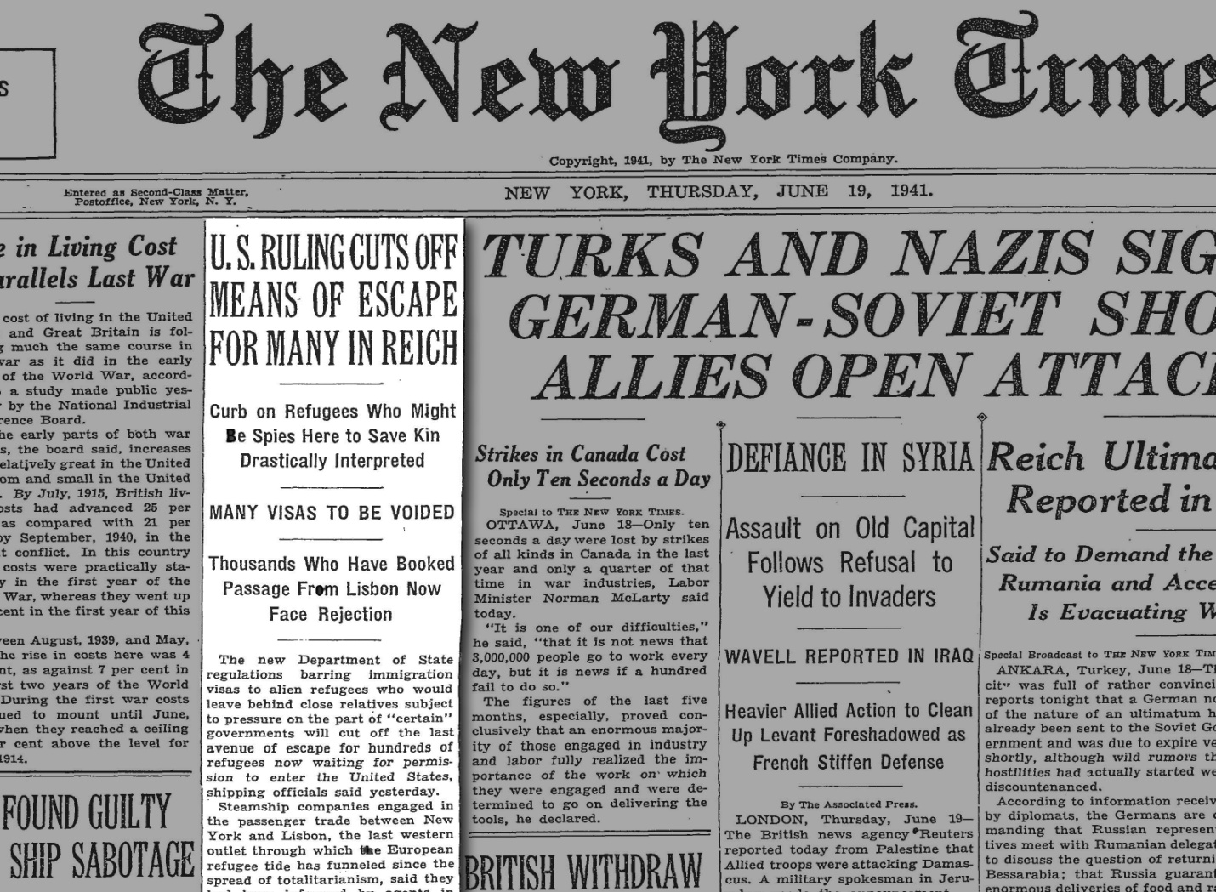
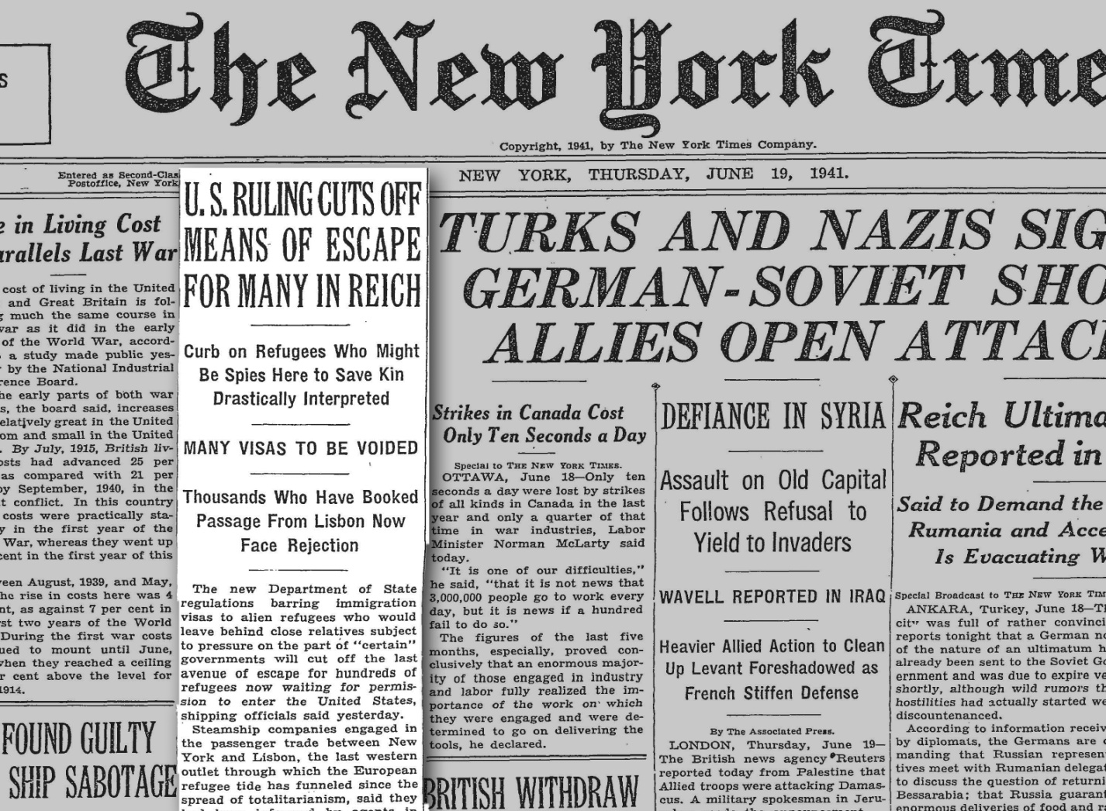
The start of World War II in September 1939 added a new challenge for those seeking refuge. In wartime, US policies became more restrictive. In June 1941, the State Department issued a regulation forbidding the granting of a visa to anyone with relatives in Axis-occupied territories.
AMERICAN RESPONSES
US Policy in the 1940s
Notes:
New York Times, June 19, 1941. Page 1.

Slide 14
Once the United States entered the war, the State Department implemented stricter immigration policies out of fear that refugees could be blackmailed into working as enemy agents.
AMERICAN RESPONSES
US Policy in the 1940s
Notes:
New York Times, June 19, 1941. Page 1.

Slide 15
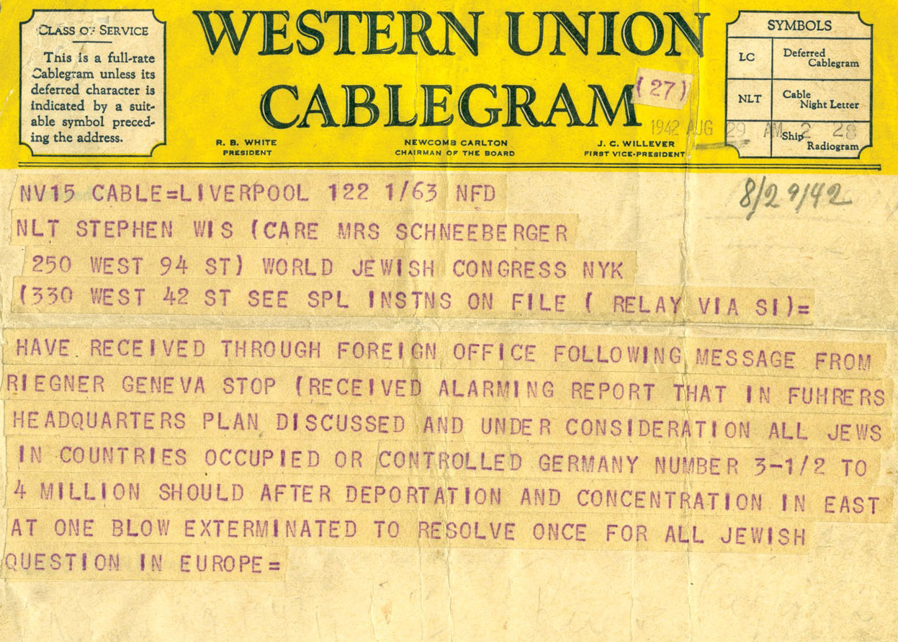
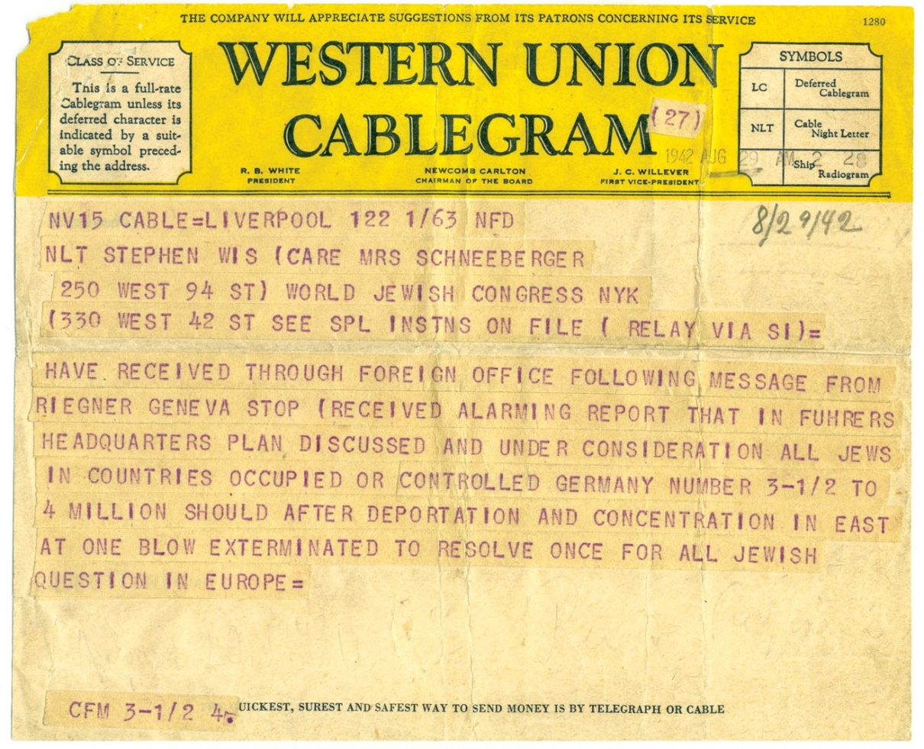
In August 1942, the State Department received a copy of a cable sent by the World Jewish Congress’s Gerhart Riegner stating that the Nazis were implementing a policy to annihilate the Jews of Europe. Afraid the cable was “war rumor,” department officials withheld its release.
AMERICAN RESPONSES
First page of a two-paged cable from Gerhart Riegner to Rabbi Stephen Wise reporting on the existence of a Nazi plan to exterminate European Jewry.
News of Nazi Annihilation Policy
Notes:
Courtesy of The Jacob Rader Marcus Center of the American Jewish Archives, Cincinnati, Ohio. americanjewisharchives.org

Slide 16
Only in November 1942 did the State Department finally confirm its accuracy and allow the Nazi policy of mass murder to be publicized. Most Americans accepted the official US policy that only the defeat of Germany could stop the murder of Europe’s Jews.
AMERICAN RESPONSES
First page of a two-paged cable from Gerhart Riegner to Rabbi Stephen Wise reporting on the existence of a Nazi plan to exterminate European Jewry.
News of Nazi Annihilation Policy
Notes:
Courtesy of The Jacob Rader Marcus Center of the American Jewish Archives, Cincinnati, Ohio. americanjewisharchives.org

Slide 17
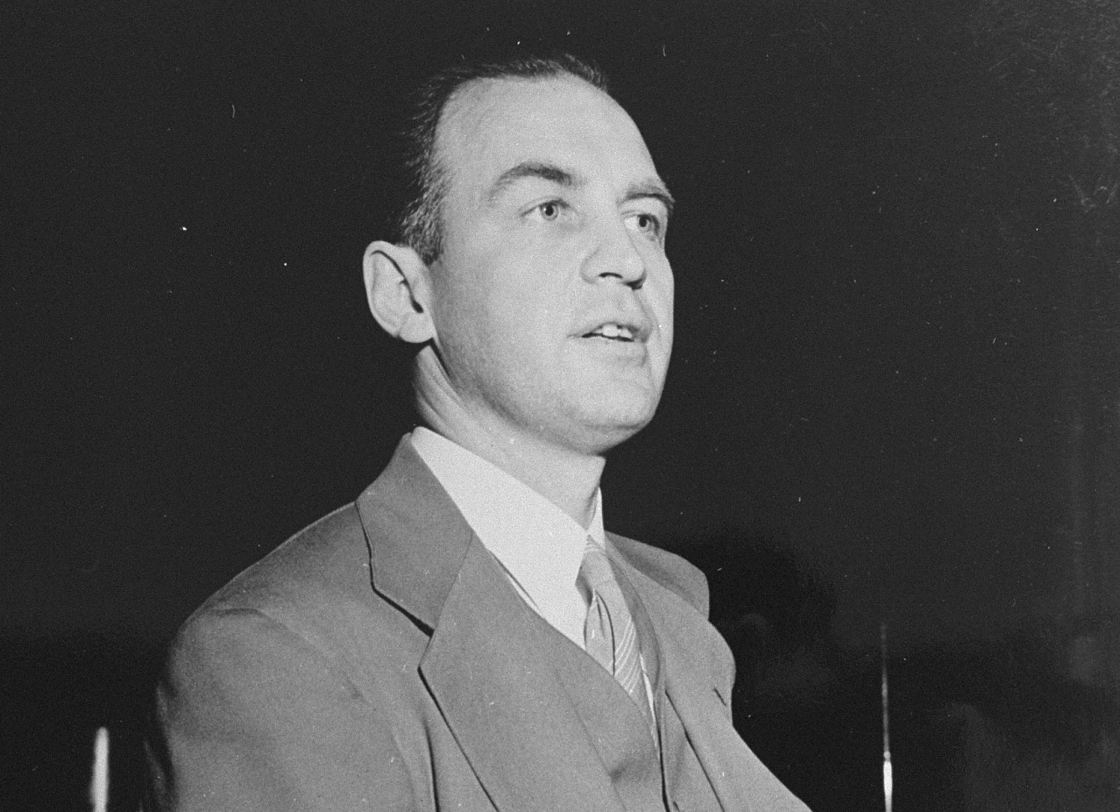
In 1943, US Treasury Department officials John Pehle and Josiah DuBois had become frustrated with what they saw as limited action by the State Department to rescue Jews. In a report presented to Treasury Secretary Henry Morgenthau, they asserted that unless steps were taken, “this government will have to share for all time the responsibility for this extermination.”
AMERICAN RESPONSES
John Pehle, executive director of the War Refugee Board.
Momentum for Action
Notes:
US Holocaust Memorial Museum

Slide 18
This effort by the Treasury staff along with public pressure helped prompt President Franklin D. Roosevelt to create the War Refugee Board in January 1944 and appoint Pehle to run it.
AMERICAN RESPONSES
John Pehle, executive director of the War Refugee Board.
Momentum for Action
Notes:
US Holocaust Memorial Museum

Slide 19
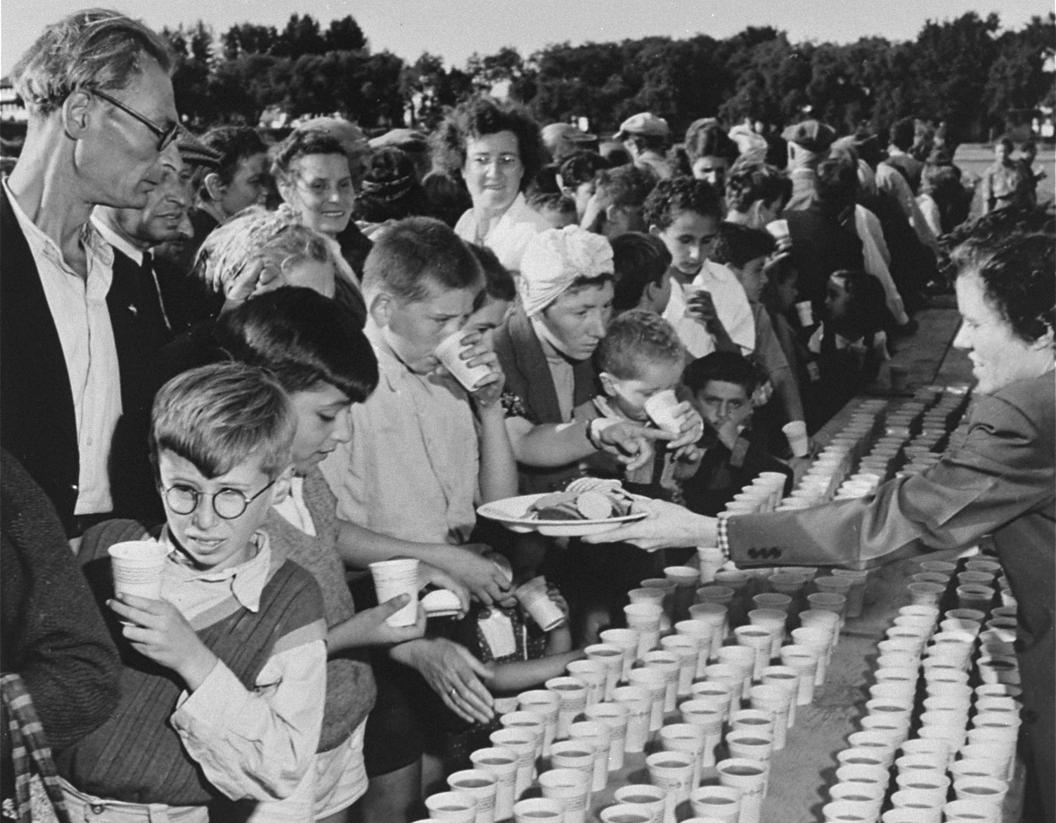
As executive director of the War Refugee Board, John Pehle used his position of leadership to leverage numerous means to rescue endangered Jews.
AMERICAN RESPONSES
Newly arrived refugees receive food and drink at a picnic at Fort Ontario in Oswego, New York.
War Refugee Board Created
Notes:
National Archives and Records Administration, College Park, Maryland

Slide 20
The board led efforts to get neutral countries to accept refugees; it funded boats to ferry refugees out of Romania; and it established a temporary refuge for some Jews at Fort Ontario in Oswego, New York. The board also financed Swedish diplomat Raoul Wallenberg’s rescue efforts in Hungary.
AMERICAN RESPONSES
Newly arrived refugees receive food and drink at a picnic at Fort Ontario in Oswego, New York.
War Refugee Board Created
Notes:
National Archives and Records Administration, College Park, Maryland

Slide 21
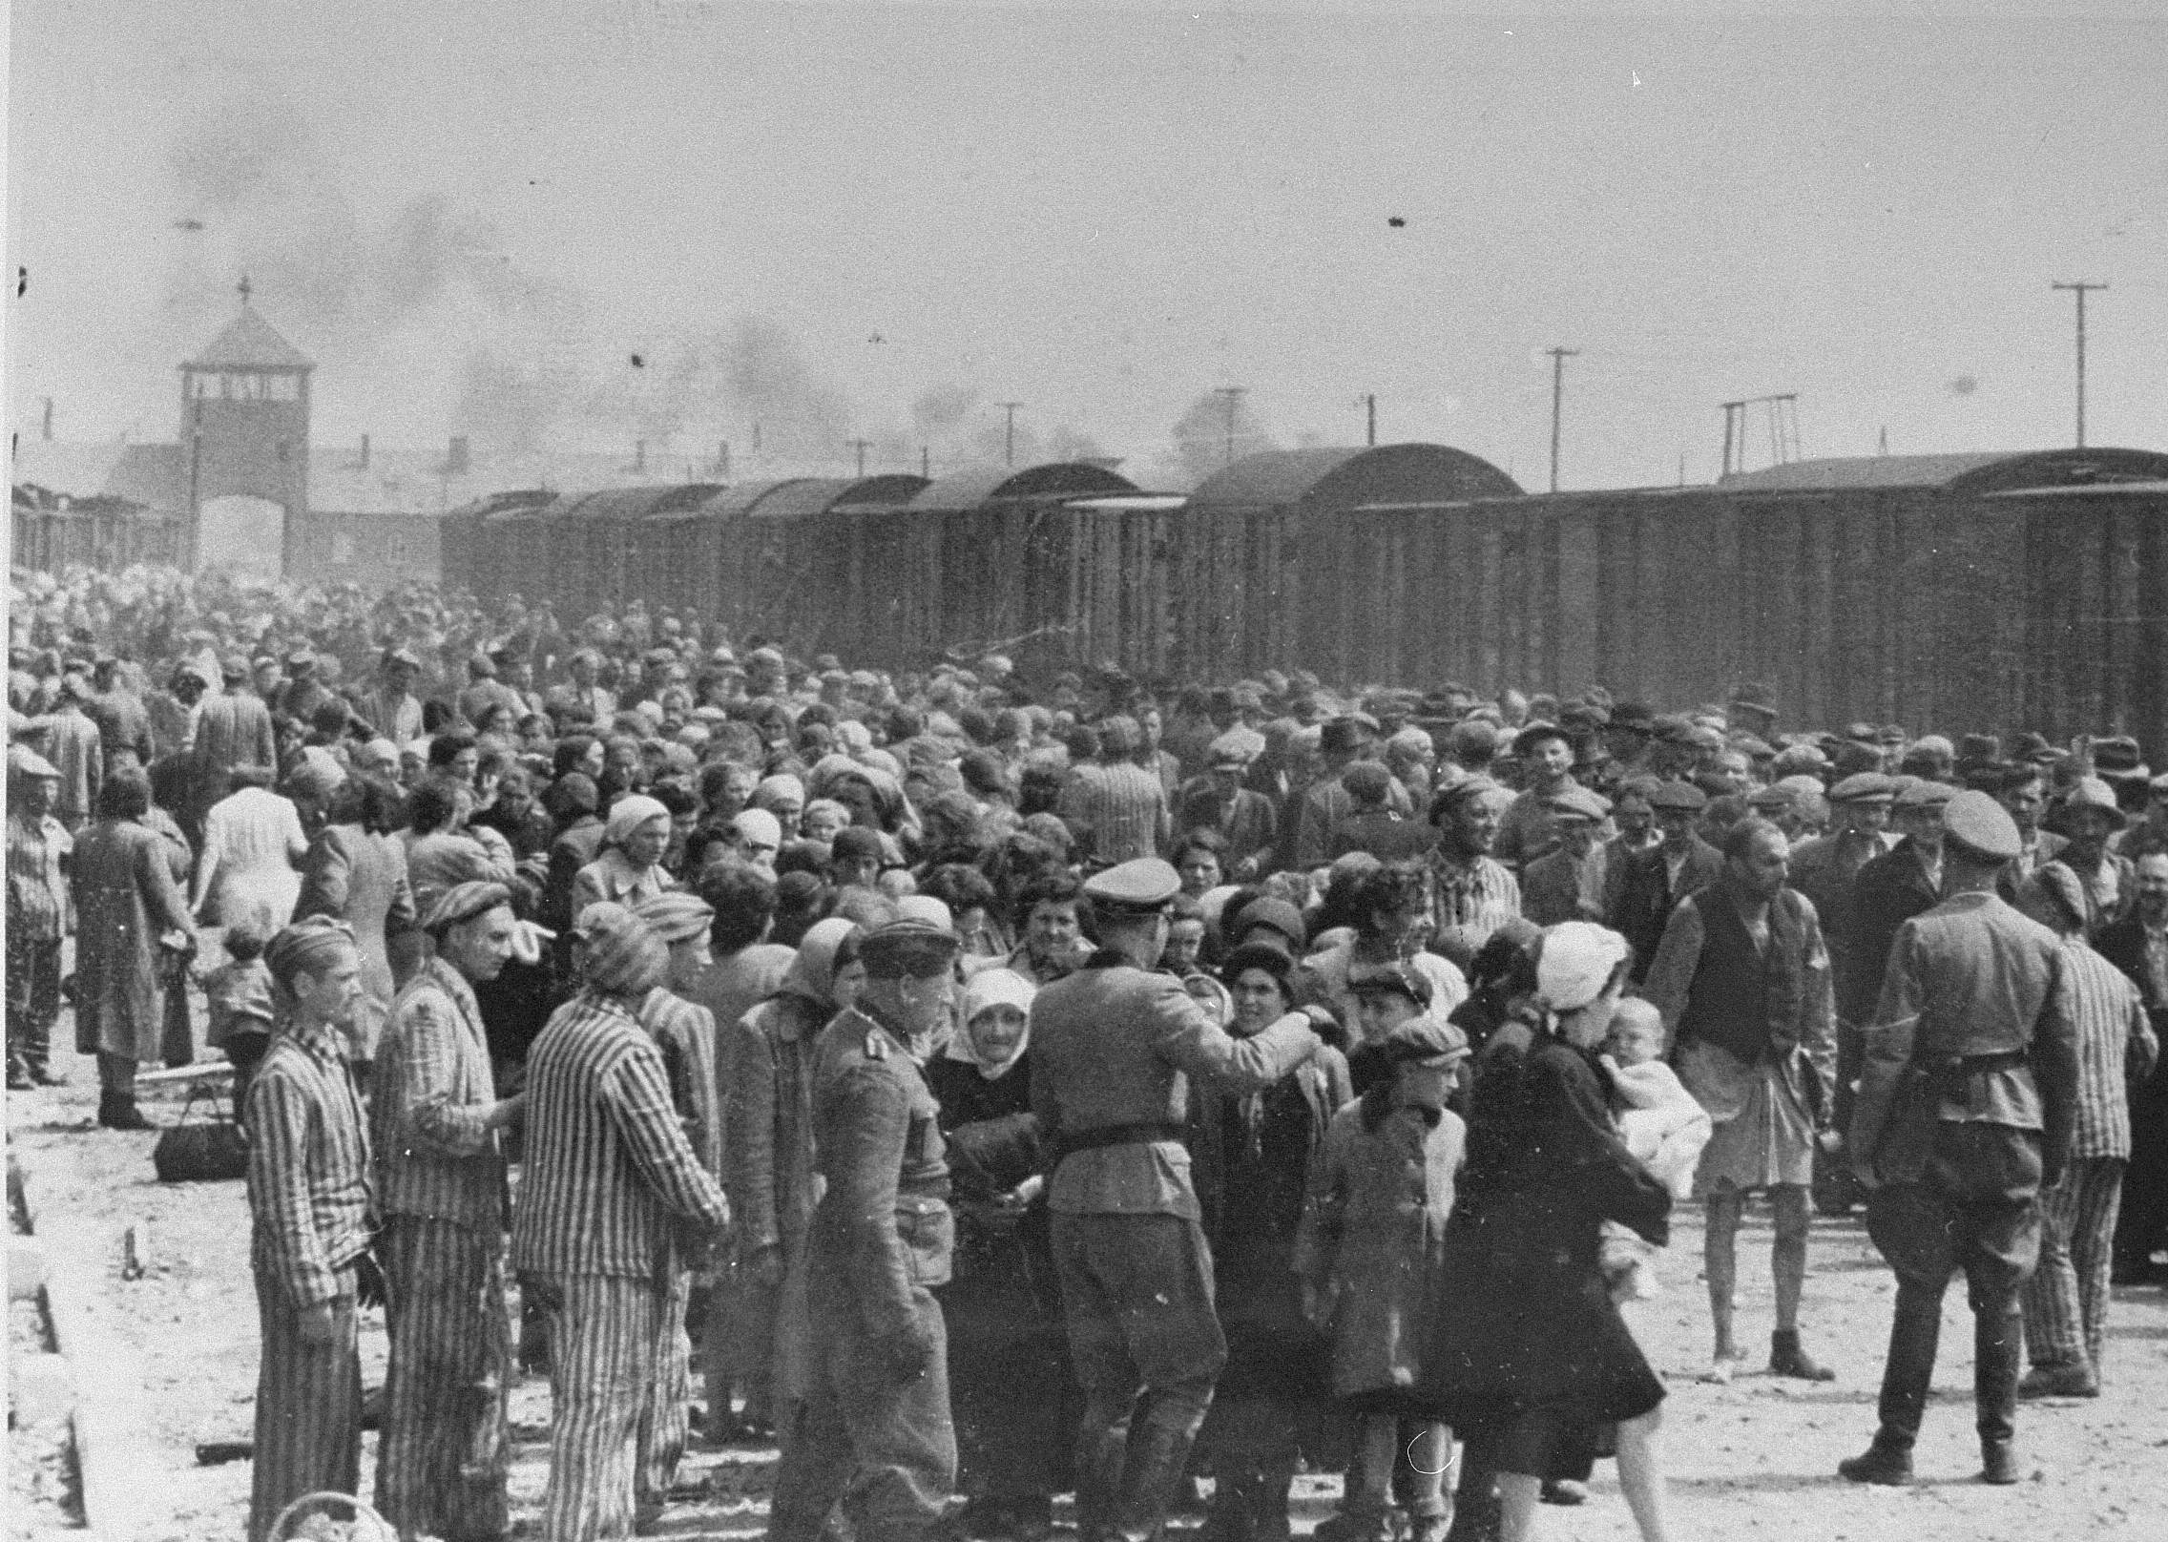
In March 1944 Germany occupied Hungary. At German request, the Hungarian authorities deported around 440,000 Jews, primarily to Auschwitz-Birkenau. Although the War Refugee Board is credited with saving as many as 200,000 lives, more than 800,000 Jews were murdered from the time the board was established until the end of the war.
AMERICAN RESPONSES
Jews from Subcarpathian Rus, then part of Hungary, undergo a selection on the ramp at
Auschwitz-Birkenau. Late May 1944.
“Late and Little”
Notes:
Yad Vashem Photo Archives

Slide 22
The majority of these Jews were from Hungary. As John Pehle, the board’s executive director, later said, “What we did was...late and little.”
AMERICAN RESPONSES
Jews from Subcarpathian Rus, then part of Hungary, undergo a selection on the ramp at
Auschwitz-Birkenau. Late May 1944.
“Late and Little”
Notes:
Yad Vashem Photo Archives

Slide 23
Fifty years after the deportation of Hungary’s Jews, genocide in Rwanda challenged the world’s ability to respond. Despite warnings of violence made by Canadian General Roméo Dallaire, the head of the UN Assistance Mission for Rwanda, the world failed to act and some 800,000 people were murdered within 100 days.
AMERICAN RESPONSES
A site in Kigali, Rwanda, where several thousand people were executed. This is one of the few locations
where some victims had the honor of individual burial.
The Legacy of Genocide
Notes:
US Holocaust Memorial Museum

Slide 24
President Bill Clinton later reflected: “If we’d gone in sooner, I believe we could have saved at least a third of the lives that were lost....It had an enduring impact on me.”
AMERICAN RESPONSES
A site in Kigali, Rwanda, where several thousand people were executed. This is one of the few locations
where some victims had the honor of individual burial.
The Legacy of Genocide
Notes:
US Holocaust Memorial Museum

Slide 25
What are the warning signs we should look for to help prevent future genocides?
AMERICAN RESPONSES

Slide 26
AMERICAN RESPONSES
What are the warning signs we should look for to help prevent future genocides?
What is our responsibility as a nation or as individuals when confronted with such crimes?

Slide 27
AMERICAN RESPONSES
What are the warning signs we should look for to help prevent future genocides?
What is our responsibility as a nation or as individuals when confronted with such crimes?
As long as genocide remains a threat, we must continue to ask ourselves about the consequences of action—and of inaction. That is how we strive to fulfill the promise of Never Again.

