Slide 2
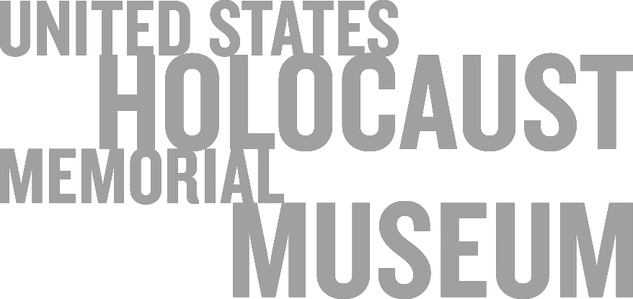

Slide 4
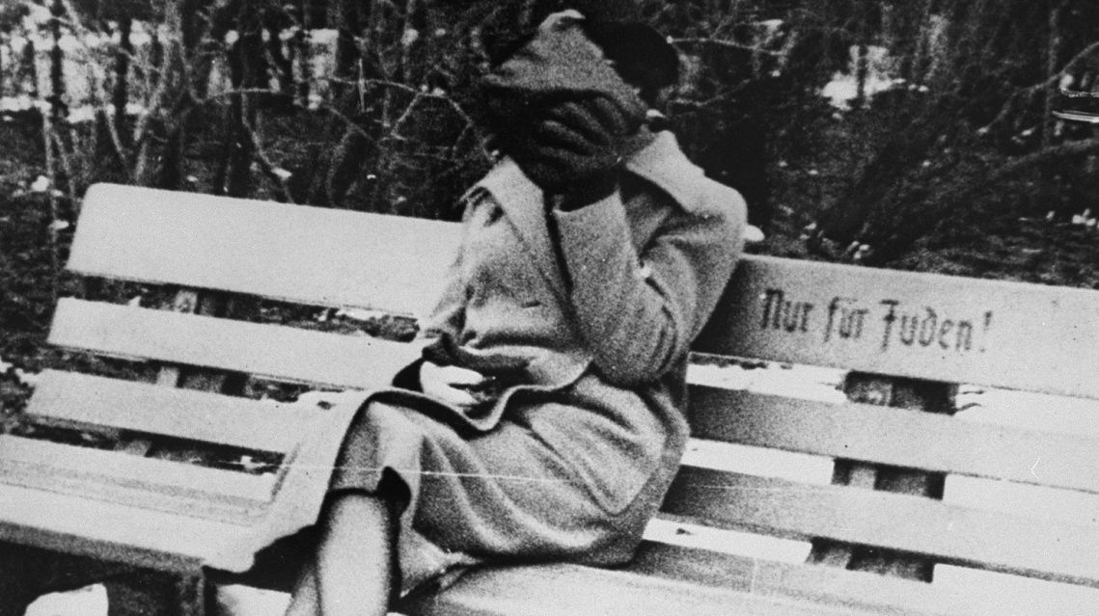
EARLY WARNING SIGNS
In the pivotal year before Nazi Germany invaded Poland and launched World War II, intervention could have saved many lives. Why did so many fail to respond to the warning signs and what lessons do their actions hold for us today?
Notes:
Austria, ca. 1938: A woman sits on a park bench marked “For Jews Only,” after German authorities implemented anti-Jewish laws. US Holocaust Memorial Museum, courtesy of The Wiener Library

Slide 5
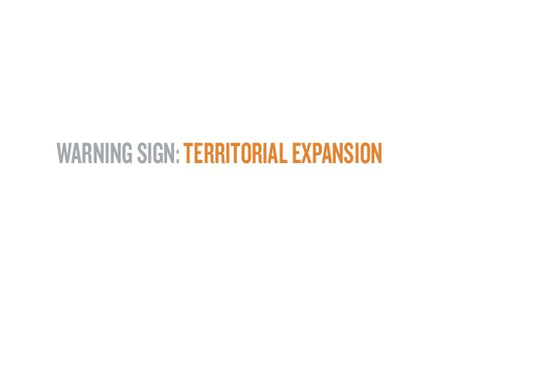
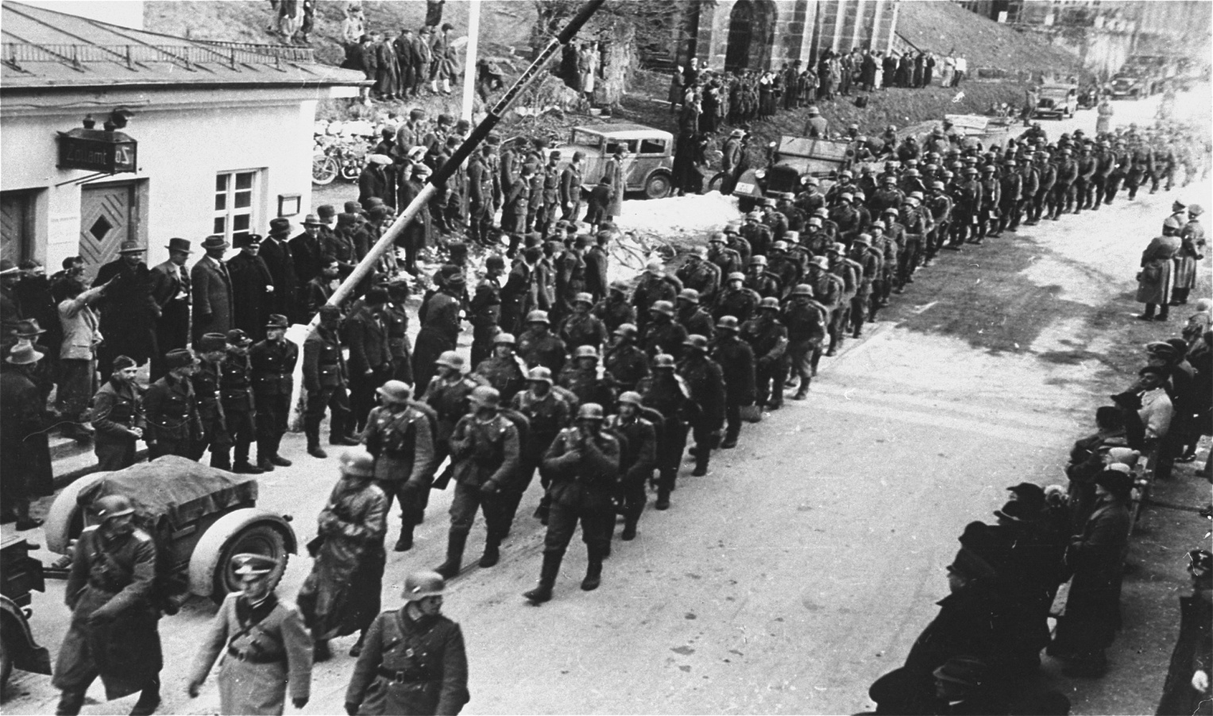
German troops enter Austria, which is incorporated into the German Reich. This is known as the Anschluss. German authorities quickly implement anti-Jewish legislation that encourages an atmosphere of hostility toward the Jewish population.
German troops cross the border from Germany into Austria at the Kiefersfelden crossing.
Anschluss March 11-13, 1938
Notes:
Dokumentationsarchiv des Österreichischen Widerstandes

Slide 6
Anschluss March 11-13, 1938
The Anschluss accelerated persecution and violence against Jews in the Reich. As a result, Hilde Kraemer’s parents, living in Germany, encouraged her to emigrate from France, where she was in boarding school. With relatives in New York as sponsors, Hilde immigrated to the United States in the summer of 1938. In 1942, her mother and stepfather were deported to Auschwitz, where they perished. Hilde’s half-brother Alfred obtained passage to the United States in 1941 with the aid of a Swedish nurse and Jewish and Quaker aid organizations. Hilde and Alfred reunited in the United States.
Hilde Kraemer (far left) and her friends, Germaine and Dee Dee, at school in France. ca. 1938.
Notes:
Courtesy of Jeanine Surwit

Slide 7
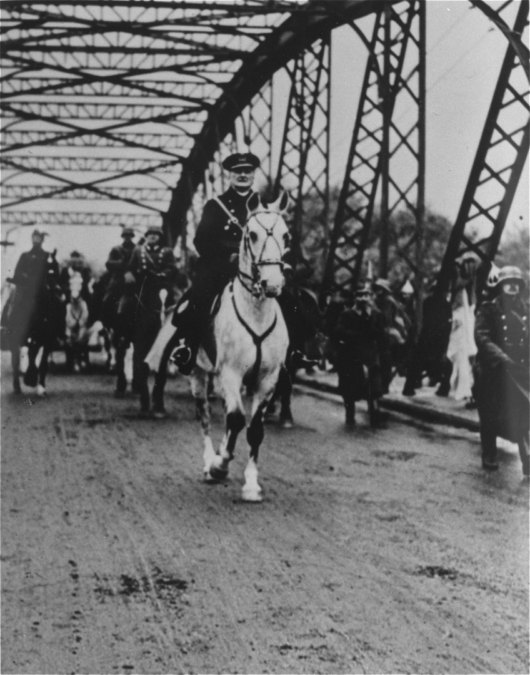
Following Germany’s example, Hungary adopts comprehensive anti-Jewish laws and measures, excluding Jews from many professions.
Hungarian Anti-Jewish Laws May, 1938
Regent Admiral Miklós Horthy, who ruled Hungary from 1920 to 1944.
Notes:
US Holocaust Memorial Museum, courtesy of Yad Vashem Photo Archives

Slide 8
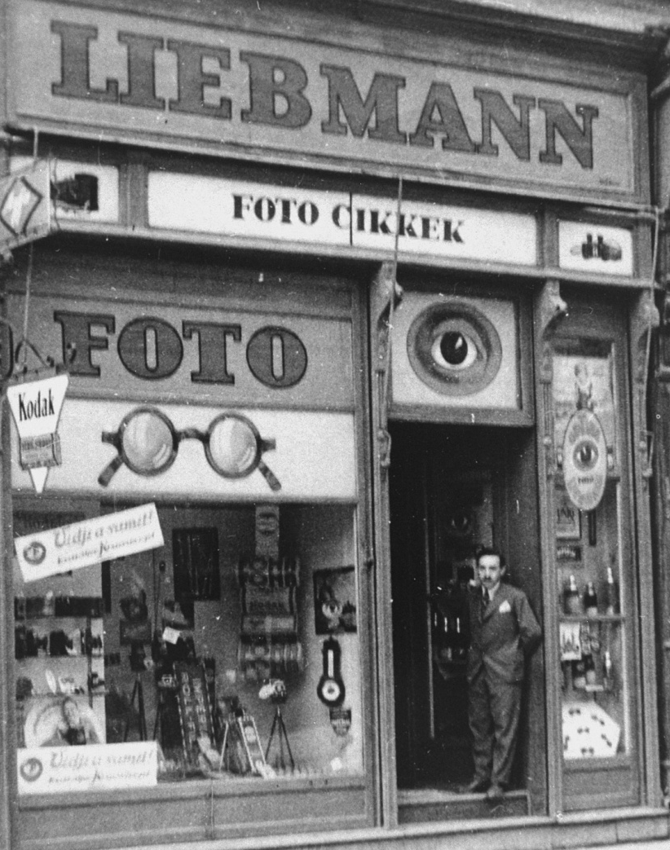
Bela Liebmann, a native of Hungary, served in the Austro-Hungarian army during World War I and was decorated for saving 120 German soldiers. After the war, he became a photographer and owner of a photographic equipment store in Szeged. Liebmann was one of hundreds of thousands of Jews whose lives were adversely affected by anti-Jewish laws that restricted their access to social and economic opportunities. Conscripted for forced labor, Bela survived the war. His wife and daughter were killed in April 1945 by retreating SS soldiers.
Hungarian Anti-Jewish Laws May, 1938
View of the Liebmann optical and photographic supply store in Szeged, Hungary.
Notes:
US Holocaust Memorial Museum, courtesy of Bela Liebmann

Slide 9
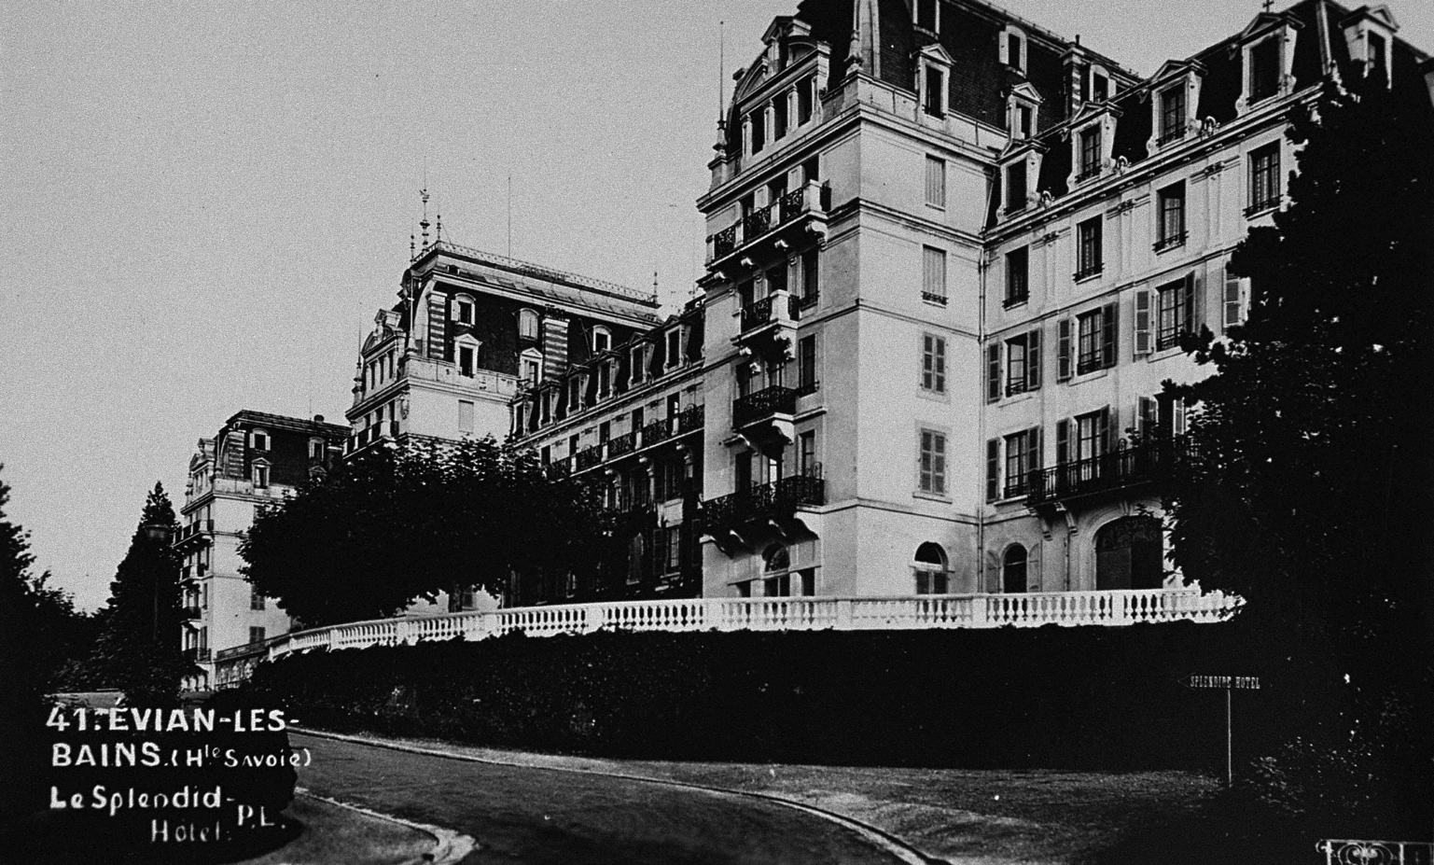
Period postcard of Evian-les-Bains, France.
Intensified persecution in Germany led more Jews to try to emigrate, which required a nation to allow them to enter. In response to increased refugee demand, US President Franklin D. Roosevelt convened a conference in Evian, France. There, representatives from 32 nations discussed their immigration policies.
Evian Conference July 6-15, 1938
Notes:
US Holocaust Memorial Museum, courtesy of Martin Smith

Slide 10
Delegate after delegate expressed sympathy for the refugees, but most countries, including the United States, refused to alter their immigration policies to admit more of them. Only the Dominican Republic agreed to accept a large number of additional refugees.
Period postcard of Evian-les-Bains, France.
Evian Conference July 6-15, 1938
Notes:
US Holocaust Memorial Museum, courtesy of Martin Smith

Slide 11
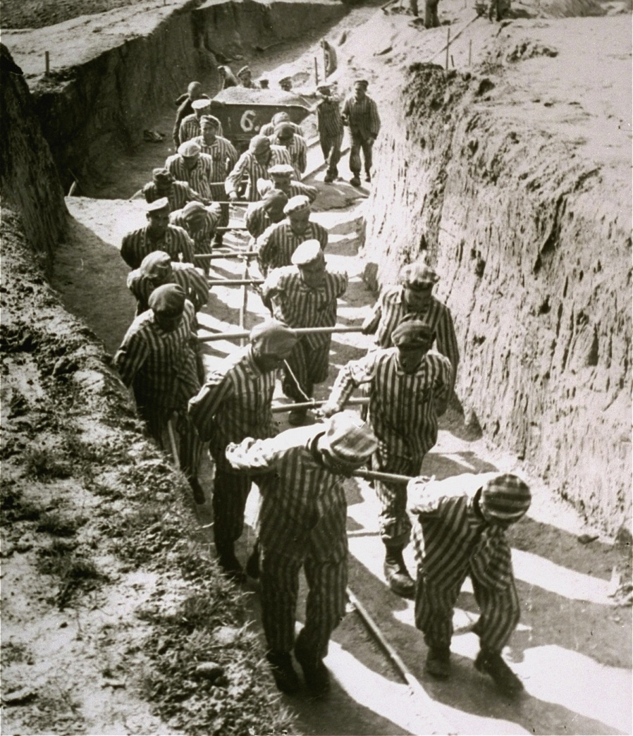
Mauthausen Opens August 8, 1938
SS authorities open the Mauthausen concentration camp in Austria, expanding the concentration camp system started in Germany in 1933 and taken over by the SS in 1934 to detain real and perceived enemies of Nazi rule.
Prisoners in the quarry at Mauthausen concentration camp in Austria.
Notes:
National Archives and Records Administration

Slide 12
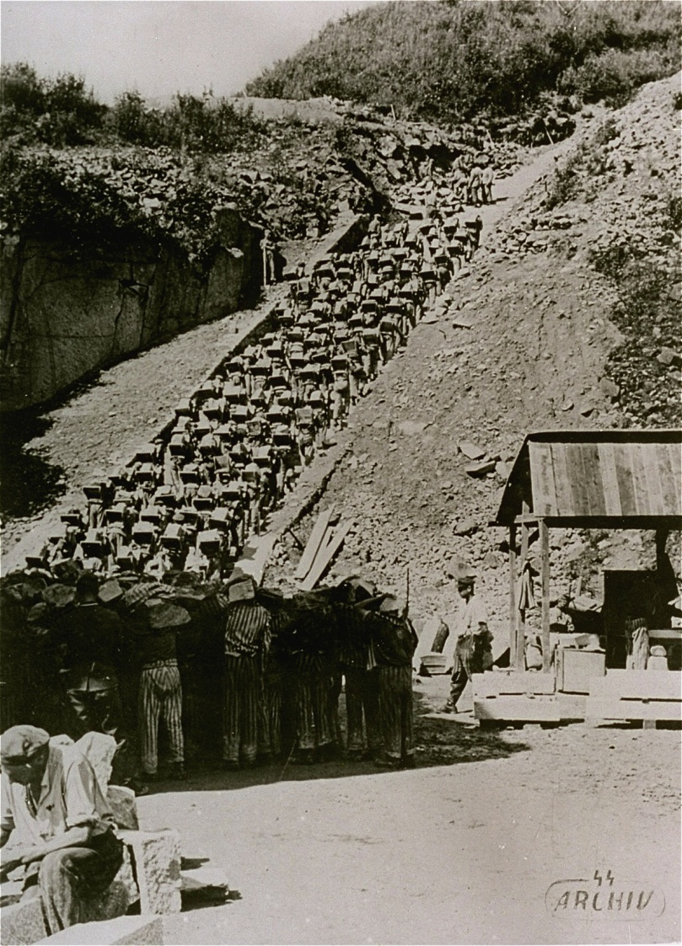
By the end of 1938, Mauthausen held nearly 1,000 prisoners, mostly convicted criminals and so-called asocials. By December 1939, the number of prisoners had increased to more than 2,600, including political opponents, homosexuals, and Jehovah’s Witnesses. Prisoners were detained for indefinite periods without being subject to judicial or administrative oversight. An estimated 197,464 prisoners passed through the Mauthausen camp system between August 1938 and May 1945. At least 95,000 prisoners died there. More than 14,000 of those who died were Jewish.
Mauthausen Opens August 8, 1938
Mauthausen, 1942.
Notes:
US Holocaust Memorial Museum, courtesy of Archiv der KZ-Gedenkstätte Mauthausen

Slide 13
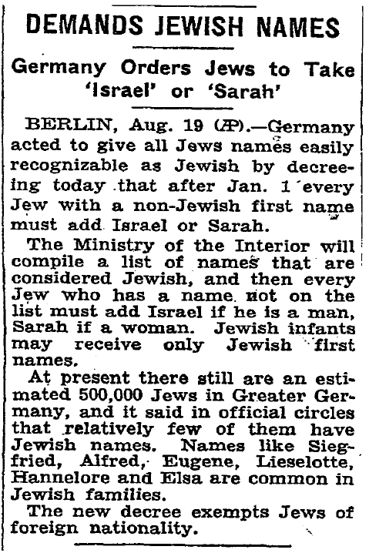
Decree Requiring Jews to Bear “Jewish” Names August 17, 1938
German and Austrian Jews without recognizably “Jewish” names are required to adopt the middle names “Sarah” or “Israel.”
The New York Times, August 20, 1938, page 5
Notes:
The New York Times

Slide 14
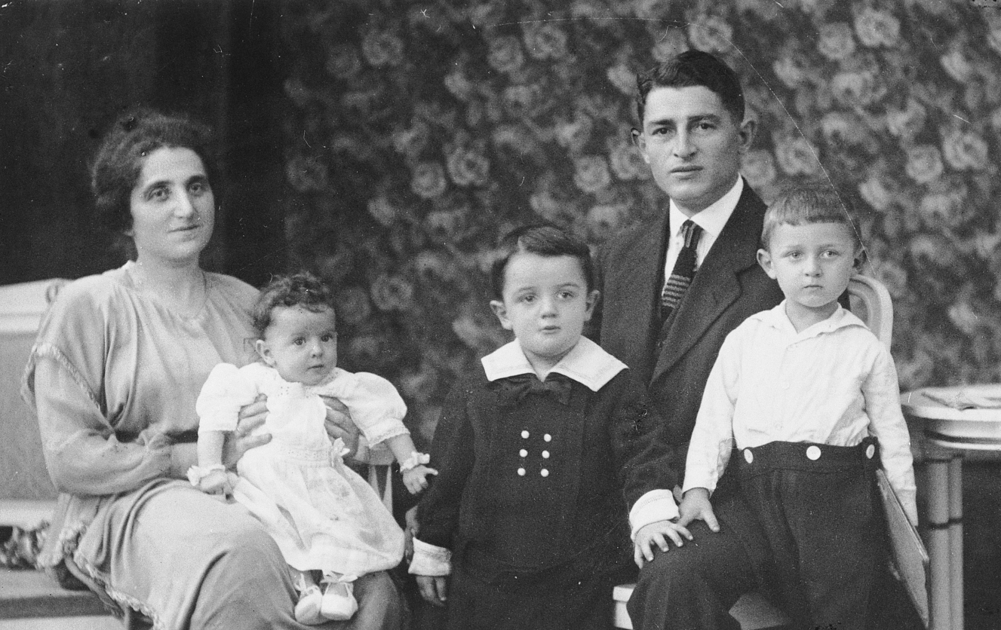
On Kristallnacht, Josef Zwienicki fled from his home believing that his presence posed a threat to his family. When SA men failed to find him, they shot and killed his wife, Selma, and arrested his son, Benno. Following Benno’s release, surviving family members departed for Canada in May 1939.
Studio portrait of the Zwienicki family taken in 1921. From left to right, Selma Zwienicki holding her daughter Liesel, Benno, Joseph Zwienicki, and Gerd.
Decree Requiring Jews to Bear “Jewish” Names August 17, 1938
Notes:
US Holocaust Memorial Museum, courtesy of Jacob G. Wiener.

Slide 15
An updated marriage certificate for the Zwienickis issued in March 1939 included the required middle names “Israel” and “Sarah” and stated that Selma was “found dead” on November 10, 1938.
Studio portrait of the Zwienicki family taken in 1921. From left to right, Selma Zwienicki holding her daughter Liesel, Benno, Joseph Zwienicki, and Gerd.
Decree Requiring Jews to Bear “Jewish” Names August 17, 1938
Notes:
US Holocaust Memorial Museum, courtesy of Jacob G. Wiener.

Slide 16
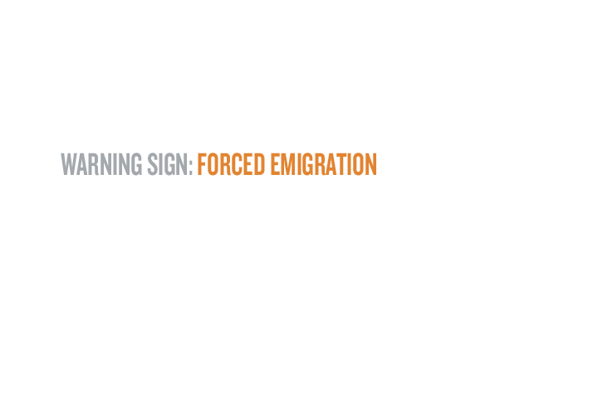
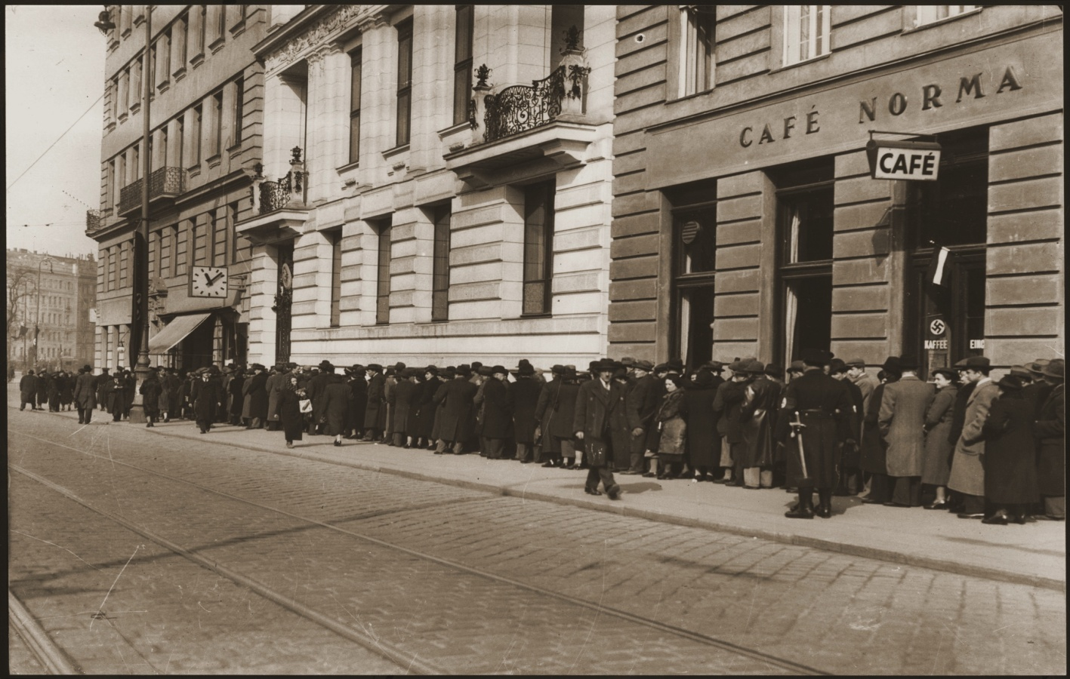
Viennese Jews wait in front of the Polish consulate to obtain entrance visas to Poland in April 1938.
Central Office for Jewish Emigration Opens August 20, 1938
SS officials establish the Central Office for Jewish Emigration in Vienna to streamline Jewish emigration from Austria. Prospective emigrants are required to pay an exit fee and give up virtually all of their property when they leave the country.
Notes:
US Holocaust Memorial Museum, courtesy of Österreichische Gesellschaft für Zeitgeschichte

Slide 17
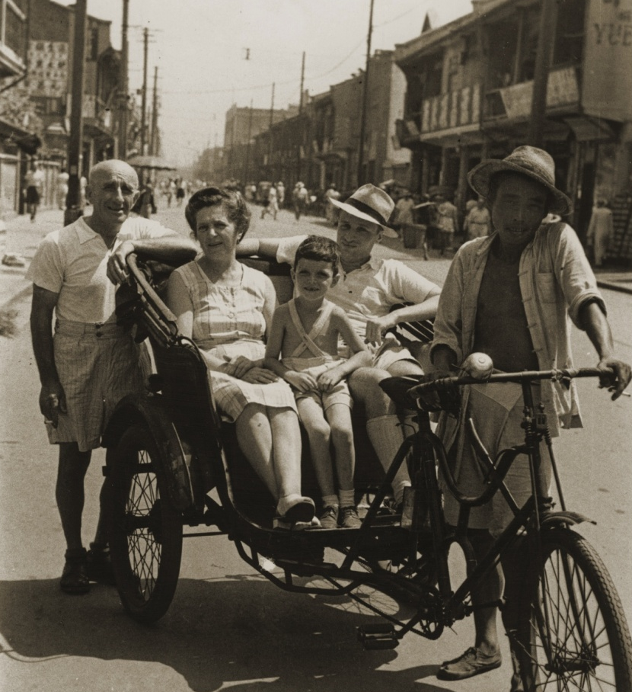
After being forced by Austrian police and SA members to scrub streets in Vienna with other Jews, Viennese-born Erich Goldstaub vowed to secure visas so his family could emigrate. Following the procedures of the Central Office for Jewish Emigration, Goldstaub eventually secured travel papers from the Chinese embassy for himself and 20 family members. On Kristallnacht, German police detained Goldstaub’s father and his store was looted. SA members detained Goldstaub, releasing him only after he produced his travel papers and ship tickets. Goldstaub and his family left Austria and arrived in Shanghai, where they survived the Holocaust.
Central Office for Jewish Emigration Opens August 20, 1938
The Goldstaub family in front of their home on Tongshan Road. Pictured from left to right are Adolf, Camilla, and Erich Goldstaub. Erich’s cousin Harry Fiedler sits between them in the pedicab. Shanghai, [Kiangsu] China, ca. 1945.
Notes:
US Holocaust Memorial Museum, courtesy of Eric Goldstaub

Slide 18
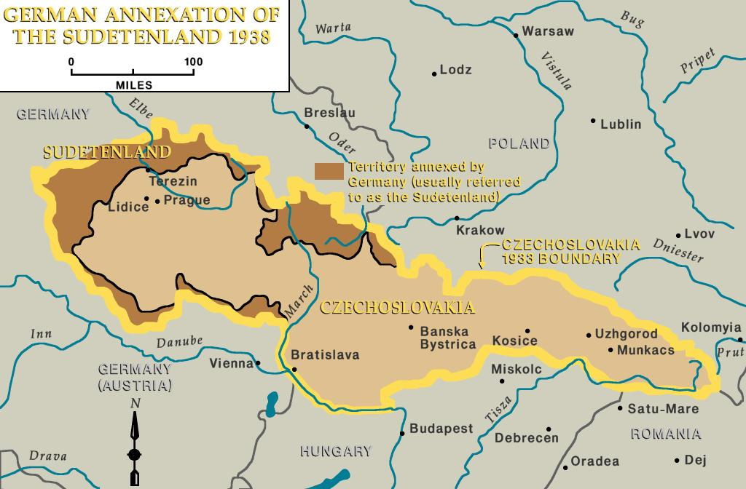
German annexation of the Sudetenland, 1938.
Munich Agreement September 29-30, 1938
In 1938, Germany acquired new territories using the threat of war. Following the Anschluss, Germany sought to annex the Sudetenland, a region of Czechoslovakia settled largely by ethnic Germans.
Notes:
US Holocaust Memorial Museum

Slide 19
On September 29, 1938, British Prime Minister Neville Chamberlain, French Premier Edouard Daladier, Italian Prime Minister Benito Mussolini, and Germany’s Adolf Hitler signed the Munich Agreement, which ceded the Sudetenland to Germany. Czechoslovakia was not permitted to attend the conference.
German annexation of the Sudetenland, 1938.
Munich Agreement September 29-30, 1938
Notes:
US Holocaust Memorial Museum

Slide 20
In March 1939, six months after signing the Munich agreement, Germany violated it, occupying the Czech lands of Bohemia and Moravia.
German annexation of the Sudetenland, 1938.
Munich Agreement September 29-30, 1938
Notes:
US Holocaust Memorial Museum

Slide 21
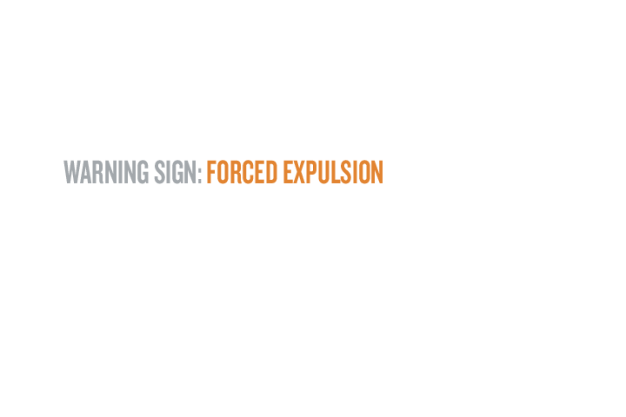
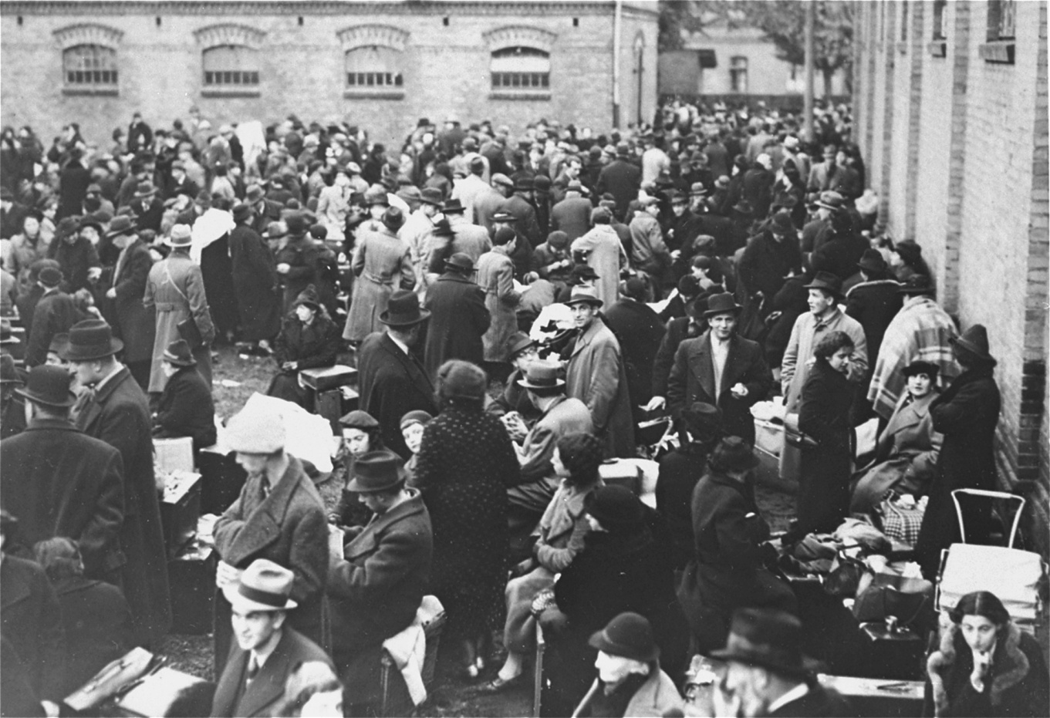
Jewish refugees in Zbaszyń after expulsion from their homes in Germany.
Deportation of Polish Jews October 26-28, 1938
Germany expels about 18,000 Jews of Polish origin who reside in the territory of the Reich.
Notes:
US Holocaust Memorial Museum, courtesy of Instytut Pamięci Narodowej

Slide 22
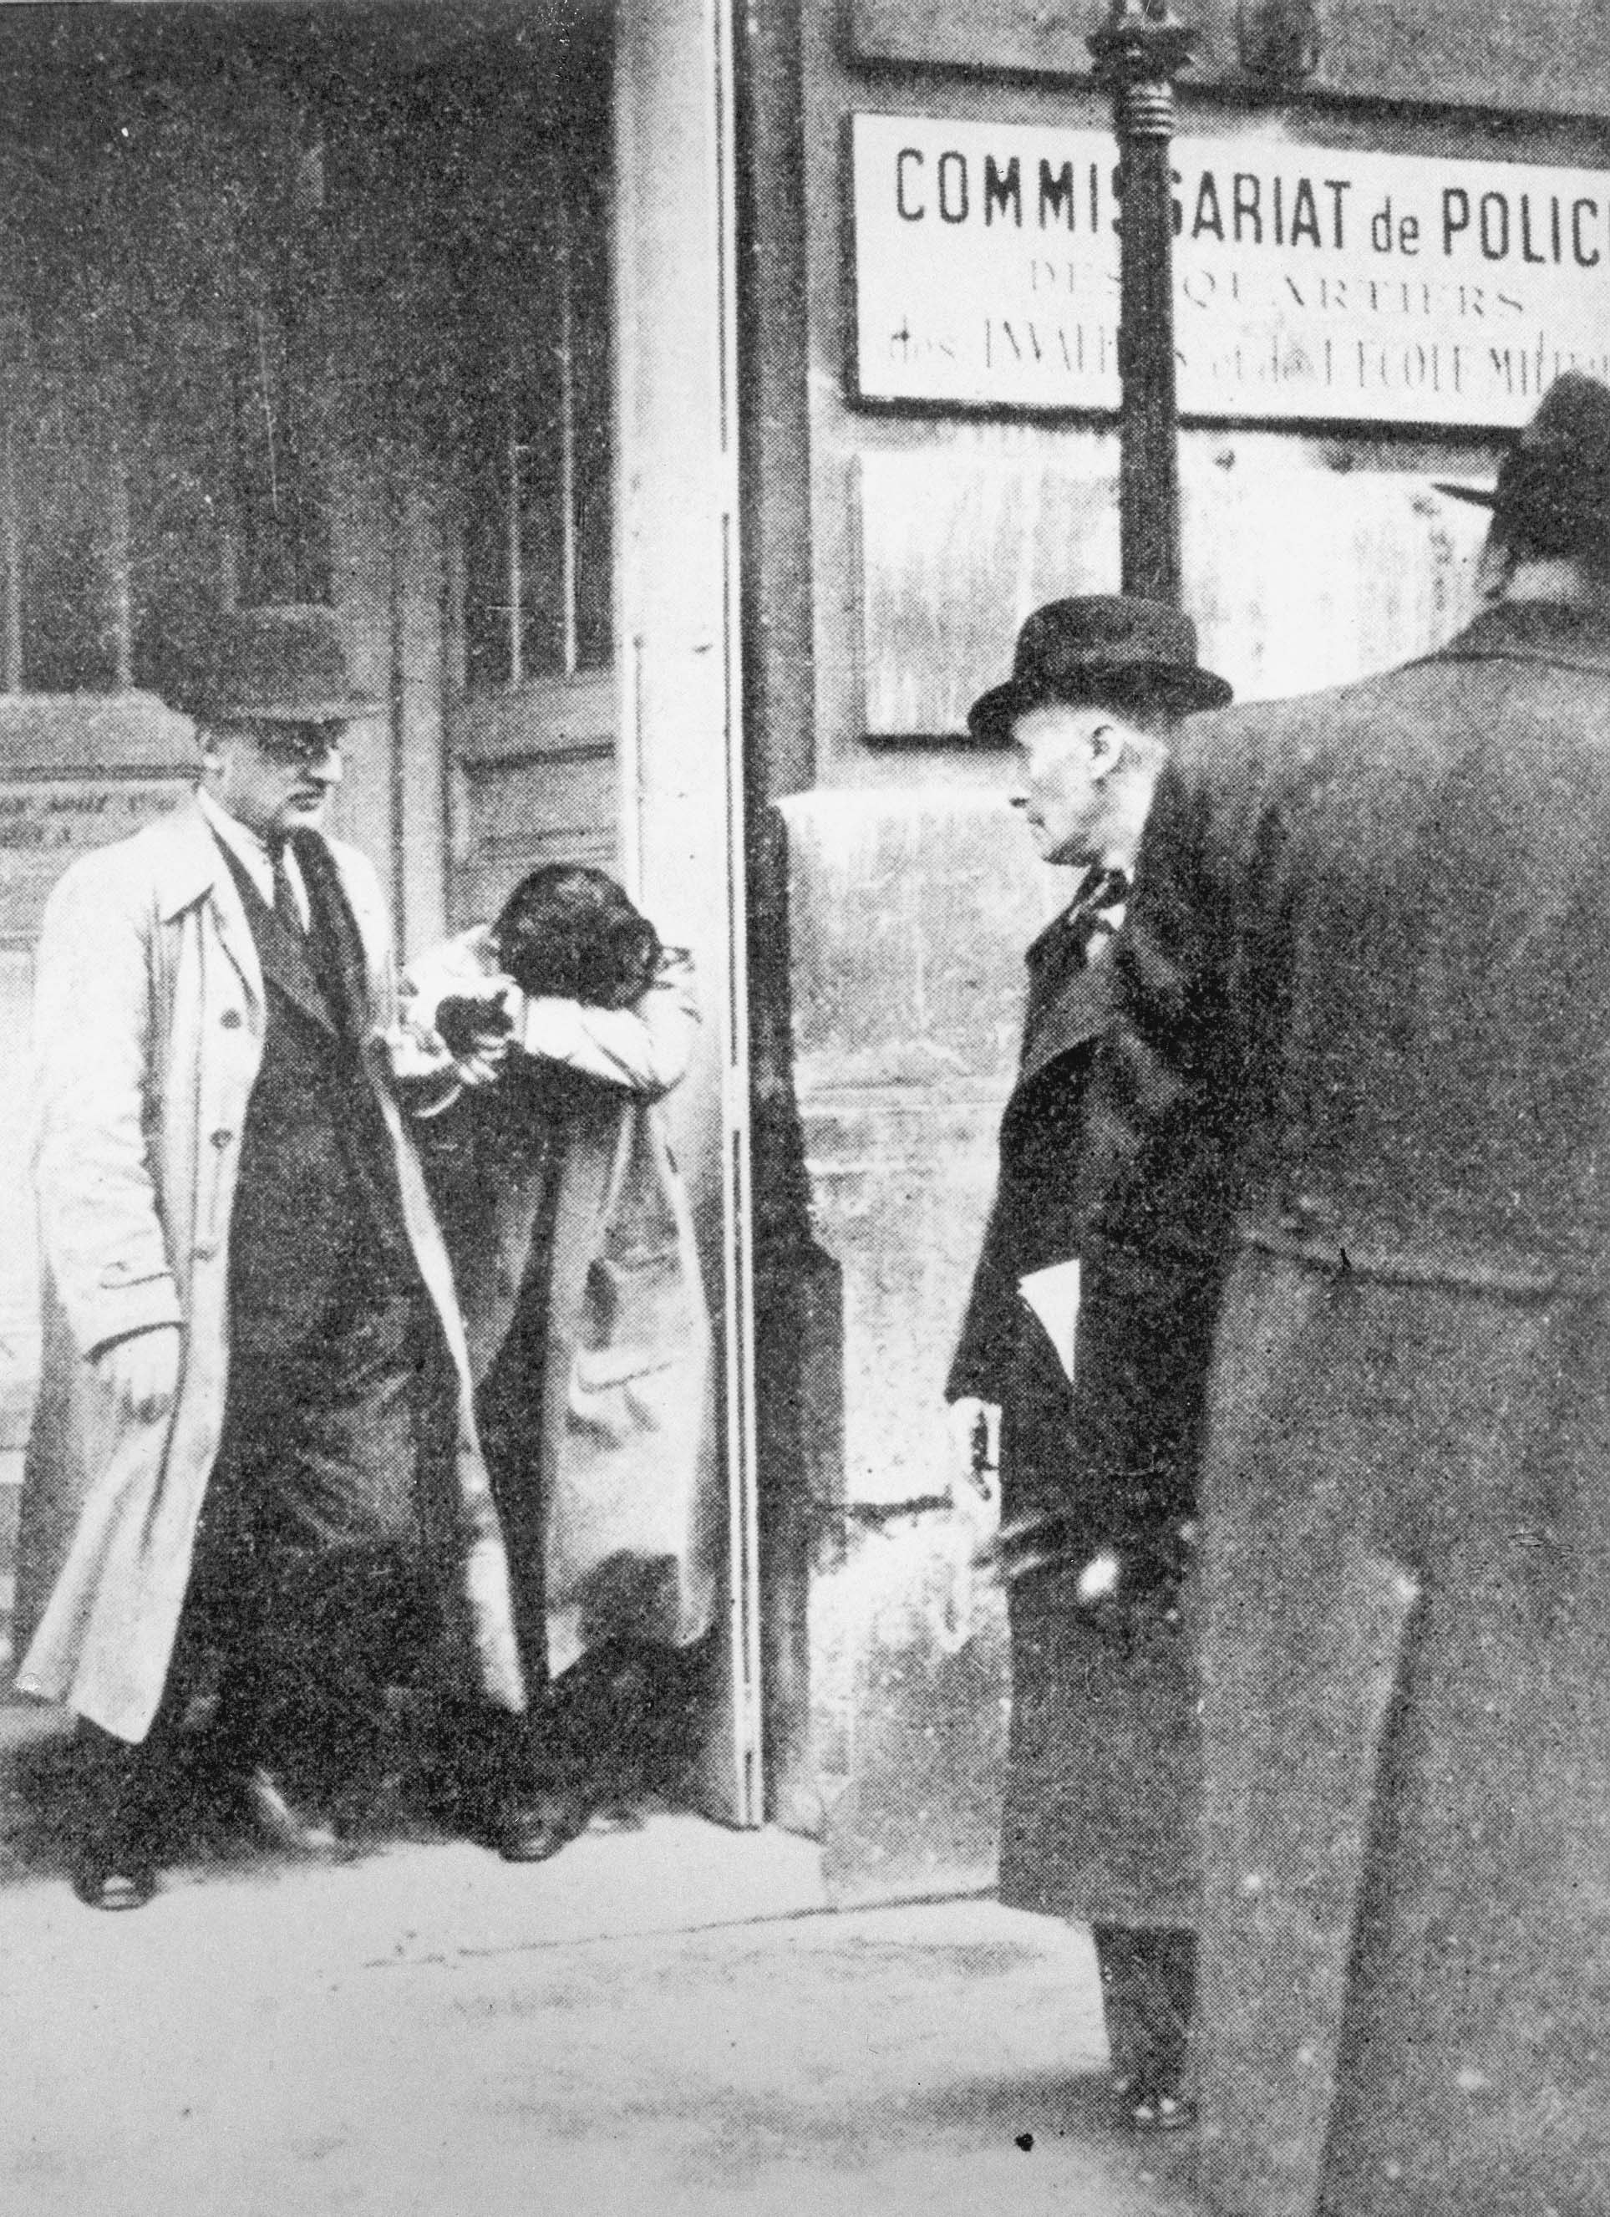
German-born Herschel Grynszpan, the son of Polish Jews, moved to Paris in 1936. After learning that German authorities deported his parents from Hanover to the Polish frontier, Grynszpan shot Ernst vom Rath, the third secretary of the German embassy in Paris, on November 7, 1938. The Nazi regime used the diplomat’s death two days later as justification for unleashing the Kristallnacht pogrom of November 9–10. The Vichy government in France turned Grynszpan over to the Germans in 1940. The date and place of his death have never been clarified.
Deportation of Polish Jews October 26-28, 1938
Hershel Grynszpan under arrest.
Notes:
US Holocaust Memorial Museum, courtesy of Yad Vashem Photo Archives

Slide 23
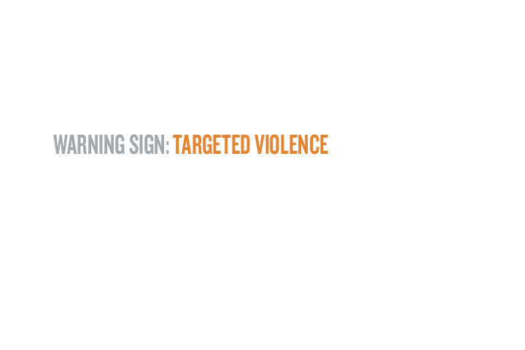
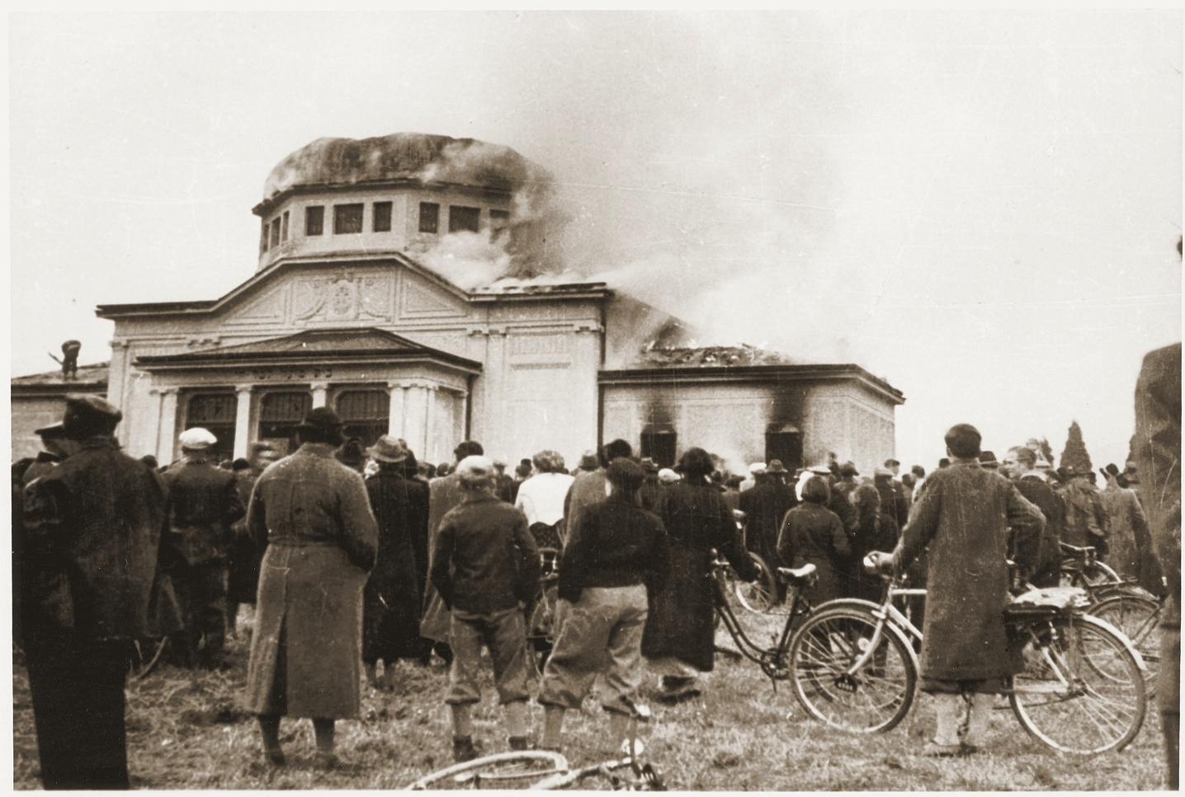
The ceremonial hall at the Jewish cemetery in Graz, Austria.
Kristallnacht November 9-10, 1938
On November 9–10, the Nazi Party and paramilitary groups organize anti-Jewish violence, known as Kristallnacht, throughout Germany, Austria, and the Sudetenland. Synagogues are burned, Jewish homes and businesses are looted, about 30,000 Jewish men are arrested, and at least 91 Jews are killed.
Notes:
US Holocaust Memorial Museum, courtesy of Dokumentationsarchiv des Österreichischen Widerstandes

Slide 24
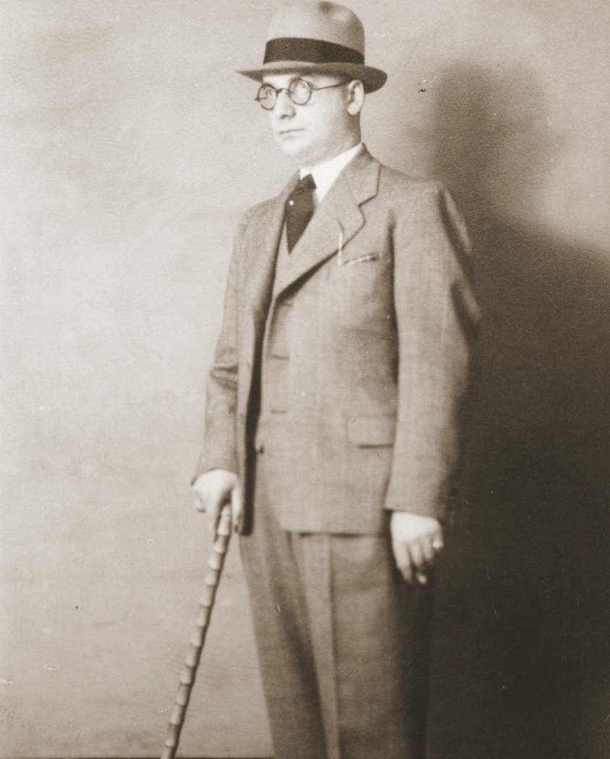
Kristallnacht November 9-10, 1938
Gustav Straus was a traveling salesman who lived in Essen, Germany. On November 10, the Gestapo detained Straus and thousands of other Jews. He was sent to the Dachau concentration camp. Straus was carrying this picture postcard with him when he was arrested and mailed it to his wife while en route to the camp. After his release several weeks later, Straus and his family obtained US visas and left Germany.
Studio portrait of Gustav Straus.
Notes:
US Holocaust Memorial Museum, courtesy of Henry Straus

Slide 25
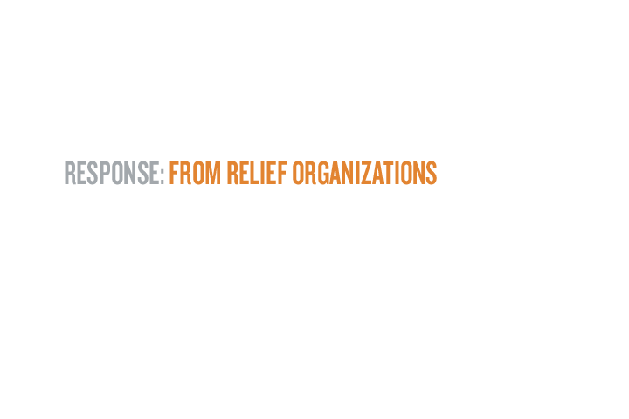
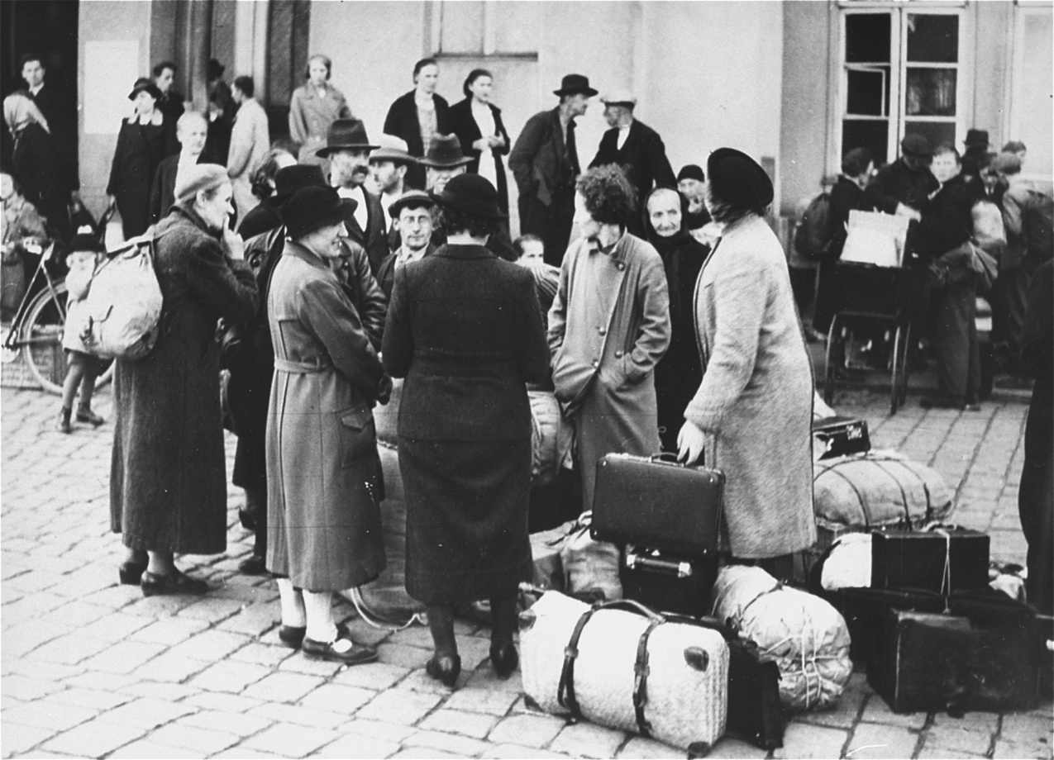
Numerous international organizations supported refugees seeking to emigrate. Founded in 1914, the American Jewish Joint Distribution Committee (JDC or “Joint”) raised and distributed funds to aid Jewish populations in eastern Europe and Palestine.
Jews in the Sudetenland wait for a train to safety in November 1938. 20,000 to 30,000 Jews left their homes after Germany annexed the Sudeten areas of Czechoslovakia. The American Jewish Joint Distribution Committee provided aid for them.
American Jewish Joint Distribution Committee November, 1938
Notes:
The American Jewish Joint Distribution Committee

Slide 26
After the Nazis came to power, the JDC assisted Jews who remained in Germany and those who had fled. Immediately following Kristallnacht in November 1938, the JDC ran an appeal in New York City newspapers asking for contributions to aid refugees.
Jews in the Sudetenland wait for a train to safety in November 1938. 20,000 to 30,000 Jews left their homes after Germany annexed the Sudeten areas of Czechoslovakia. The American Jewish Joint Distribution Committee provided aid for them.
American Jewish Joint Distribution Committee November, 1938
Notes:
The American Jewish Joint Distribution Committee

Slide 27
Jews in the Sudetenland wait for a train to safety in November 1938. 20,000 to 30,000 Jews left their homes after Germany annexed the Sudeten areas of Czechoslovakia. The American Jewish Joint Distribution Committee provided aid for them.
American Jewish Joint Distribution Committee November, 1938
In all, the JDC assisted at least 190,000 Jews who left German-controlled territory between 1933 and 1939.
Notes:
The American Jewish Joint Distribution Committee

Slide 28
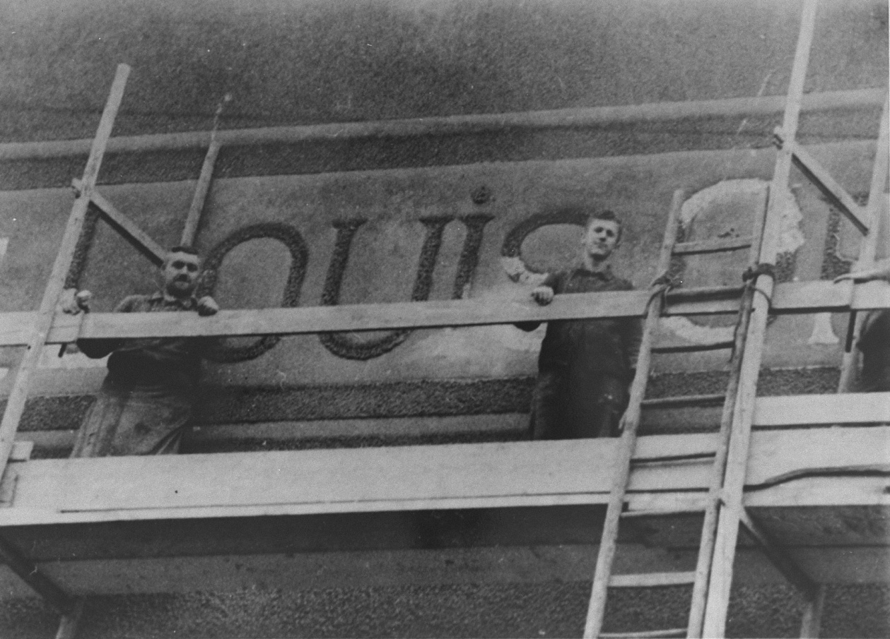
German laborers remove the name of Louis Oppenheimer from the front of his “Aryanized” firm.
Decree Making Jewish Ownership of Businesses Illegal December 3, 1938
In December 1938, the German government issues a decree mandating the “Aryanization” of all Jewish businesses. German authorities force Jews to sell immovable property, businesses, and stocks to non-Jews, usually at prices far below market value.
Notes:
Leo Baeck Institute

Slide 29
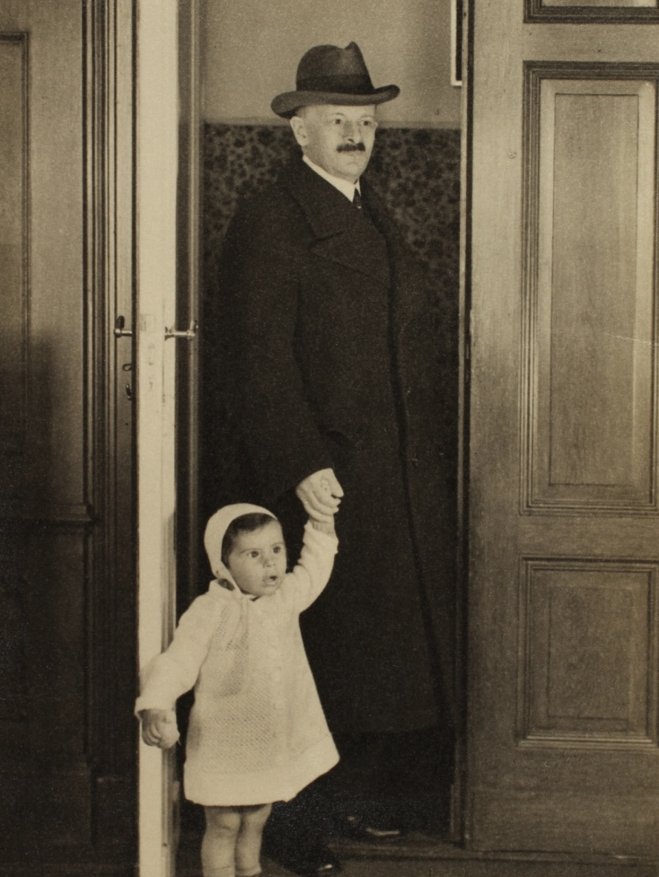
Dr. Ernst Silten lived in Berlin with his wife and family. In 1938 German authorities forced Ernst to sell his pharmacy for well below market value to an “Aryan” German. Ernst’s son and his family then relocated to Amsterdam, where they were later joined by Ernst’s wife. Ernst remained in Berlin, where he eked out a living with financial support from former employees and non-Jewish friends. He refused to go into hiding. In March 1943, the German police detained Ernst. To avoid being “relocated in the east,” a Nazi euphemism for deportation, Ernst committed suicide.
Decree Making Jewish Ownership of Businesses Illegal December 3, 1938
Ernst Silten with his granddaughter.
Notes:
US Holocaust Memorial Museum, courtesy of R. Gabriele Silten

Slide 30
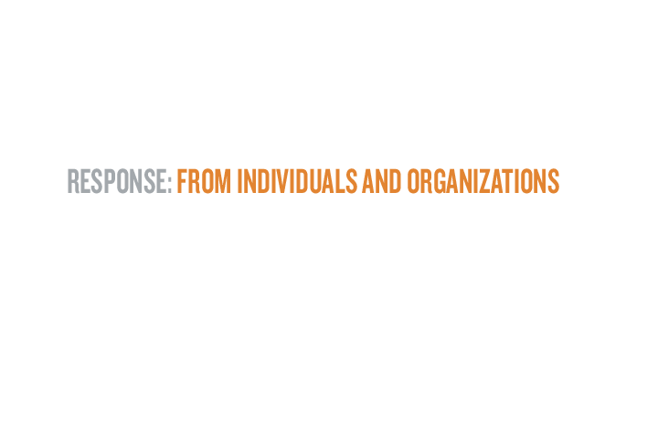
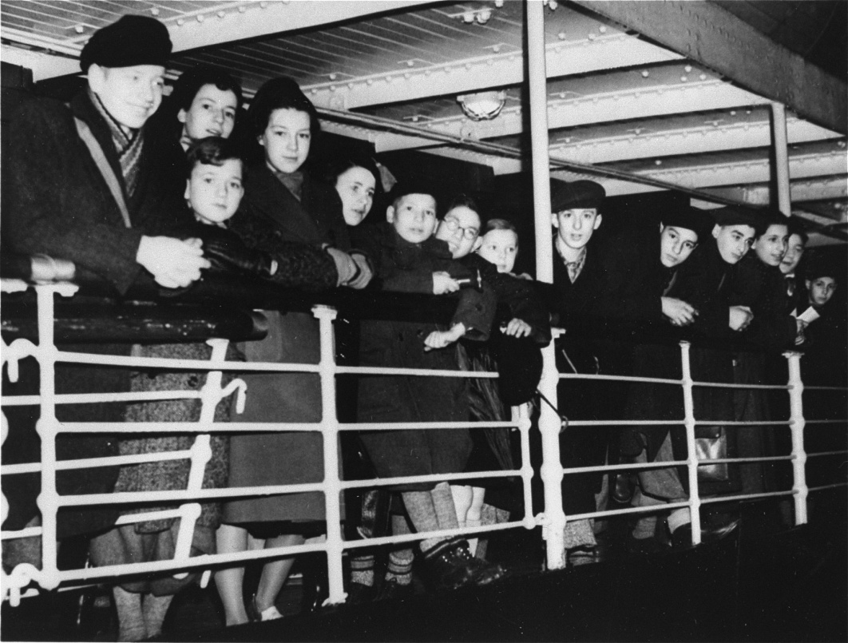
Two hundred Jewish refugee children, who are members of the first Kindertransport from Germany, arrive in Harwich, England.
Kindertransport Begins December, 1938
The term Kindertransport encompasses a series of rescue efforts to bring Jewish children to the United Kingdom between 1938 and 1940. As a result of efforts made by many private citizens and aid organizations, who had to guarantee each child’s transit costs, care, education, and eventual emigration from Britain, the United Kingdom admitted between 9,000 and 10,000 primarily Jewish children from the Greater German Reich.
Notes:
Instytut Pamięci Narodowej

Slide 31
Two hundred Jewish refugee children, who are members of the first Kindertransport from Germany, arrive in Harwich, England.
Kindertransport Begins December, 1938
The first Kindertransport arrived on December 2, 1938, bringing some 200 children from a Jewish orphanage in Berlin that had been destroyed during Kristallnacht.
Notes:
Instytut Pamięci Narodowej

Slide 32
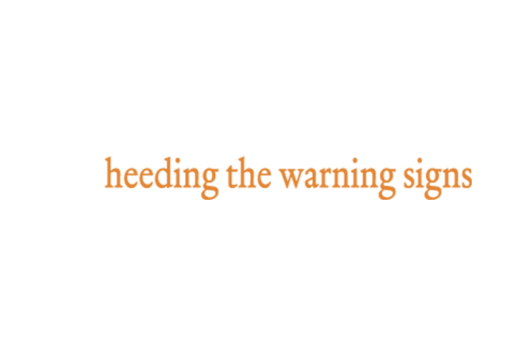
While warning signs are undoubtedly clearer in hindsight, reflecting on the events of 1938 challenges us to consider what might motivate us to respond to indicators of genocide today. History teaches us that genocide can be prevented if people care enough to act.
Our choices in response to hatred truly do matter, and together we can help fulfill the promise of “Never Again.”

