Slide 2
ETHICAL LEADERSHIP
Leadership that is directed by respect for ethical beliefs and values and for the dignity and rights of others
Theresa Watts (2008). Business leaders' values and beliefs regarding decision making ethics
Notes:
Leadership can take the form of action rather than position. Anyone can exercise leadership in a situation that demands it (regardless of their status, their job, or their station in the community)
For the purposes of this module, and in the context of the United States Holocaust Memorial Museum and the history of the Holocaust, we will use this definition.
A core component of leadership, therefore, is respect for ethical beliefs and values and for the dignity and rights of others.
The history of the Holocaust reminds us that values can shift and bend in challenging contexts. This module prompts discussion and inquiry about leadership, ethics, human behavior, and decision-making.

Slide 3
How can examining the human vulnerabilities that led so many ordinary people to play a role in the Holocaust illustrate the challenges leaders may confront today?
Can studying history prepare us to be more ethically conscious leaders?
Some Were Neighbors:
Collaboration and Complicity in the Holocaust
Notes:
We examine leadership and ethics in the context of the Holocaust because it is a case study in failures of individuals, communities, societies, nations, and the international community.
The Museum’s special exhibition, Some Were Neighbors: Collaboration and Complicity in the Holocaust examines the role of ordinary people in the Holocaust. It helps us to understand the range of motives and pressures that influenced people’s decisions and actions (or inaction) during these events.
While some of those pressures and motivations are specific to the time period and rooted in the political, cultural, and ideological context, others reflect timeless social and psychological vulnerabilities all human beings face. These are important to understand in order to prepare ourselves to be more ethically conscious leaders.
The questions we’ll pose when exploring the history are:
How can examining the human vulnerabilities that led so many ordinary people to play a role in the Holocaust illustrate the challenges leaders may confront today?
Can studying history prepare us to be more ethically conscious leaders?

Slide 4
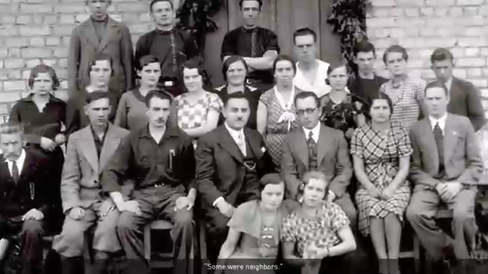
Notes:
This film introduces the concept of the exhibition, Some Were Neighbors: Collaboration and Complicity in the Holocaust.

Slide 5
What human vulnerabilities help to explain failures of ethical leadership?
Rationalization
Conformity
Obedience to Authority
In-group / Out-group dynamics
Notes:
Exploring the role of ordinary people during history of the Holocaust highlights how susceptible human beings are to rationalization, to pressures to conform, to a desire to please those in positions of authority, or to value an in-group to which we belong above a group being targeted.
We will consider how and why so many people failed to exercise ethical leadership (through their actions or inaction) during the Holocaust.
We will also consider how and why some other individuals made different choices to help Jews, even when there was risk involved.

Slide 6
Conformity
A type of social influence involving a change of belief or behavior in order to fit in with a group
The tendency to think or act like members of a group
Conformity is the tendency to align your attitudes, beliefs, and behaviors with those around you. It's a powerful force that can take the form of overt social pressure or subtler unconscious influence.
Notes:
One of the human vulnerabilities that helps to explain the failures of ethical leadership, decision-making, and action is conformity.
Conformity is a social influence or pressure involving a change of beliefs, attitudes, or behaviors in order to fit with a group.
Looking at this human vulnerability in such an extreme context as the Holocaust provides a powerful example of the potential consequences that can help us to think more critically when we find ourselves struggling with the pressure to conform in our own contexts.
We will see several examples of conformity during the Holocaust.

Slide 7
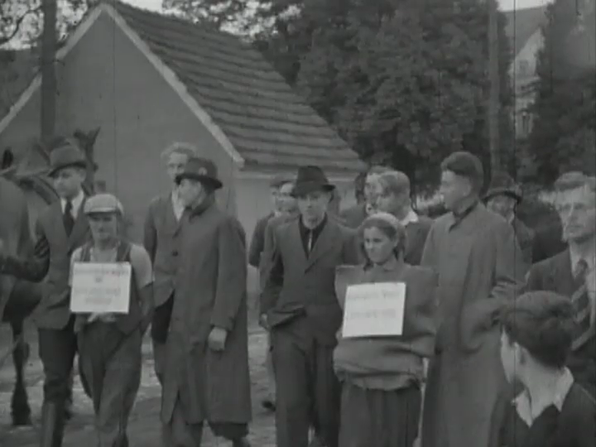
Notes:
Direct students to write down observations as they watch this piece of film, paying attention to the action at the center and the group around the periphery of the scene.

Slide 8
Questions
What observations did you make about the events at the center of the scene and the reactions and activity of the crowd around the periphery?
What are the consequences for the victims? For the community?
Notes:
Have students break into pairs or small groups to discuss their observations and reactions to the film.
What observations did you make about the events at the center of the scene and the reactions and activity of the crowd around the periphery?
Center: Victims endure public humiliation in a ritual shaming. Perpetrators cut their hair and leave a tail in the front to humiliate the victims.
Periphery: Witnesses of all ages (including children) crowd around to watch the humiliating scene. They march in a parade and play musical instruments. They make the event a public spectacle.
NOTE: Victims are not Jewish, but are committing ‘race defilement’ against the Nuremberg Laws.
We can’t know what people are thinking, but we do know that many people are present and participating.
What are the consequences?
For the victims
The presence of so many witnesses and the parade taking place around the periphery makes it all the more humiliating for the victims—knowing that so many are watching and seemingly enjoying themselves.
The size of the crowd—and the presence of young and old alike–lends legitimacy and normalcy to these actions.
For the victims, it sends the message that no one cares or objects to their mistreatment.
The message to the community is to abide by the laws or else this treatment could happen to you.

Slide 9
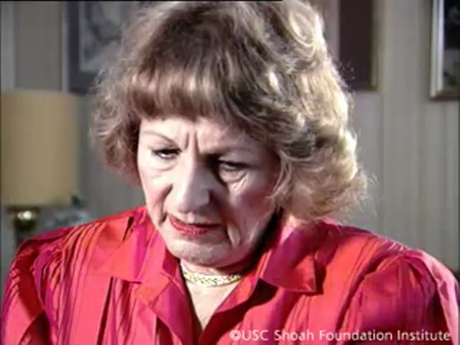
Notes:
Next, we will watch testimony from Holocaust survivor Ruth Rack. Ruth will share her memories of Kristallnacht.
Kristallnacht was a turning point where the exclusion and persecution of Jews took the form of violence and public terror for the first time. It affected Jewish people in every community under Nazi rule.
Kristallnacht is translated as “Night of the Broken Glass.”
It refers to the violent anti-Jewish pogrom that took place November 9-10, 1938 throughout Germany (which at that time included Austria and the Sudetenland region of Czechoslovakia).
The violence was instigated by Nazi Party officials who directed the SA, SS, and Hitler Youth.
More than 250 synagogues were attacked, vandalized, looted, and destroyed. Many were set on fire.
Over 7,000 Jewish owned businesses were vandalized and looted.
Many Jews were attacked by mobs and arrested.
At least 91 died during this event.

Slide 10
Questions
What emotions does Ruth show as she describes the events of Kristallnacht?
What might be possible explanations for her friend’s participation in the mob?
What are the consequences for Ruth and for the community?
Notes:
Questions to ask students:
What emotions does Ruth show as she describes the events of Kristallnacht?
Sadness, shock, betrayal
Ruth ends by asking ‘What is she doing? We’ve never done anything to her. Why is she doing this?’ What might be possible explanations for her friend’s participation in the mob?
Desire to be part of something, desire to belong
Curiosity—something to see
Physical fear of stepping out of the crowd
Not wanting to be different or take a stand
Fear of becoming an outcast—loss of social status, membership in the group
What are the consequences for Ruth and for the community?
For Ruth— Ruth views this event of enormous magnitude through the lens of one relationship that transformed dramatically and the deep sense of betrayal she feels.
For the Jewish community—No one is on your side. You are no longer part of this community. Previous friendships and relationships are gone. There is fear for their physical safety and an understanding that no one will intervene on their behalf and many may benefit from their mistreatment.
For the non-Jewish community—Jews are no longer part of the community. They are outcasts deserving of harsh treatment. There is an effort to remove their presence physically and spiritually.

Slide 11
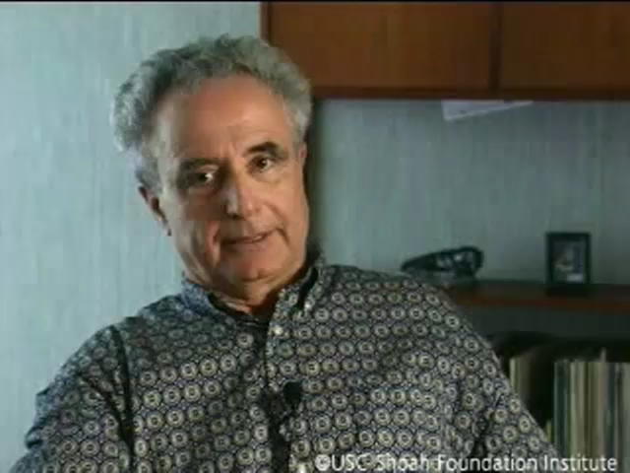
Notes:
In this clip, we hear Holocaust survivor Manfred Wildmann describe the moment of his family’s deportation.

Slide 12
Questions
How does he describe the scene at the moment of his family’s deportation?
What is the impact of the woman’s actions on Manfred and his family?
Notes:
Questions to ask students:
How does he describe the scene at the moment of his family’s deportation?
Emphasis on the public nature of it
It takes place in the town square
People have assembled to watch (a crowd forms)
What is the impact of the woman’s actions on Manfred and his family?
Pivotal, poignant, emotional moment for him to describe
It is clear it was incredibly meaningful and something that had an enormous impact on him and his family.
Of the entire recollection of the deportation, he gets most emotional describing her embrace of his mother.
The woman took a risk and nothing happened to her physically. But we don’t know if she risked her status or her sense of place within the community that saw her step out in that situation.
In this testimony and the preceding testimony from Ruth Rack, we hear the significant impact one person can have—for good or for ill.

Slide 13
“The people did not seem very enthusiastic [about the anti-Jewish measures], but nobody did anything about it.”
- Hilda Henneh Siche,
a Jewish American married to a German Jew 1940
Notes:
When few people take public action, it tells the Nazis they can push further without resistance and will incrementally gain public tolerance or acceptance of their actions.
Questions for reflection:
What might have been the perceived consequences for stepping out?
But what were the consequences for so many who failed to step out?

Slide 14
Factors that increase conformity
Group size
Difficulty of task
Status of majority group
Ambiguity of situation
Factors that decrease conformity
Social support- “The Power of One”
Ability to voice opposition privately
Motivation to achieve and strong leadership abilities
Solomon Asch study
Notes:
These are some factors that either increase or decrease pressure to conform.
Which factors might have influenced the behaviors of the individuals we just heard about?

Slide 15
Questions
How can being part of a crowd influence one’s sense of personal morality?
Can the desire to belong outweigh one’s sense of compassion toward others?
How does recognizing the tendency to conform help to equip
us as ethical leaders?
Notes:
Questions for reflection:
How can being part of a crowd influence one’s sense of personal morality?
Can the desire to belong outweigh one’s sense of compassion toward others?
How does recognizing the tendency to conform help to equip us as ethical leaders?

Slide 16
Questions for Discussion
Can you think of a time when you did something just because everyone else was doing it—even if it didn’t feel right to you? What led to those actions? Do you regret it now?
When a group to which you belong seems to be making a decision that seems unethical to you, how should you go about trying to balance your loyalty to the group against your own ethical integrity? Have you had an experience like that? How did you resolve it?
Can you think of a time when you went against the crowd? What were the risks? What were the benefits?
How can we increase awareness in situations when we are taking cues for proper behavior from the actions of others?
What are the implications for you as a leader?
From University of Texas “Ethics Unwrapped”
Notes:
What questions might help your students relate and apply this concept to their lives today?

