Slide 2
ETHICAL LEADERSHIP
Leadership that is directed by respect for ethical beliefs and values and for the dignity and rights of others
Theresa Watts (2008). Business leaders' values and beliefs regarding decision making ethics
Notes:
Leadership can take the form of action rather than position. Anyone can exercise leadership in a situation that demands it (regardless of their status, their job, or their station in the community)
For the purposes of this module, and in the context of the United States Holocaust Memorial Museum and the history of the Holocaust, we will use this definition.
A core component of leadership, therefore, is respect for ethical beliefs and values and for the dignity and rights of others.
The history of the Holocaust reminds us that values can shift and bend in challenging contexts. This module prompts discussion and inquiry about leadership, ethics, human behavior, and decision-making.

Slide 3
How can examining the human vulnerabilities that led so many ordinary people to play a role in the Holocaust illustrate the challenges leaders may confront today? Can studying history prepare us to be more ethically conscious leaders?
Some Were Neighbors:
Collaboration and Complicity in the Holocaust
Notes:
We examine leadership and ethics in the context of the Holocaust because it is a case study in failures of individuals, communities, societies, nations, and the international community.
The Museum’s special exhibition, Some Were Neighbors: Collaboration and Complicity in the Holocaust examines the role of ordinary people in the Holocaust. It helps us to understand the range of motives and pressures that influenced people’s decisions and actions (or inaction) during these events.
While some of those pressures and motivations are specific to the time period and rooted in the political, cultural, and ideological context, others reflect timeless social and psychological vulnerabilities all human beings face. These are important to understand in order to prepare ourselves to be more ethically conscious leaders.
The questions we’ll pose when exploring the history are:
How can examining the human vulnerabilities that led so many ordinary people to play a role in the Holocaust illustrate the challenges leaders may confront today?
Can studying history prepare us to be more ethically conscious leaders?

Slide 4
Notes:
This film introduces the concept of the exhibition, Some Were Neighbors: Collaboration and Complicity in the Holocaust.

Slide 5
What human vulnerabilities help to explain failures of ethical leadership?
Rationalization
Conformity
Obedience to Authority
In-group / Out-group dynamics
Notes:
Exploring the role of ordinary people during history of the Holocaust highlights how susceptible human beings are to rationalization, to pressures to conform, to a desire to please those in positions of authority, or to value an in-group to which we belong above a group being targeted.
We will consider how and why so many people failed to exercise ethical leadership (through their actions or inaction) during the Holocaust.
We will also consider how and why some other individuals made different choices to help Jews, even when there was risk involved.

Slide 6
Rationalization
Excuses we give ourselves for not living up to our own ethical standards
A psychological device to resolve the cognitive dissonance that comes with wanting to preserve our sense of being a good person while engaging in unethical behaviors or actions
When our conduct clashes with our prior beliefs, our beliefs swing into conformity with our conduct, without noticing that this is going on
Notes:
One of the human vulnerabilities that helps to explain the failures of ethical leadership, decision-making, and action is rationalization.
Rationalization is a psychological device to resolve the cognitive dissonance that comes with wanting to preserve our sense of being a good person while engaging in unethical behaviors or actions.
Looking at this human vulnerability in such an extreme context as the Holocaust provides a powerful example of the potential consequences that can help us to think more critically when we find ourselves making rationalizations in our own contexts.
We will see several examples of rationalization during the Holocaust.

Slide 7
Notes:
The first clip we will watch discusses Kristallnacht. Kristallnacht was a turning point where the exclusion and persecution of Jews took the form of violence and public terror for the first time. It affected Jewish people in every community under Nazi rule.
In this clip, you will see a Holocaust survivor, Rosa Marx, reflect on the impact on her experience during Kristallnacht and the impact that event had on her as a child.
Kristallnacht is translated as “Night of the Broken Glass.”
It refers to the violent anti-Jewish pogrom that took place November 9-10, 1938 throughout Germany (which at that time included Austria and the Sudetenland region of Czechoslovakia).
The violence was instigated by Nazi Party officials who directed the SA, SS, and Hitler Youth.
More than 250 synagogues were attacked, vandalized, looted, and destroyed. Many were set on fire.
Over 7,000 Jewish owned businesses were vandalized and looted.
Many Jews were attacked by mobs and arrested.
At least 91 died during this event.

Slide 8
Questions
What rationalization does the teacher make in this context?
Why might the teacher have created this explanation?
What were the consequences for the students in her class?
Notes:
Questions to ask students:
What rationalization do you hear the teacher make?
The explanation she has created in her mind for Rosa’s family’s arrest is that Rosa’s father had not paid income taxes. This is a clear rationalization because we can presume she knows Rosa and her family well and knows them to be good, law abiding citizens.
Why might the teacher have created this explanation?
The teacher feels compelled to go along with the actions/events that took place on Kristallnacht—perhaps out of respect for authority or deference to actions on the part of the state.
Rather than accept the student back into the fold of the classroom or demonstrate any sort of sympathy, she goes along with the prevailing mindset.
She creates the tax explanation to reconcile her previous relationship with Rosa and Rosa’s new status within society.
Rosa appears to have always shown reverence and respect for her teacher. Thus, the teacher creates this rationalization to distance herself from her previously held relationship with Rosa, and to avoid possible sympathy for her after Kristallnacht.
What were the consequences for the students in the class? (For both Rosa and the other students)
The teacher is a role model, someone who the students (or at least Rosa) view as cultured and intelligent, so her actions toward Rosa have implications for all of her students. She sets the tone in the classroom.
For the non-Jewish students, the message is that mistreatment of Jews is legitimate and okay. They have done something to deserve it.
For Rosa, it means her status in the class has become that of outcast. Her view of the teacher and her relationships with her classmates has been transformed.

Slide 9
Notes:
Watch the next clip featuring testimony from Holocaust survivor Fred Werner.
What are your reactions?
What were the consequences of the friend’s rationalization?
Friend benefits from Fred’s family’s misfortune by moving into the now vacant apartment.
His family is thrown out of their home.

Slide 10
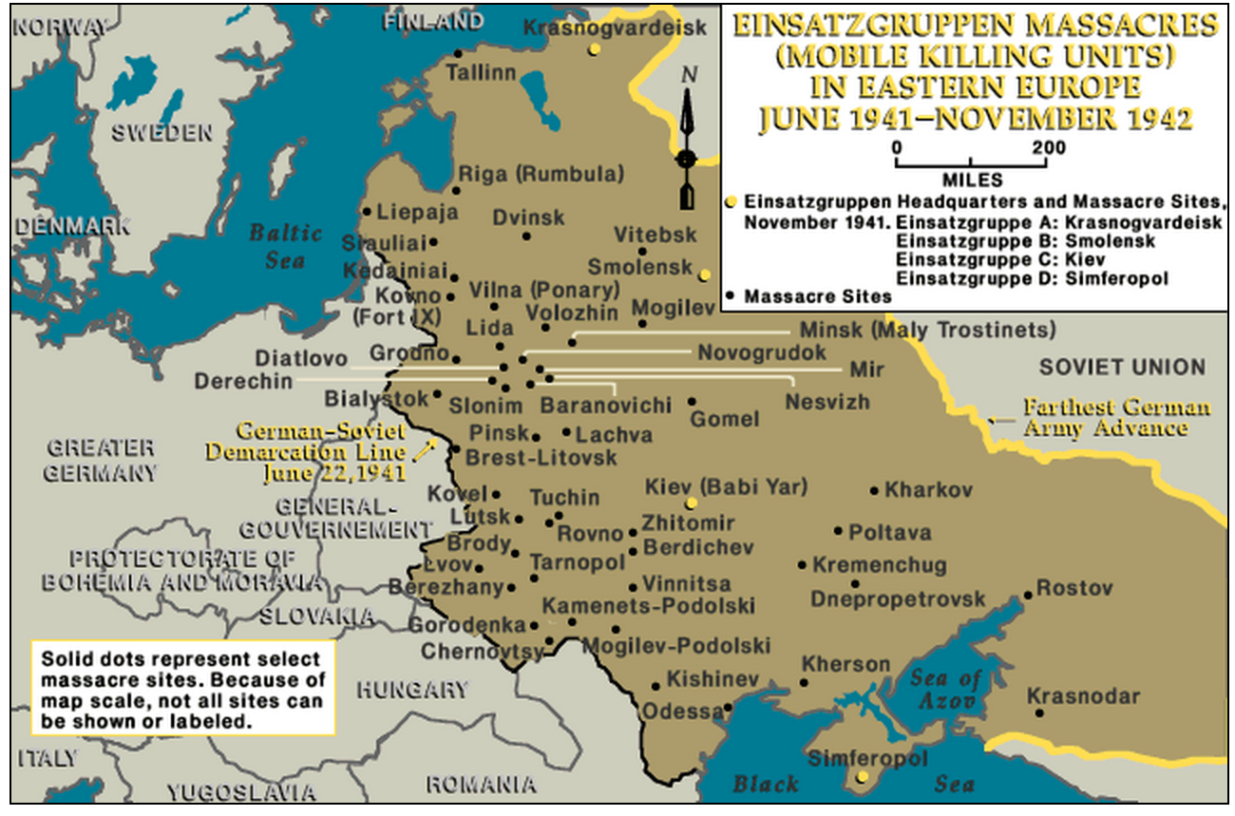
As German troops advanced into eastern Europe, Germany’s power extended over millions more Jewish inhabitants in the occupied lands. Under conditions of war and military occupation, the Nazi regime could pursue its political and racial goals with more radical measures.
Notes:
This is a map of Einsatzgruppen massacres.
1) Establish scale of mass shootings
After the invasion of the Soviet Union in June 1941, millions more Jews came under German occupation. German killing squads and their auxiliaries murdered at least two million Jewish men, women, and children in mass shooting operations.
Establish process, roles
As German military forces advanced, mobile killing units advanced with them.
The German Army, military SS, and German police units took an active part in authorized mass murders. The Germans and their accomplices:
Rounded up the victims
Drove them on foot or in trucks to a killing site.
Often made them remove their clothes.
Shot them
Participants in the murders included local collaborators—especially police—in Latvia, Lithuania, Estonia, Ukraine and Belarus. Help from local populations was essential for killing on a mass scale.
The map illustrates where mass shootings occurred. The arrow points to Lithuania.

Slide 11
Notes:
This clip features Juozas Aleksynas of Lithuania. During World War II, he served as an auxiliary to German forces and participated in several massacres of Jews in Belorussia in fall 1941.

Slide 12
Questions
What is your reaction to hearing the man in the video describe the process and his role in it?
How does he rationalize his involvement in this process?
Notes:
Questions to ask students:
What is your reaction to hearing the man in the video describe the process and his role in it?
How do you hear him rationalize his involvement in the mass shooting?
He says a person became like a “robot” and that he was forced to do it. He also blames God. ”I don’t blame anyone else — just God. If He exists anywhere, you know, why He allows humanity to destroy innocent people.”

Slide 13
Common Rationalizations
Denial of responsibility (“I shouldn’t do this, but my boss is making me, so it isn’t really my fault.”)
Denial of injury (“I know that I shouldn’t do this, but who’s really being hurt?”)
Denial of victim (“I know that I shouldn’t do this, but this guy is so stupid that he deserves to get ripped off.”)
Social weighing (“I know that I shouldn’t do this, but my competitors are doing even worse stuff.”)
Appeal to higher authority (“I know that I shouldn’t do this, but I have a family to feed.”)
Metaphor of the ledger (“I know that I shouldn’t do this, but I give a lot of money to charity.”)
From University of Texas “Ethics Unwrapped”
Notes:
These are some common types of rationalizations.
Which did you hear in the examples we just saw?

Slide 14
How does recognizing the human vulnerability to rationalize our actions help to equip us as leaders?
Notes:
Question for reflection:
How does recognizing the human vulnerability to rationalize our actions help to equip us as leaders?

Slide 15
Questions for Discussion
Brainstorm some common rationalizations and discuss ways to respond to them.
If you suspect that your ethical objections will not be heard, is it still worthwhile to make them? Why or why not?
Is it necessary to have a foolproof argument when raising an ethical objection?
Think about a time when you (or someone you observed) were able to effectively respond to rationalizations. What are some effective ways to reframe the challenge and/or respond to them?
From University of Texas “Ethics Unwrapped”
Notes:
What questions might help your students relate and apply this concept to their lives today?

