Slide 1
What are Mass Atrocities?
Lessons in Leadership: Criminal Justice Approaches for Preventing Mass Atrocities

Slide 2
Overview
How do we define mass atrocities?
Why prevent mass atrocities?
How does mass atrocity prevention fit into the work criminal justice professionals are already doing?

Slide 3
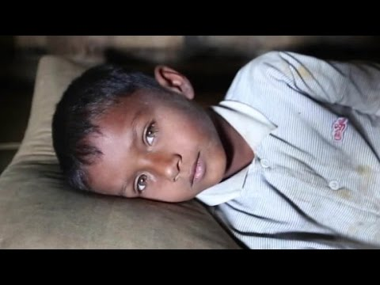
As You Watch
What did you see in the video?
As a criminal justice professional, what concerns does this situation raise, if any?
CNN via YouTube

Slide 4
After You Watch
What did you see in the video?
As a criminal justice professional, what concerns does this situation raise, if any?

Slide 5
Mass atrocities generally refers to “large-scale, systematic violence against civilian populations.”

Slide 6
What Are Mass Atrocities?
US Holocaust Memorial Museum

Slide 7
Crimes against Humanity and War Crimes
What stood out to you as you listened to the discussion of these two terms?
In what ways is it useful to have these terms defined?
Have you encountered application of these terms in your professional experience? If so, how?

Slide 8
What Are Mass Atrocities?
US Holocaust Memorial Museum

Slide 9
After You Watch
What barriers exist to identifying a situation as a mass atrocity? How can you identify communities that are most at risk of being targeted in mass atrocities?
What elements of these four types of mass atrocities (crimes against humanity, war crimes, genocide, ethnic cleansing) do you think are most important to understand in your work?

Slide 10
After You Watch
What tools currently exist in your domestic criminal justice system that could be used to address mass atrocities? What else could the criminal justice system in your country do to address mass atrocities?
Why do you think preventing mass atrocities is important?

Slide 11
Conclusion

