Slide 1
Prevention: Identifying Risk Factors, Warning Signs, and Triggers
Lessons in Leadership: Criminal Justice Approaches for Preventing Mass Atrocities

Slide 2
Overview
What is Prevention and why do it?
Discuss and apply risk factors, warning signs, and triggers

Slide 3
1948: Genocide Convention adopted by UN General Assembly
2005: UN member states unanimously endorse principle of Responsibility to Protect (R2P)

Slide 4
Mass Atrocity Prevention—Key Points
Ideal Prevention Is EARLY and LOCAL
Maximize potential for prevention
Spend less money
Preserve local autonomy
Build overall resilience
Save more lives

Slide 5
Risk Factors, Warning Signs, and Triggers
US Holocaust Memorial Museum

Slide 6
Risk Factors, Warning Signs, and Triggers
What stood out to you as you learned about the risk factors, warning signs, and triggers for mass atrocities?
Have you observed any of these risk factors, warning signs, and triggers in your own context? Do you think naming them is helpful for atrocity prevention? Why or why not?

Slide 7
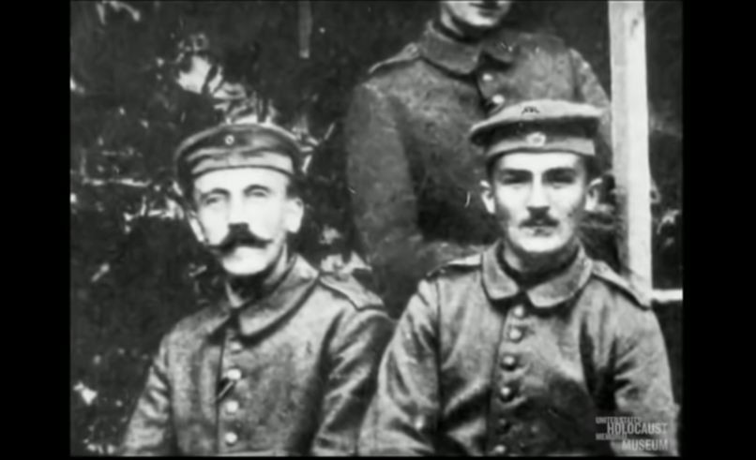
Identifying Risk Factors, Warning Signs, and Triggers: The Path to Nazi Genocide
US Holocaust Memorial Museum

Slide 8
Identifying Risk Factors, Warning Signs, and Triggers: The Path to Nazi Genocide
What risk factors, warning signs, and triggers did you observe in the film?
What did these factors look like in action in this particular situation?

Slide 9
Conclusion

Slide 10
Additional Slides
The following slides are included for reference during discussions if needed.

Slide 11
Understanding Atrocity Risk
Risk Factors Warning Signs Triggers
+ +
=

Slide 12
Macro-Level Risk Factors
Common Findings | Sometimes
Large-scale instability | Deep-seated hatreds
Armed conflict and regime change | Government capacity
Exclusionary, nationalist, or transformative ideology | Authoritarianism
Prior discrimination or unpunished violence against a particular group | Economic causes

Slide 13
Warning Signs
Tension and polarization among groups
Apocalyptic public rhetoric by leaders
Labeling civilian groups as the “enemy”
Development and deployment of irregular armed forces
Stockpiling weapons
Emergency or discriminatory legislation
Removing moderates from leadership or public service
Lack of punishment for past crimes

Slide 14
Triggers
High-level assassinations
Coups or attempted coups
Change in conflict dynamics
Crackdowns on civilian protests
Symbolically significant attacks against individuals or physical sites

