Slide 1
Case Study: Criminal Justice Professionals and the Holocaust
Lessons in Leadership: Criminal Justice Approaches for Preventing Mass Atrocities

Slide 2
Video and Discussion: Criminal Justice Professionals and the Holocaust
Kristallnacht Case Study
Conclusion

Slide 3
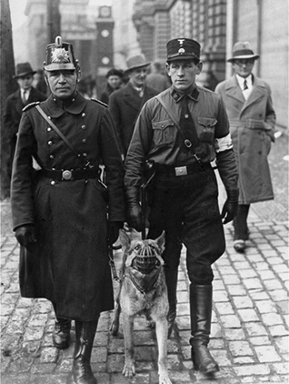
A Berlin police officer and a member of the SS on patrol.
Germany, March 5, 1933
Bundesarchiv Bild 102/14381
Notes:
USHMM Photo Archives #: 31104

Slide 4
Criminal Justice Professionals During the Holocaust
US Holocaust Memorial Museum

Slide 5
Criminal Justice Professionals During the Holocaust
Why might German criminal justice professionals have supported the Nazi regime in its early years?
How do their actions intersect with the early warning signs we have discussed?

Slide 6
Kristallnacht and the Criminal Justice System
November 9–10, 1938

Slide 7
Police Report, Hanover, December 1938
What questions does this report raise for you?

Slide 8
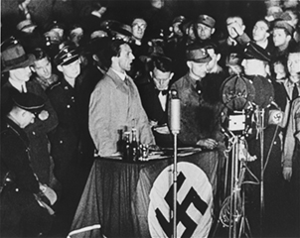
Joseph Goebbels Minister of Propaganda
National Archives
Notes:
USHMM Photo Archives #85339A

Slide 9
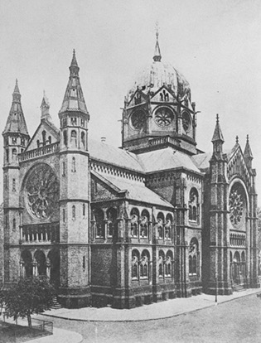
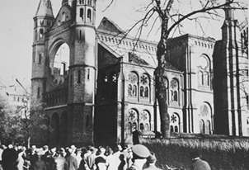
Views of the Hanover synagogue before and after Kristallnacht
US Holocaust Memorial Museum, courtesy of Yad Vashem Photo and Film Archives
Notes:
USHMM Photo Archives #11937 (before Kristallnacht), #13005 (Kristallnacht destruction)

Slide 10
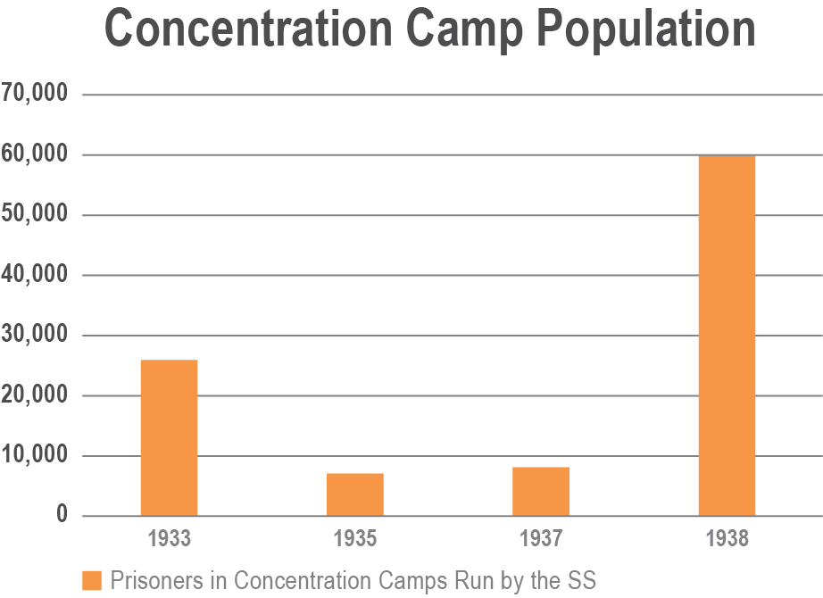
Notes:
Source of statistics: Martin Weinmann, ed. Das Nationalsozialistische Lagersystem. Frankfurt am Main: Zweitausendeins, 1990, pp. XCI-CXXXI.

Slide 11
Tager family portrait circa 1935
Hanover, Germany
US Holocaust Memorial Museum, courtesy of Alan Edelman
Notes:
USHMM Photo Archives #75777

Slide 12
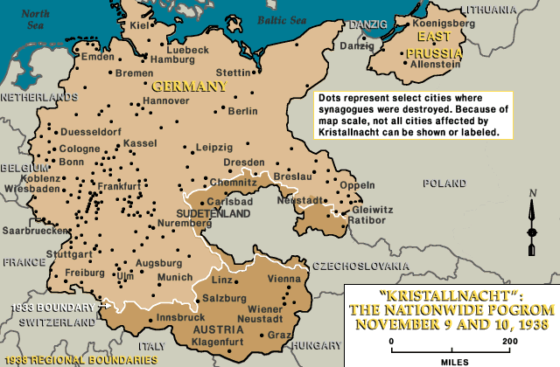
US Holocaust Memorial Museum
Notes:
Source: https://www.ushmm.org/information/exhibitions/online-exhibitions/special-focus/kristallnacht/synagogues/how-was-kristallnacht-carried-out/map-synagogues-destroyed-during-kristallnacht

Slide 13
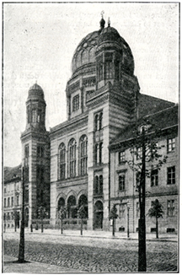
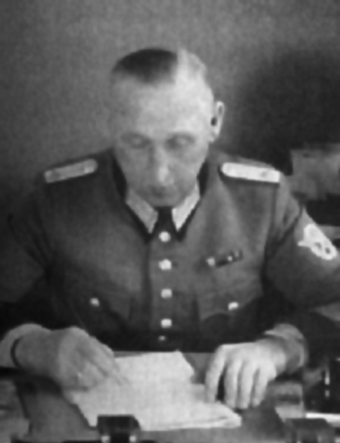
Lebrecht Music & Arts/Alamy Stock Photo
Staatsbibliothek zu Berlin—Preußischer Kulturbesitz, Handschriften Abteilung, Nachlass 353 (Heinz Knobloch)
Notes:
(Left) Neue Synagoge (New Synagogue) on Oranienburger Strasse (1933): USHMM Photo Archives #85948
(Right) Wilhelm Kruetzfeld (Staatsbibliothek zu Berlin)

Slide 14
What, if anything, is surprising to you about this case study?

Slide 15
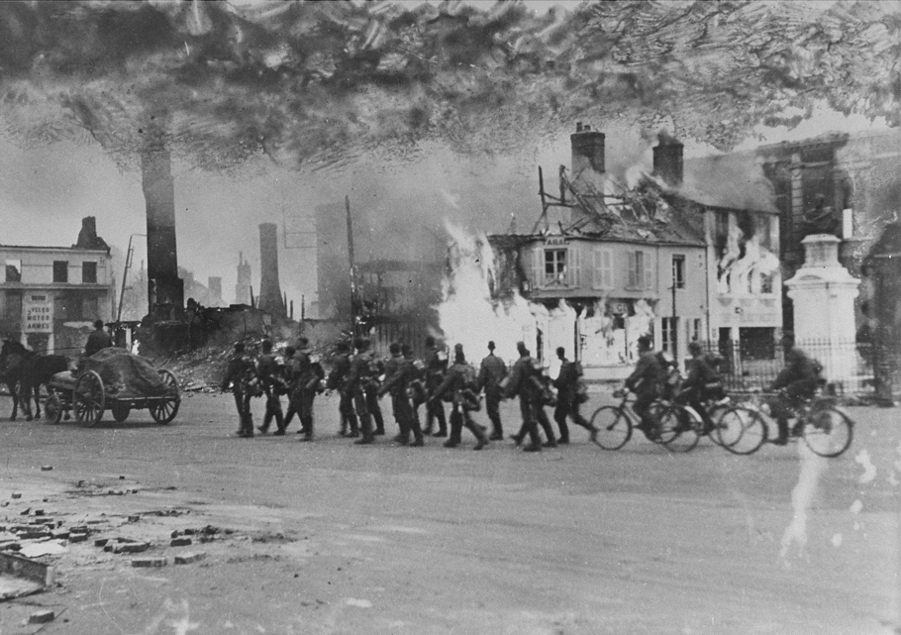
German troops march through a town in Poland
September 1939
US Holocaust Memorial Museum, courtesy of Jerzy Tomaszewski
Notes:
USHMM Photo Archives #06046

Slide 16
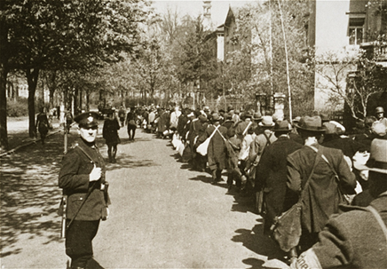
Deportation of Jews from Würzburg, Germany
April 25, 1942
National Archives
Notes:
USHMM Photo Archives #: 46207

Slide 17
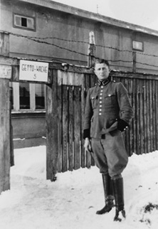
A member of police battalion 101 poses in front of the Łódź ghetto, German-occupied Poland, 1940–1941.
US Holocaust Memorial Museum, courtesy of Michael O’Hara
Notes:
USHMM Photo Archives #: 47431

Slide 18
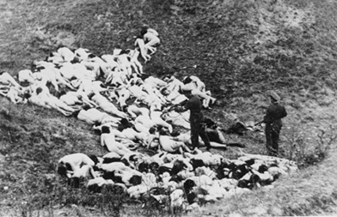
A German police officer shoots wounded Jewish women and children following the mass shooting of Jewish civilians outside the Mizocz ghetto.
German-occupied Poland (today: Ukraine), October 1942.
US Holocaust Memorial Museum, courtesy of Instytut Pamieci Narodowej
Notes:
USHMM Photo Archives #: 17878

Slide 19
Conclusion

