Slide 1
TOOLS FOR ADDRESSING THE Warning Sign OF Dangerous Speech
Lessons in Leadership: Criminal Justice Approaches for Preventing Mass Atrocities

Slide 2
Overview
Discuss dangerous speech and hate speech
Analyze how certain speech can enable acts of violence
Reflect on your roles and capabilities when dealing with dangerous speech and hate speech

Slide 3
Freedom of expression is a fundamental human right, enshrined in Article 19 of the Universal Declaration of Human Rights (UDHR).
Article 19: “Everyone has the right to freedom of opinion and expression; this right includes freedom to hold opinions without interference and to seek, receive and impart information and ideas through any media and regardless of frontiers.”

Slide 4
Dangerous Speech
Any form of expression (e.g., speech, text, or images) that can increase the risk that its audience will condone or commit violence against members of another group
Dangerous Speech Project, https://dangerousspeech.org/about-dangerous-speech/

Slide 5
Hate Speech
...any kind of communication in speech, writing or behaviour, that attacks or uses pejorative or discriminatory language with reference to a person or a group on the basis of who they are, in other words, based on their religion, ethnicity, nationality, race, colour, descent, gender, or other identity factor.
United Nations Strategy and Plan of Action on Hate Speech (May 2019)
Notes:
United Nations Strategy and Plan of Action on Hate Speech, May 2019, page 2. https://www.un.org/en/genocideprevention/documents/advising-and-mobilizing/Action_plan_on_hate_speech_EN.pdf

Slide 6
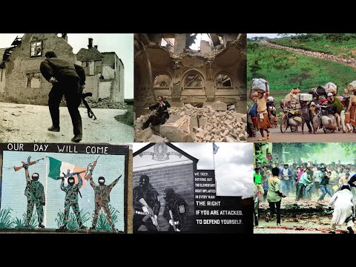
Dangerous Speech Project via YouTube

Slide 7
Discussion
Have you encountered dangerous speech or hate speech in your own context? What would be an example of hate speech? Can you share an example of dangerous speech?
Are you familiar with any domestic laws regarding speech, either hate speech or dangerous speech? Do you have laws relating to freedom of expression?

Slide 8
Discussion
Do you collect information on hate crimes and bias incidents? At what point would you take action?
How do you balance freedom of expression (as outlined in the Universal Declaration of Human Rights) with the need to address dangerous and hate speech in your own context?

Slide 9
Case Study
Report from a community member about subjects standing in a public area
Handing out brochures—Nonaggressive:
Hateful remarks about a minority group (name calling)
Language blaming the minority group for economic problems in the country
Language blaming the minority group for ruining the community and society
Language stating that society needs to remain “pure” and people need to avoid interacting or procreating with the minority group
Information on how to join the organization that the subjects belong to in order to aid “spreading the word”
The community and politicians are demanding immediate action ...

Slide 10
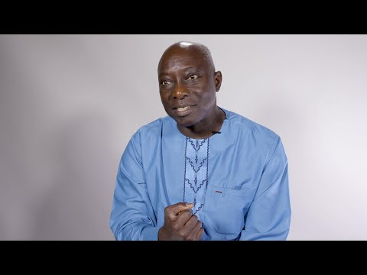
United Nations via YouTube

Slide 11
COMMUNITY DIALOGUE AS A TOOL FOR PREVENTION
Lessons in Leadership: Criminal Justice Approaches for Preventing Mass Atrocities

Slide 12
Overview
Discuss community dialogue as a tool for atrocity prevention
Analyze a community dialogue in terms of an atrocity risk assessment framework
Reflect on your roles and capabilities for reducing atrocity risk through community dialogues

Slide 13
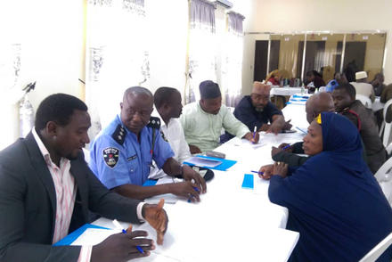
Criminal Justice Tool: Community Dialogue
Community dialogue: Communication between the criminal justice system (police, prosecutors, etc.) and the community, in order to build relationships and solve justice problems
This can help with early warning analysis and atrocity risk assessment.
A USIP Justice and Security Dialogue in Jos, Nigeria, Dec. 18, 2019. US Institute of Peace

Slide 14
Community Dialogue: Burkina Faso
US Institute of Peace

Slide 15
Community Dialogue: Burkina Faso
Who is participating in the community dialogue? Is there anyone you were surprised to see in this dialogue? Why might their participation be important?
Is there anyone whose participation might make the dialogue more complicated or inhibit mass atrocity prevention efforts?
How might an effort like this help criminal justice professionals better understand and evaluate risk for mass violence against civilians?

Slide 16
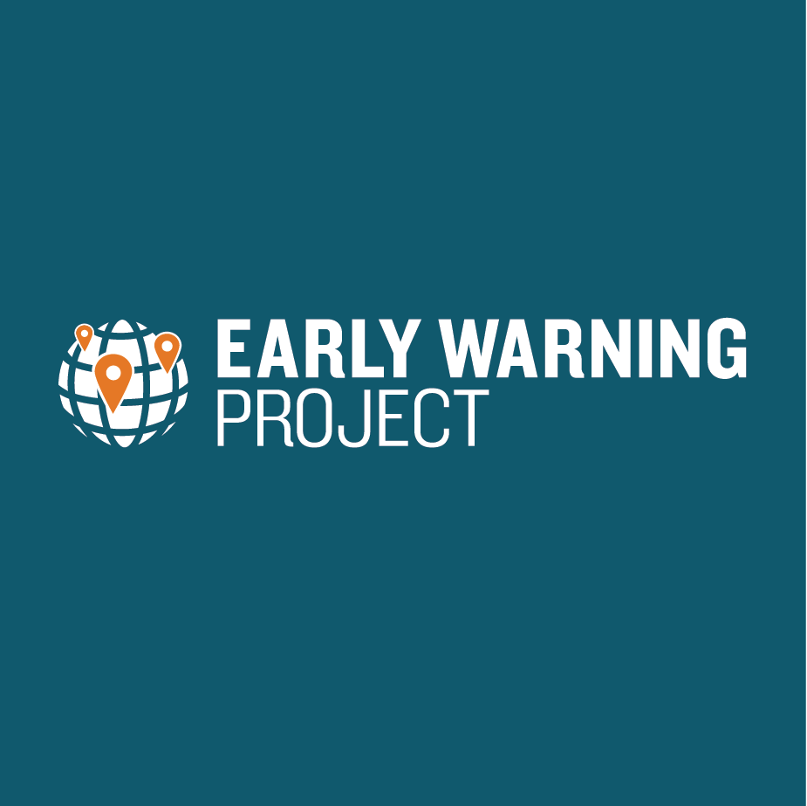
Community Dialogues and Assessment
https://earlywarningproject.ushmm.org/countries/burkina-faso
Notes:
https://earlywarningproject.ushmm.org/reports/state-of-the-world-mass-killing-in-2019

Slide 17
Conclusion

