Slide 1
Leadership, Motivations, and Rationalizations during Mass Atrocities
Lessons in Leadership: Criminal Justice Approaches for Preventing Mass Atrocities

Slide 2
Overview
Explore the concept of leadership
Analyze and discuss the role of ethical leadership in mass atrocity prevention
Explore common rationalizations and motivations for unethical behavior during mass atrocities
Reflect on leadership characteristics in relation to your role as a leader

Slide 3
Group Discussion
What does the term leadership mean to you?

Slide 4
What Is Leadership?
The ability to influence and motivate others to complete or accomplish a goal
ArchOneZ/VectorStock.com

Slide 5
Types of Power
There are two types of power:
Positional Power
Personal Power
The Noun Project, CC0 1.0 Public Domain Dedication

Slide 6
Ethical Leadership
The demonstration of normatively appropriate conduct through personal actions and interpersonal relationships, and the promotion of such conduct to others through two-way communication, reinforcement, and decision making
Notes:
Definition from: Brown, Michael E, Linda K Trevino, and David A Harrison. “Ethical Leadership: A Social Learning Perspective for Construct Development and Testing.” Organizational Behavior and Human Decision Processes 97 (February 17, 2004): 120. https://doi.org/10.18502/kss.v3i22.5051.

Slide 7
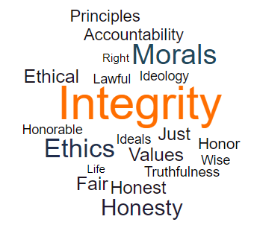
Principles of Ethical Leadership
Respects Others
Serves Others
Shows Justice
Manifests Honesty
Builds Community
Notes:
Source: Northouse, Peter. Leadership: Theory and Practice. 8th Ed. Los Angeles: Sage Publications, 2019, pg. 347.

Slide 8
Rationalization
Trying to resolve the tension between your unethical actions and the desire to see yourself as a “good person”
ACTIONS
BELIEFS
ACTIONS
BELIEFS

Slide 9
Common Rationalizations
“I know that I shouldn’t do this, but ...
Denial of responsibility: “... my boss is making me, so it isn’t really my fault.”
Denial of injury: “... who’s really being hurt?”
Denial of victim: “... this person deserves it.”
Social weighing: “... the other side is doing even worse stuff.”
Appeal to higher authority: “... I have a family to feed.”
Metaphor of the ledger: “... I give a lot of money to charity.”

Slide 10
5 minutes for reading time
German police officer quotes

Slide 11
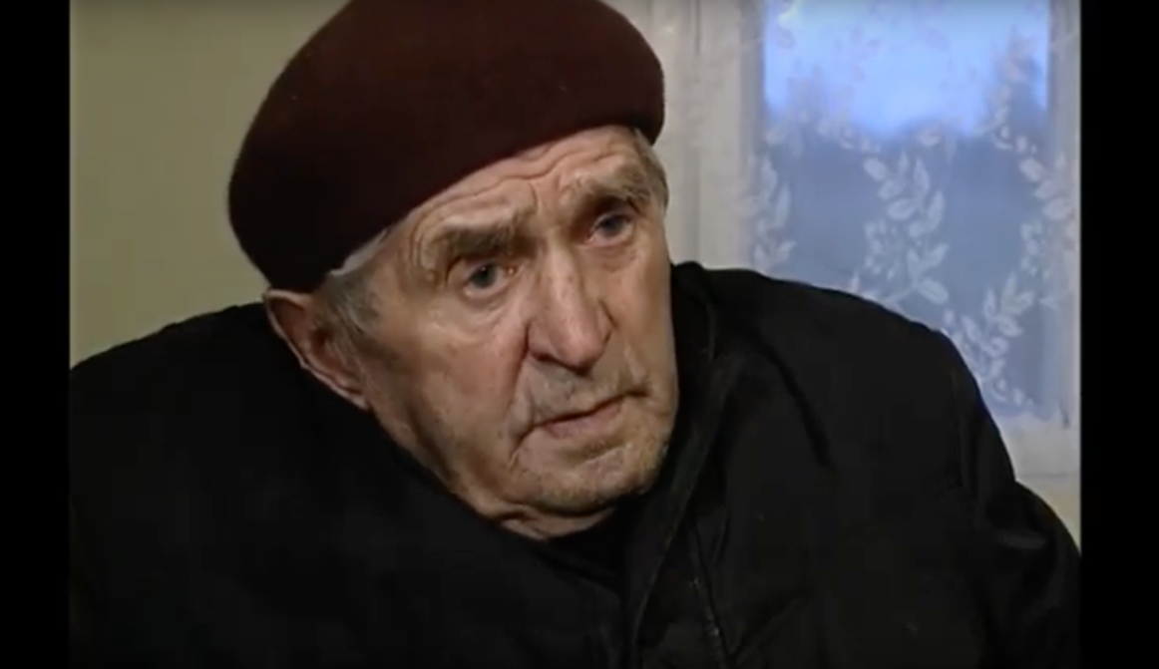
US Holocaust Memorial Museum Collection, courtesy of the Jeff and Toby Herr Foundation
Notes:
http://somewereneighbors.ushmm.org/#/exhibitions/workers/un2991

Slide 12
After You Watch
How did each person explain their decision to participate in mass killings?
How did the choice to participate or not participate in mass killings affect the police officers?
How might society be affected if those who participated in mass atrocities don’t face any consequences?

Slide 13
Questions for Discussion
If a colleague tries to rationalize unethical behavior, how can you respond?
Is it still worthwhile to object if you think no one will listen to you? Or if you think there will be consequences for speaking out?

Slide 14
Questions for Discussion
What could you do to improve your leadership environment for the purpose of atrocity prevention?
Is giving feedback to supervisors encouraged in your agency or organization? Why or why not?

Slide 15
Ethical Leadership and Atrocity Prevention
Modeling behaviors and relationships that preserve life and help prevent atrocities, and encouraging others to do the same

Slide 16
Conclusion

Slide 17
Optional Add-On
Battalion 101 Photo Analysis Exercise

Slide 18
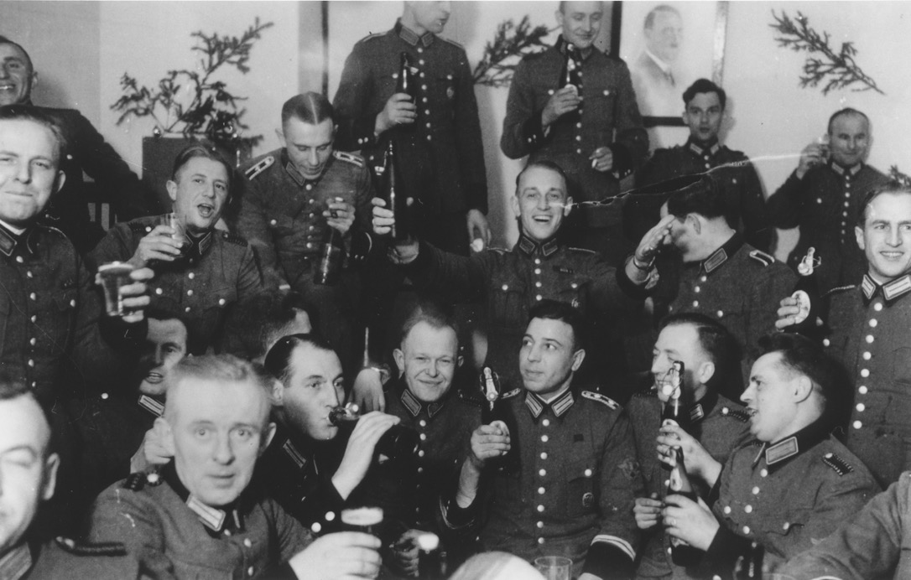
US Holocaust Memorial Museum, courtesy of Margaret Chelnick
Notes:
USHMM Photo Archives #47434

Slide 19
Members of Police Battalion 101 celebrate Christmas in their barracks.
December 25, 1940
US Holocaust Memorial Museum, courtesy of Margaret Chelnick

