Slide 1
Redress for Mass Atrocities: The After STAGE
Lessons in Leadership: Criminal Justice Approaches for Preventing Mass Atrocities

Slide 2
Overview
Why is pursuing justice and redress after mass atrocities important? Who is involved?
What are the challenges to pursuing justice?
How can criminal justice professionals support social healing and prevent recurrence?

Slide 3
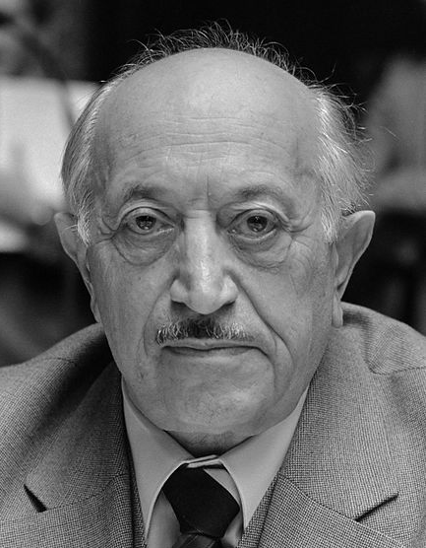
“My cause is justice, not vengeance. My work is for a better tomorrow and a more secure future for our children and grandchildren who will follow us.”
Simon Wiesenthal, Holocaust survivor and founder of the Jewish Historical Documentation Center
BNA Photographic/Alamy Stock Photo
Notes:
Quote source: http://www.wiesenthal.com/about/about-simon-wiesenthal/a-tribute-to-simon-wiesenthal-in-his-95th-year.html
Photo source: https://www.nationaalarchief.nl/onderzoeken/fotocollectie/ad201a9c-d0b4-102d-bcf8-003048976d84

Slide 4
Goals of Justice and Accountability
Deliver justice to targeted groups
Ensure accountability of perpetrators
Establish the truth
Promote societal healing, reconciliation and reintegration, and reestablish trust
Rebuild and reform institutions
Stop ongoing atrocities
Prevent future atrocities
Notes:
Source: based on goals identified by Straus in Fundamentals on pg. 206, 216–217

Slide 5
Macro-Level Risk Factors
Common Findings | Sometimes
Large-scale instability | Deep-seated hatreds
Armed conflict and regime change | Government capacity
Exclusionary, nationalist, or transformative ideology | Authoritarianism
Prior discrimination or unpunished violence against a particular group | Economic causes

Slide 6
Prevention Matters at Each Stage
Before
Prevention
After
Redress
During
Response

Slide 7
Challenges to Pursuing Justice
Think about a time when you handled a case that attracted significant public attention.
What pressures or challenges did you face? How did you respond?
What impact do you think that case had? (On the parties involved, the public, policy, or other factors?)

Slide 8
Transitional Justice
A range of measures—judicial and nonjudicial, formal and informal, retributive and restorative—employed by countries transitioning out of armed conflict or repressive regimes to redress legacies of atrocities and to promote long-term, sustainable peace
Notes:
Source: https://2009-2017.state.gov/documents/organization/257771.pdf

Slide 9
Transitional Justice Tools
Trials or Legal Accountability
Fact-Finding or Truth-Telling Bodies
Reparations (compensation/economic assistance, apologies)
Lustration and Vetting
Memorialization
Legal and Institutional Reform, Rule of Law

Slide 10
Some Criminal Justice Tools for Prevention
Risk Factors | Prevention Measures | Criminal Justice Prevention Tools
Armed Conflict Instability Prior Violence or Discrimination Transformative, Exclusionary Ideology | Prevent Conflict Promote Stability, Rule of Law End Impunity, Promote Equality and Rule of Law Promote Pluralism, Tolerance, and Inclusion | Provide training on mass atrocity prevention Conduct early warning analysis Engage in community outreach or dialogues Strengthen awareness of dangerous speech Respond to hate crimes; prosecute past violence Support restorative justice Plan for emergencies Peacefully manage public protest Promote rule of law (criminal justice reform, professional ethics, anti-corruption, efficiency, human rights)

Slide 11
Transitional Justice Tools
Trials or Legal Accountability
Fact-Finding or Truth-Telling Bodies
Reparations (compensation/economic assistance, apologies)
Lustration and Vetting
Memorialization
Legal and Institutional Reform, Rule of Law

Slide 12
Transitional Justice After Mass Atrocities
US Holocaust Memorial Museum

Slide 13
Discussion
What reasons did the interviewees give for pursuing transitional justice efforts? How might the motivations of criminal justice professionals and victims vary in pursuing transitional justice efforts?
What are the challenges of the various transitional justice tools described?
How might the transitional justice efforts described in the video have contributed to reducing the risk of future violence or mass atrocities?

Slide 14
Write down one tool that you could use to promote reconciliation in your community.

Slide 15
Conclusion

Slide 16
Optional Add-On
Transitional Justice Examples Exercise

Slide 17
What are the potential challenges and benefits of this transitional justice tool for leaders trying to respond to mass atrocities?

Slide 18
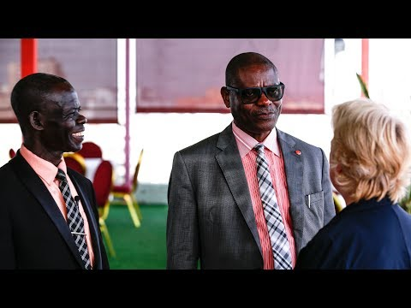
Trials: Hybrid Courts
Africa Group for Justice and Accountability via YouTube

Slide 19
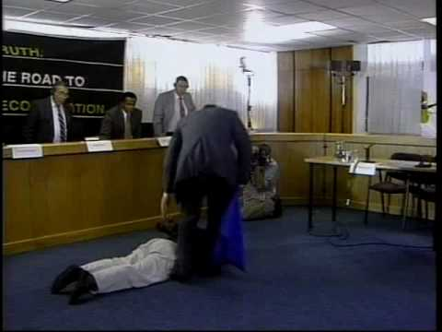
Fact-Finding or Truth-Telling Bodies
Facing History and Ourselves via YouTube

Slide 20
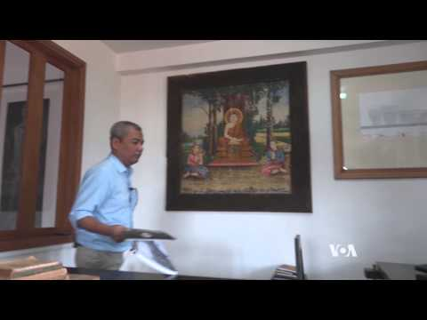
Memorialization
Video: VOA via YouTube
Notes:
https://www.youtube.com/watch?v=wNXHuRuuVbY&t=3s

Slide 21
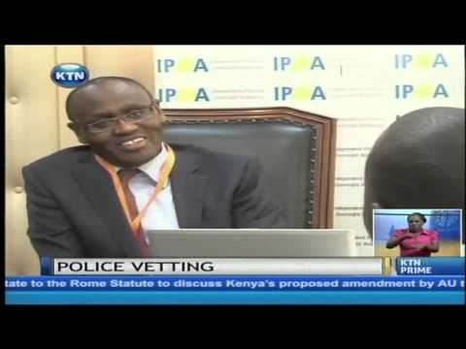
Institutional Reforms and Vetting
KTN News Kenya via YouTube

Slide 22
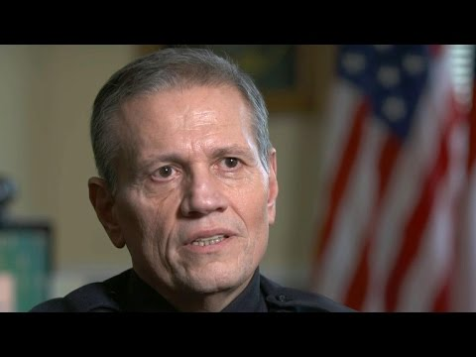
Reparations (Apologies)
CBS News via YouTube

