Slide 1
Action Planning and Change Management
Lessons in Leadership: Criminal Justice Approaches for Preventing Mass Atrocities

Slide 2
Reflection
What stood out for you today?
What did today’s material make you think of in your own work?

Slide 3
Atrocity Risk Assessment
Situational Analysis
Key Actors
Agency and Individual Role
Recommendations → Action Plan

Slide 4
Types of Change
Implementing a new reform or initiative
Applying preexisting laws or approaches more effectively
In atrocity prevention, actions and changes to counter risk factors and warning signs and build resilience

Slide 5
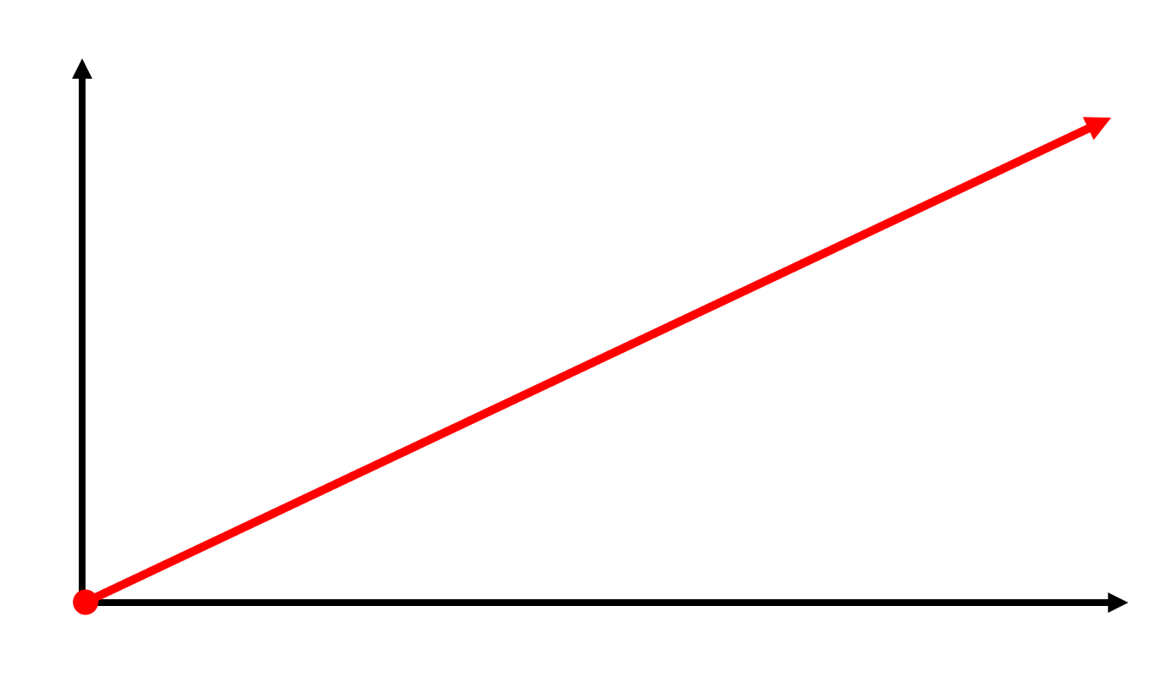
Perspective: Ideal
Performance
Time

Slide 6
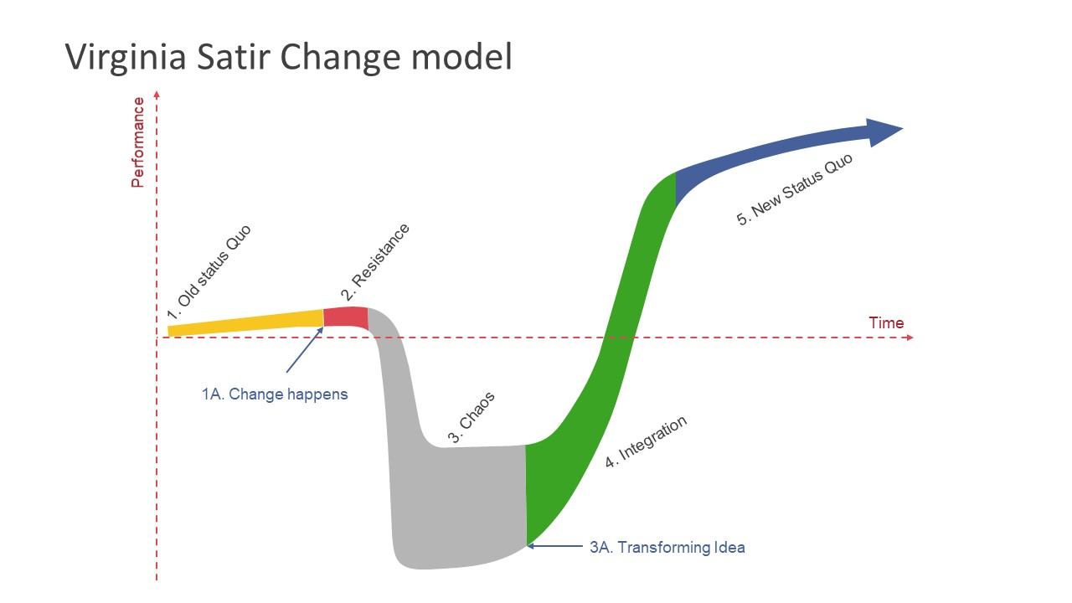
Perspective: Reality
Credit: SlideModel

Slide 7
Ask: What’s the Problem We Seek to Address?
What | Diagnose the problem
How | Include varied stakeholders to get to reality of system Find the patterns beyond individual events (Iceberg Model) Look at relationships within the system

Slide 8
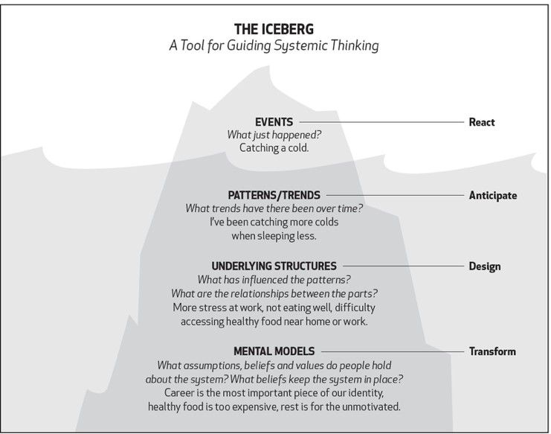
Systematic Analysis: Diagnosing the Problem
Image courtesy of Ecochallenge.org. Used with permission. ecochallenge.org/iceberg-model/

Slide 9
Ask: Where Do I Have the Most Influence?
What | Shrink the change: Act locally to address problems that arise in our sphere of influence
How | Where do I have influence? Where can small actions have the most impact? What relationships across the whole system can help? Is the time right to act?

Slide 10
Leverage is the process of applying a small force that multiplies into a large effect.
Patrick Guenette/Alamy Stock Vector

Slide 11
Ask: How Can I Support the People Required to Make This Change a Success?
What | Ensure key stakeholders are invested and supported
How | Build relationships and trust Connect and create change networks Share new information through networks Encourage wide participation Address resistance to change Be aware of political realities

Slide 12
Action Planning
Situation Analysis: Risk Factors and Warning Signs
Key Actors:
Who increases or decreases risk?
Potential perpetrators?
Potential targeted groups?

Slide 13
Action Planning
Agency and Individual Role
Where do you have influence? Over who or what do you have influence (thinking about high leverage points)?
What would you need from your department or from the public to take action to address this risk factor, warning sign, or trigger you identified?
What sources of resistance can you expect and how could you respond to this resistance?

Slide 14
Action Planning
Recommendations
Based on your assessment, what plan or recommendations have you generated to reduce mass atrocity risk?
How do you anticipate this plan will help prevent mass atrocities? Does it address risk or resilience before, during, or after mass atrocities?

Slide 15
Action Planning
Recommendations
Can you identify two or three steps to implement this plan and its recommendations?
What leadership qualities are important to implementing this plan and its recommendations?

Slide 16
Conclusion

