Slide 2
Notes:
In order to answer this question, students need to learn a little bit about the history of immigration law in the United States during the first third of the 20th century.

Slide 3
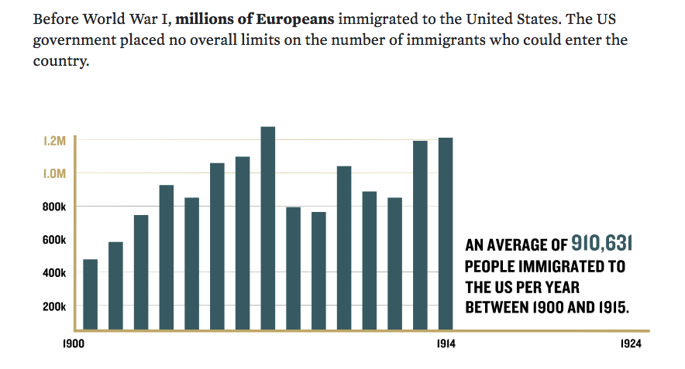
US Immigration, 1900–1915
Before World War I, millions of Europeans immigrated to the United States. The US government placed no overall limits on the number of immigrants who could enter the country.
AN AVERAGE OF 910,631 PEOPLE IMMIGRATED TO THE UNITED STATES PER YEAR BETWEEN 1900 AND 1915.
Notes:
A large number of the “new” immigrants during the first quarter of the 20th century were Jews and Catholics from southern and eastern Europe.

Slide 4
The Immigration Act of 1924
In 1924, Congress passed a law to set immigration quotas by country and limit total immigration to about 164,000 people per year. The quotas were designed to “protect” America’s “racial stock” by severely limiting “undesirable” immigrants, including Jews, Asians, and Africans. There were no quotas for immigrants from North or South America.
Notes:
Based on racist eugenic ideas, the Immigration Act of 1924 represented a backlash against new immigrants whom lawmakers considered religiously, racially, ethnically, and economically undesirable. The law privileged immigration from the United Kingdom, Germany, and Ireland, and it heavily restricted immigration from most other countries, outright barring immigration from many countries in Asia and Africa.
This immigration law -- which remained largely unchanged in 1939 -- established quotas based on country of birth, not nationality; almost half of the immigration quota was reserved for people born in the UK and Ireland - 65, 721 (UK), 17,853 (Ireland). Germany had the second largest quota at 25, 957 (in 1939, the German quota was combined with the Austrian quota to total 27,370).
In 1939, US immigration law did not differentiate between refugees and regular immigrants. Those fleeing racial or religious persecution and violence had to follow the same rules as everyone else. Quota immigrants were subjected to literacy and medical tests, and had to submit extensive paperwork attesting to financial resources, identity, and moral conduct. They were also subjected to a ruling as to whether they could support themselves financially during the Depression, or whether they were likely to become public charges (LPC).
Immigration was controlled by Congress, which set national origins quotas and laid out the qualifications for various types of immigrants. Immigration laws were largely enforced by the State Department. President Franklin Roosevelt was not legally able to adjust immigration law unilaterally, and rarely dictated the State Department’s interpretation of the law.

Slide 5
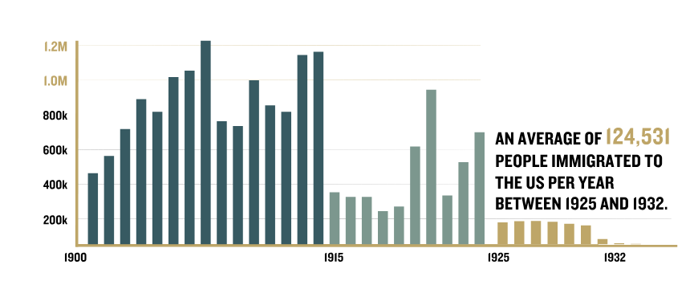
US Immigration, 1925–1932
Immigration fell significantly after the 1924 law went into effect. In 1929, the Great Depression began. President Herbert Hoover ordered the State Department to make sure immigrants would not become economic burdens to the United States. Immigration plummeted even further.

Slide 6
Immigration from Germany to the United States, 1933–1937
1933
The 1924 US quota law set a yearly limit of 25,957 immigration visas for people born in Germany. In 1933, the State Department issued visas to only 1,241 Germans. Although 82,787 people were on the German waiting list for a US visa, most did not have enough money to qualify for immigration.
1934–1937
From 1934 through 1937, there were between 80,000 and 100,000 Germans on the waiting list for a US immigration visa. Most were Jewish. Although the State Department slowly began to issue more visas, the German quota went unfilled.
1933
Adolf Hitler became chancellor of Germany. The Nazi regime immediately started discriminating against German Jews, and thousands sought to leave.
1934–1937

Slide 7
It Is 1938…
Notes:
In 1938, Americans—who had not fully recovered from the Great Depression of 1929—were beset by a new serious economic recession. Unemployment jumped to 20 percent. Many in the country were deeply suspicious of foreigners and minorities in the United States, particularly African Americans, who struggled for equal rights in the face of official discrimination and the threat of racial violence.
It was in this context that Nazi Germany annexed Austria and the Sudeten region of Czechoslovakia, sparking a massive refugee crisis.

Slide 8
Nazi Persecution Sparked a Refugee Crisis
Notes:
In 1938, Americans—who had not fully recovered from the Great Depression of 1929—were beset by a new serious economic recession. Unemployment jumped to 20 percent. Many in the country were deeply suspicious of foreigners and minorities in the United States, particularly African Americans, who struggled for equal rights in the face of official discrimination and the threat of racial violence.
It was in this context that Nazi Germany annexed Austria and the Sudeten region of Czechoslovakia, sparking a massive refugee crisis.

Slide 9
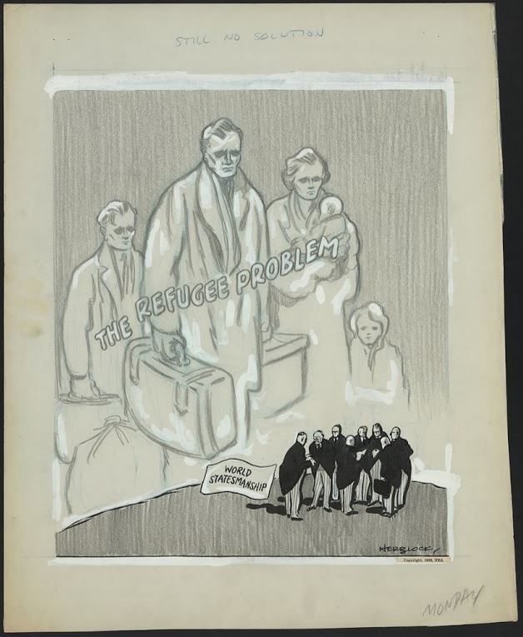
“It is a fantastic commentary on the inhumanity of our times that for thousands and thousands of people a piece of paper with a stamp on it is the difference between life and death.” —Dorothy Thompson, Refugees: Anarchy or Organization, NY: Random House, 1938, p. 28
Source: National Archives and Records Administration
Notes:
Image: “Still no solution.” January 1939. Library of Congress
Quote: Dorothy Thompson, Refugees: Anarchy or Organization, NY: Random House, 1938, p. 28.

Slide 10
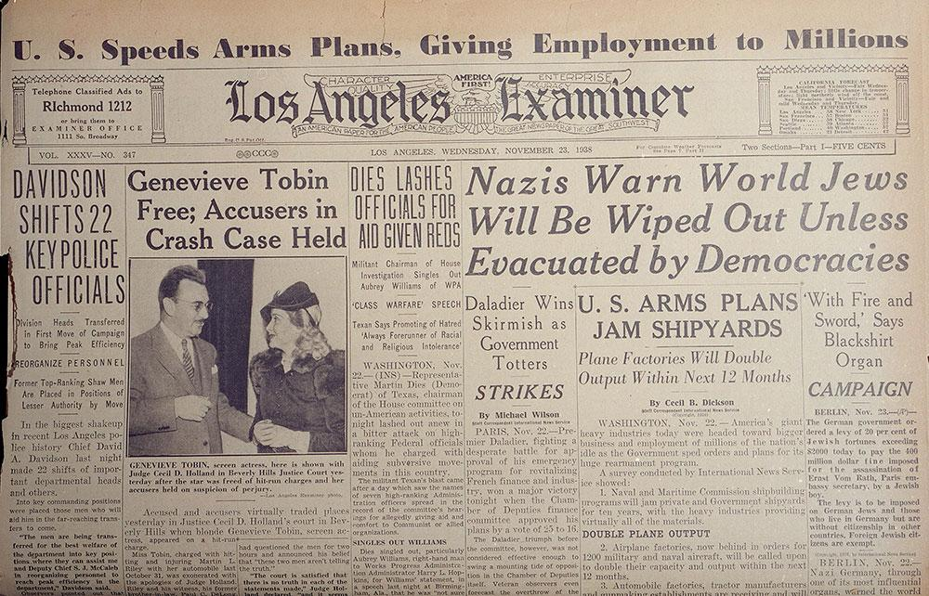
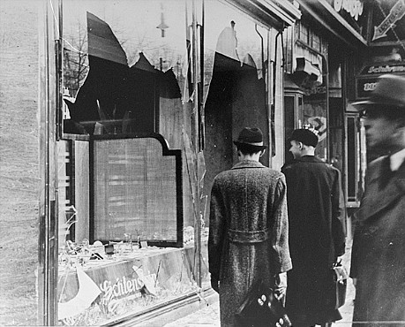
November 1938: Kristallnacht (“The Night of Broken Glass”)
Source: National Archives and Records Administration
Notes:
Shattered storefront of a Jewish-owned shop destroyed during Kristallnacht in Berlin, Germany, November 1938. National Archives and Records Administration
Los Angeles Examiner, November 23, 1938
In a nationwide pogrom known as Kristallnacht, which took place on November 9–10, 1938, members of the Nazi party and other Nazi formations burned synagogues, looted Jewish homes and businesses, and killed at least 91 Jews. Kristallnacht was on the front page of American newspapers for weeks. There were plenty of full-page articles and multi-page spreads. Americans were horrified by the violence.

Slide 11
November 15, 1938: President Roosevelt Extended Visas for Refugees in the US
In the aftermath of Kristallnacht, President Franklin D. Roosevelt extended temporary visas allowing some 12,000 German Jews already in the United States to stay in the country indefinitely.
Notes:
Though Congress determined the immigration laws of the United States, in the aftermath of Kristallnacht, President Roosevelt chose to exercise his executive power to aid Germans (most of them Jewish) who were temporarily in the United States as tourists by extending their visitor visas. He also recalled the US ambassador to Germany as a sign of protest.
“The news of the past few days from Germany has deeply shocked public opinion in the United States. Such news from any part of the world would inevitably produce a similar profound reaction among American people in every part of the Nation. I myself could scarcely believe that such things could occur in a twentieth-century civilization. With a view to gaining a first-hand picture of the situation in Germany, I asked the Secretary of State to order our Ambassador in Berlin to return at once for report and consultation.” —President Roosevelt’s statement on Kristallnacht
New York Times, November 19, 1938, 1.

Slide 12
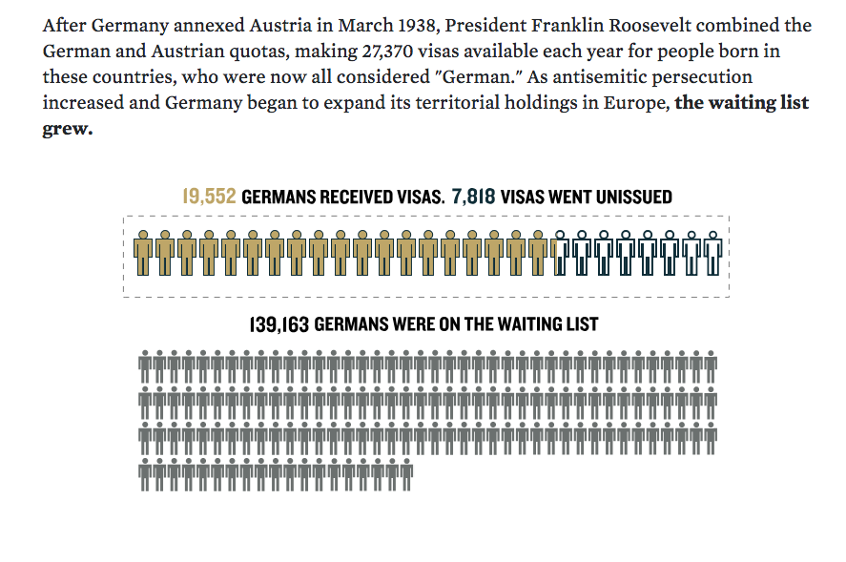
Immigration from Germany to the United States, 1938
After Germany annexed Austria in March 1938, President Roosevelt combined the German and Austrian quotas making 27,370 visas available each year for people born in these countries, who now were considered “German.” As antisemitic persecution increased and Germany began to expand its territorial holdings in Europe, the waiting list grew.
19,552 GERMANS RECEIVED VISAS; 7,818 VISAS WENT UNISSSUED
139,163 GERMANS WERE ON THE WAITING LIST
Notes:
The Refugee Crisis of 1939
By the end of January 1939, Adolf Hitler had been in power for six years, and the German government had severely disenfranchised, segregated, and isolated the country’s Jews. The previous March, Germany had annexed Austria and immediately instituted a reign of terror against political opponents and the Jewish population. That, combined with the anti-Jewish violence of Kristallnacht in November 1938, spawned a flood of refugees from the Greater German Reich. In response, President Roosevelt combined the German and Austrian quotas, and for the first and only time during the 1930s and 1940s, the United States admitted the full German quota: 27,370 Germans and Austrians, mostly Jewish refugees. By this time, however, with hundreds of thousands of Reich Jews desperately clamoring for a US visa, the quota was not nearly adequate to meet the demand.
In the United States, there were no special laws at this time distinguishing “refugees” from regular immigrants. All people seeking to enter the United States, including those fleeing persecution and violence, had to follow the same procedures under the same onerous restrictions and quotas. Quotas were not targets to be met; rather, they represented the maximum limit of people allowed to immigrate each year. Every year from 1933-1938, the German quota was not filled, despite a growing waiting list of refugees trying to come to the United States.

Slide 13
US Public Opinion and the Refugee Crisis, November 1938
6%
Approve
“Do you approve or disapprove of the Nazi treatment of Jews in Germany?”
Source: Gallup Opinion Poll November 1938
94%
Disapprove
Notes:
The vast majority of Americans were horrified by the wanton violence and destruction of Kristallnacht.

Slide 14
US Public Opinion and the Refugee Crisis, November 1938
7%
21%
No opinion
Yes
“Should we allow a larger number of Jewish exiles from Germany to come to the United States to live?”
Source: Gallup Opinion Poll November 1938
72%
No
Notes:
Nonetheless, a large majority of Americans opposed allowing Jews from Germany to immigrate to the United States.

Slide 15
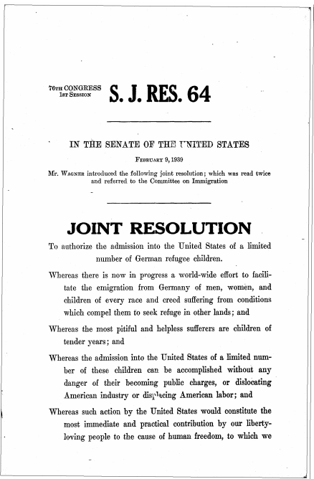
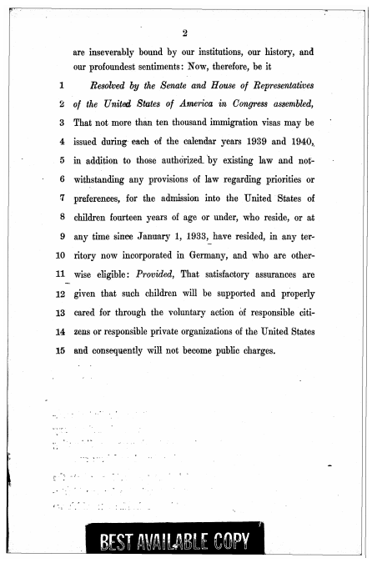
February 9, 1939: Wagner-Rogers Bill Introduced
Notes:
On February 9, 1939, Democratic senator Robert Wagner of New York and Republican congresswoman Edith Nourse Rogers of Massachusetts sponsored identical bills in the US Senate and House of Representatives to admit 20,000 German refugee children under the age of 14 over a two-year period. The bills, written by Pickett and his interfaith colleagues, specified that 10,000 children each fiscal year (1939 and 1940) would enter the United States and not be counted against the existing immigration quota. Although the bill did not indicate that the “German refugee children” would mostly be Jewish children, the realities of the refugee crisis in Europe made this an obvious and understood fact. The bill specified that when the refugee children reached the age of 18, they would either be counted against that year’s German immigration quota or would return to Europe.

Slide 16
US Public Opinion and the Wagner-Rogers Bill, January 1939
7%
No opinion
26%
Yes
“It has been proposed that the government permit 10,000 refugee children be brought into this country and taken into American homes. Do you approve of this plan?”
Gallup Opinion Poll January 1939
67%
No
Notes:
The public debate on the Wagner-Rogers Bill mirrored a broader debate about Americans’ responsibilities to refugees during the crisis brought about by Nazi Germany’s persecution of Jews. In January 1939, weeks before the Wagner-Rogers Bill was introduced, a public opinion poll asked Americans whether they would favor a proposal to “permit 10,000 refugee children from Germany to be brought into this country and taken care of in American homes.” Only 26% of respondents favored this idea; 67% opposed it. Senator Wagner and Representative Rogers faced an American public that remained largely opposed to any expansion of immigration to the United States -- even a limited exception for child refugees.

Slide 17
Learn about your individual or group by reading the relevant biography.
Review the documents in your packet. They include:
A copy of the Wagner-Rogers Bill
A document that illustrates your individual’s or group’s position on the bill
If your document is lengthy, a printed excerpt is attached. It is not necessary to read the long-form documents.
Summarize your position. Prepare to present your argument.
Notes:
Use this slide to introduce the small group student activity.

Slide 18
What group or individual did you read about?
What was this person’s or group’s stance on the Wagner-Rogers Bill?
How does your individual justify his or her stance?
Notes:
Pause here, and leave this slide up during the small group student activity.

Slide 19
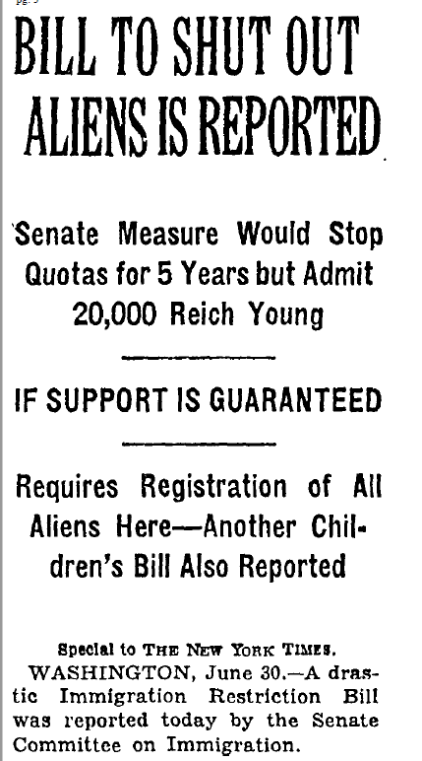
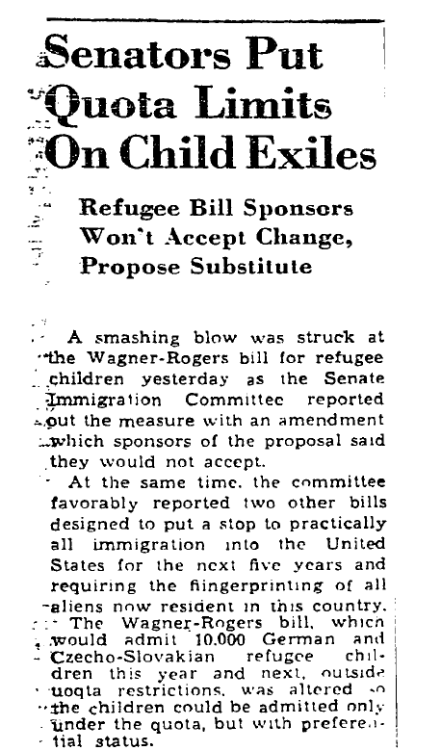
The Wagner-Rogers Bill is Withdrawn, July 1939
Source: New York Times, July 1, 1939 (left); Washington Post, July 1, 1939 (right)
Notes:
Once students have had a chance to present their positions and discuss the proposed Wagner-Rogers Bill, reveal what actually happened to the bill.
In late June 1939: Congressional opponents of the Wagner-Rogers Bill, led by Senator Robert Reynolds, introduced legislation that would reduce, rather than increase, the quota. In fact, Reynolds amended the bill to count refugee children against the existing German quota and to halt all further immigration for five years, thus reversing the original bill’s intent. Roosevelt remained silent, and after several months of public and Congressional debate, Senator Wagner withdrew his bill and it effectively died in the Senate Immigration Committee during the first week of July 1939. Though the House version of the bill was not amended, a poll of members found that it did not have sufficient votes to make it out of committee, and it was never brought to a floor vote. By the end of summer 1939, the Wagner-Rogers Bill was dead. Within a month, Germany invaded Poland and, with the onset of World War II, immigration to the United States became increasingly more treacherous and difficult. After US entry into the war on December 8, 1941, immigration became nearly impossible.

Slide 20
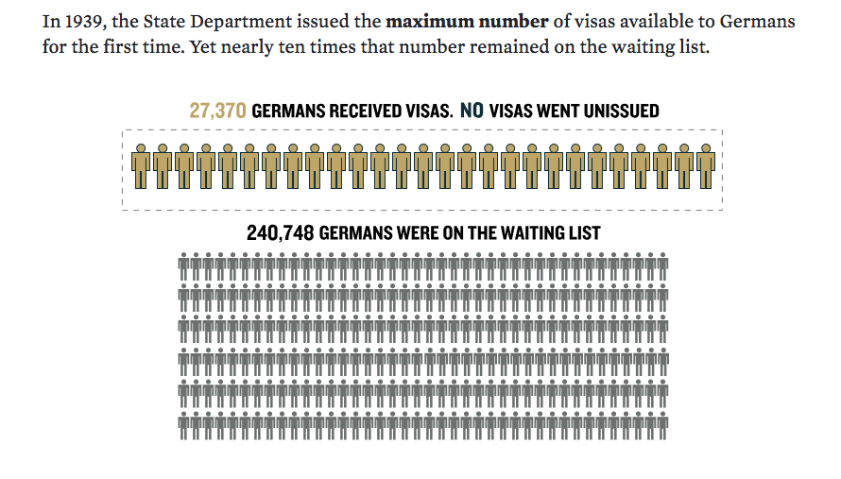
German Immigration to the United States, 1939
In 1939, the State Department issued the maximum number of visas available to Germans for the first time. Yet nearly ten times that number remained on the waiting list.
27,370 GERMANS RECEIVED VISAS; NO VISAS WENT UNISSSUED
240,748 GERMANS WERE ON THE WAITING LIST
Notes:
In 1939, for the first and only time during the 1930s, the United States issued the maximum number of visas allowed under the German quota. However, the national origins quota system remained in effect despite a massive waiting list of refugees attempting to flee Nazi persecution. Under the quota, by the end of 1939, it would have taken eleven years to admit every applicant on the list.

Slide 21
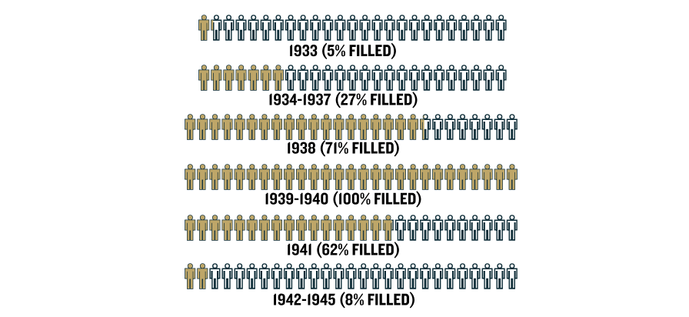
German Immigration to the United States, 1933–1945
Many more people could have reached the United States had the State Department filled the German quota beginning in 1933, or had Congress changed immigration laws to address the refugee crisis. Approximately 125,000 Germans, most of them Jewish, immigrated to the United States between 1933 and 1945.
Notes:
In 1939, for the first and only time during the 1930s, the United States issued the maximum number of visas allowed under the German quota. However, the national origins quota system remained in effect despite a massive waiting list of refugees attempting to flee Nazi persecution. Under the quota, by the end of 1939, it would have taken eleven years to admit every applicant on the list.

Slide 22
Concluding Discussion
How would you characterize American public opinion regarding refugees from 1938–1941?
What factors influenced American attitudes and opinions on these issues?
Were there particular arguments that you found convincing? Why? Was there additional information you would need to accurately assess the validity of these arguments?
Why do you think the Wagner-Rogers Bill failed?
What is the role of informed public debate about policy decisions in a democracy?
What questions does this case study raise about America’s role in the world?

Slide 23
The Museum wishes to acknowledge and thank the following donors to the Americans and the Holocaust Initiative:
^{Jeannie & Jonathan Lavine}
The Bildners–Joan & Allen z”l, Elisa Spungen & Rob, Nancy & Jim
^{Jane and Daniel Och}
Akin Gump Strauss Hauer & Feld LLP
Arnold & Porter Kaye Scholer LLP
^{Ruth Miriam Bernstein}
Joyce and Irving Goldman Family Foundation
^{In Memory of Simon Konover}
Philip and Cheryl Milstein Family
Benjamin and Seema Pulier Charitable Foundation
David and Fela Shapell Family Foundation
^{Deborah Simon}
^{Laurie and Sy Sternberg}

