Slide 2
A Wehrmacht Battalion and its Orders, Fall 1941: A Case Study

Slide 3
Section 47, German Military Penal Code (1872)
If through the execution of an order pertaining to official duties, a penal law is violated, then the superior giving the order is solely responsible. However, the subordinate who obeys shall be punished as a participant:
(1) if he exceeded the order he received, or,
(2) if he knew that the order of the superior concerned an act which constituted a civil or military crime or offense.
Notes:
Citation: Keller C., Militär-Strafgesetzbuch für das Deutsche Reich, trans. United States Holocaust Memorial Museum (Berlin: Weidmann, 1873).

Slide 4
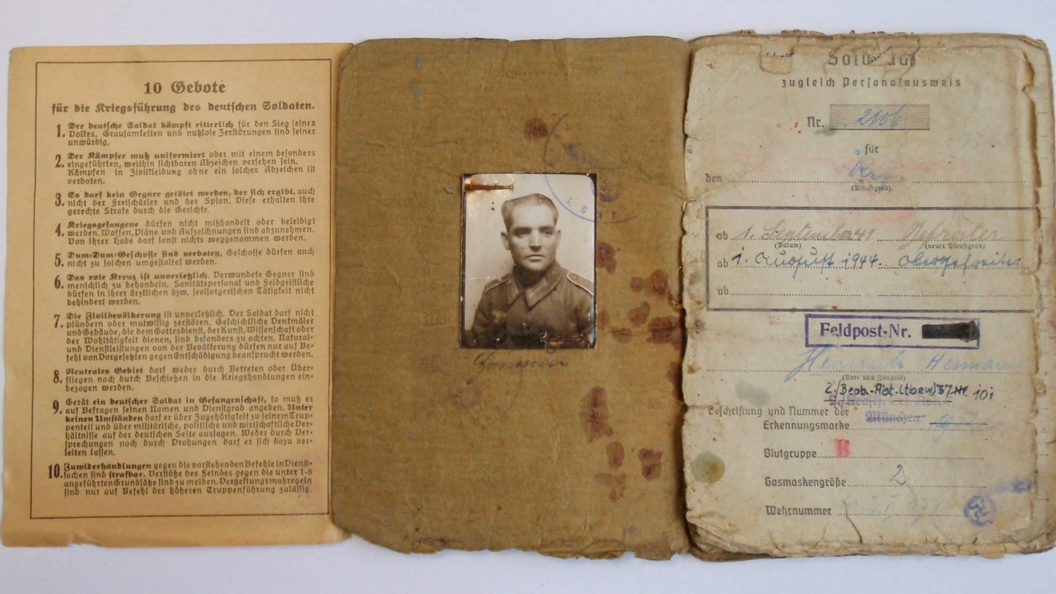
A German Soldier’s Paybook
Notes:
Citation: Deutsche Dienststelle (WASt), translation United States Holocaust Memorial Museum

Slide 5
Excerpts from “Ten Commandments for
the Conduct of the German Soldier at War”
The German soldier fights honorably for the victory of his people. Cruelty and pointless destruction is dishonorable.
No opponent who surrenders may be killed. This includes even the guerrilla fighter and the spy. They will receive their just punishment before the courts.
Prisoners of war may not be mishandled or insulted. Weapons, plans, sketches are to be confiscated. None of their personal possessions may be taken.
The civilian population is inviolable. A soldier may not arbitrarily engage in plunder or destruction. Historical memorials and buildings which serve as houses of God, or serve science, art, or the general welfare are especially to be safeguarded. Resources and services from the population may only be demanded against compensation only on the orders of superior officers.
Notes:
Citation: Deutsche Dienststelle (WASt), translation United States Holocaust Memorial Museum
Additional Information: For a translation of the entire “Ten Commandments for the Conduct of the German Soldier at War”, see context sheet “Codes of Conduct in the German Military”

Slide 6
Why did the German Military support Hitler?

Slide 7
Military Provisions of Versailles Treaty (1919)
German Army was reduced to 100,000 men; no tanks were permitted
German air force was abolished
German navy was reduced to 6 capital ships; submarine forces abolished
The Rhineland and 50 kms. east of the Rhine River was designated a demilitarized zone and occupied by Allied forces for 15 years
Notes:
Citation: United States Holocaust Memorial Museum
Additional information: Please see the United States Holocaust Memorial Museum Holocaust Encyclopedia article: Treaty of Versailles, 1919;

Slide 8
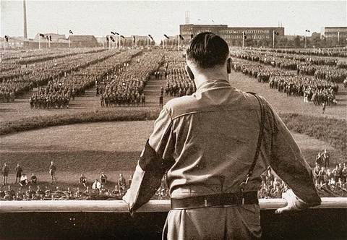
Adolf Hitler addresses a rally of the Nazi paramilitary formation, the SA (Sturmabteilung), in 1933
Notes:
Photo Caption: Adolf Hitler addresses a rally of the Nazi paramilitary formation, the SA (Sturmabteilung), in 1933.
Citation: United States Holocaust Memorial Museum, courtesy of William O. McWorkman
Additional information: By 1934, the SA had grown to nearly four million members, significantly outnumbering the 100,000 member professional army. Holocaust Encyclopedia article: Röhm Purge.

Slide 9
The German Military Oath, Weimar Republic (1919–1933)
“I swear loyalty to the Reich Constitution and vow that I will protect the German nation and its lawful establishment as a brave soldier at any time, and will obey the President and my superiors.”
The German Military Oath, as of August 2, 1934
"I swear by God this sacred oath: I will render unconditional obedience to Adolf Hitler, the Führer of the German nation and people, Supreme Commander of the Armed Forces, and will be ready as a brave soldier to risk my life at any time for this oath."
Notes:
Citation: Robert B. Kane, Disobedience and Conspiracy in the German Army (Jefferson, NC: McFarland & Co., 2002), 227; J. Noakes and G. Pridham, eds., Nazism, 1919-1945: A History in Documents and Eyewitness Accounts, vol. 1, The Nazi Party, State and Society 1919-1939 (New York: Schocken Books, 1983), 185-186.
Additional information: During World War I, soldiers swore their allegiance to the Kaiser (emperor) of the German Empire. Under the Weimar Republic, the oath shifted to the first example here, which emphasizes loyalty to the Republic’s constitution. It was not until President Hindenburg’s death in the summer of 1934 that German soldiers swore an oath to Hitler personally.

Slide 10
Excerpt from “Guidelines for the
Behavior of the Troops in Russia,” May 19, 1941
1. Bolshevism is the deadly enemy of the National Socialist German people. Germany’s struggle is directed against this subversive ideology and its functionaries.
2. This struggle requires ruthless and energetic action against Bolshevik agitators, guerillas, saboteurs, and Jews, and the total elimination of all active or passive resistance.
3. The members of the Red Army—including prisoners—must be treated with the most extreme reserve and the greatest caution since one must reckon with devious methods of combat. The Asiatic soldiers of the Red Army in particular are inscrutable, unpredictable, devious, and brutish...
4. When taking units prisoner the leaders must be separated from the rank and file at once.
5. In the Soviet Union the German soldier is not confronted with a unified population. The USSR is a state formation that combines a multiplicity of Slav, Caucasian, and Asiatic peoples held together by the violence of the Bolshevik rulers. Jewry is strongly represented in the USSR…
Notes:
Citation: Hans-Adolf Jacobsen, “Kommissarbefehl und Massenexecutionen sowjetischer Kriegsgefangener,” in Anatomie des SS Staates, vol. 2, trans. United States Holocaust Memorial Museum (Munich: Deutscher Taschenbuch Verlag, 1989), 187-188.

Slide 11
Summary of the Barbarossa Jurisdiction Decree, May 13, 1941
Section I
Crimes committed by enemy civilians in the Barbarossa theater of operations would not be tried by courts-martial but instead would be handled immediately by the troops
Individuals suspected as partisans were denied due process under the decree
Section II
Abolished the obligatory prosecution and punishment of German servicemen for crimes against enemy civilians in the Barbarossa area of operations, even if the crimes represented felonious military offenses
Military penal code is nullified
Notes:
Citation: RG-242, NOKW-2080, National Archives and Records Administration, College Park, MD, trans. United States Holocaust Memorial Museum.

Slide 12
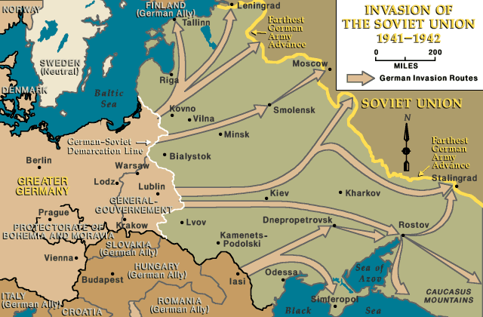
Notes:
Caption: Invasion of the Soviet Union, 1941 – 1942, United States Holocaust Memorial Museum
Citation: United States Holocaust Memorial Museum
Additional Information: Holocaust Encyclopedia Articles: Invasion of the Soviet Union, June 1941; The Soviet Union and the Eastern Front

Slide 13
1st Battalion, 691st Infantry Regiment, German-occupied eastern Belarus
Mission: Secure and pacify occupied Belarus
Environment:
Scattered Soviet soldiers behind the lines
Daily reports of “enemy contact”
No indication of a partisan threat
The Mogilev Conference, September 1941
Execution of 41 Jews as reprisals for supposed connection to partisans and the shooting of a German soldier.
Notes:
Context Sheet: “Case Study: Army Group Center (Rear)”
and “Belarus”

Slide 14
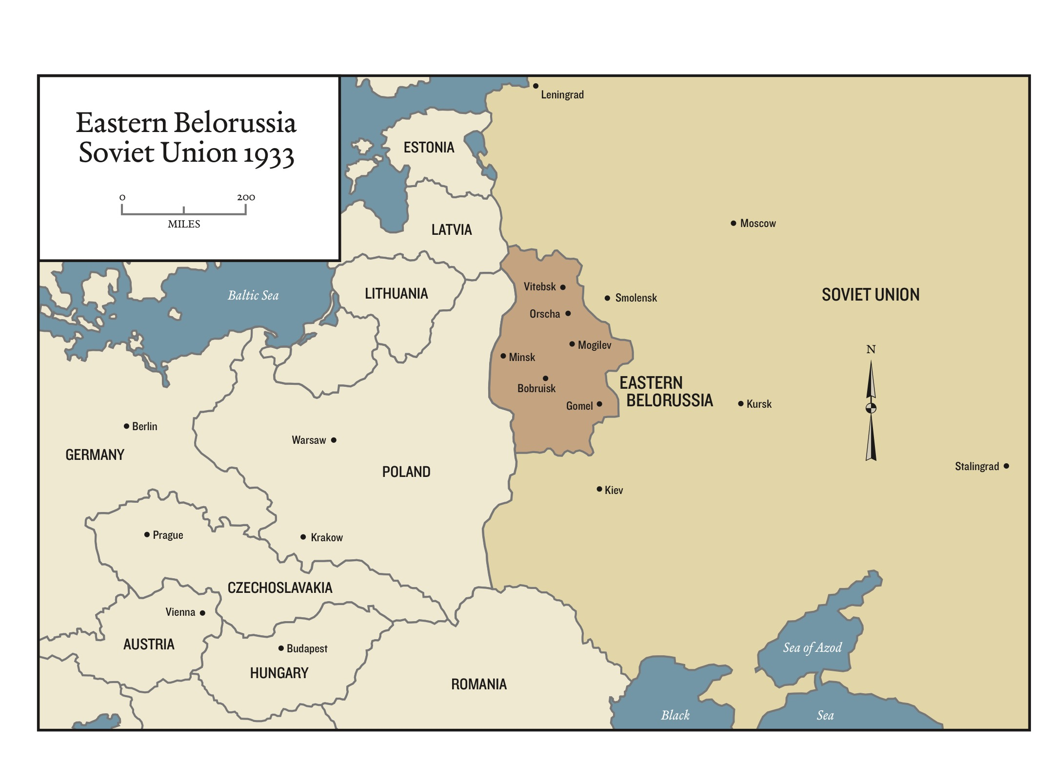
Notes:
Context Sheet: “Belarus” and “Case Study: Army Group Center (Rear)”

Slide 15
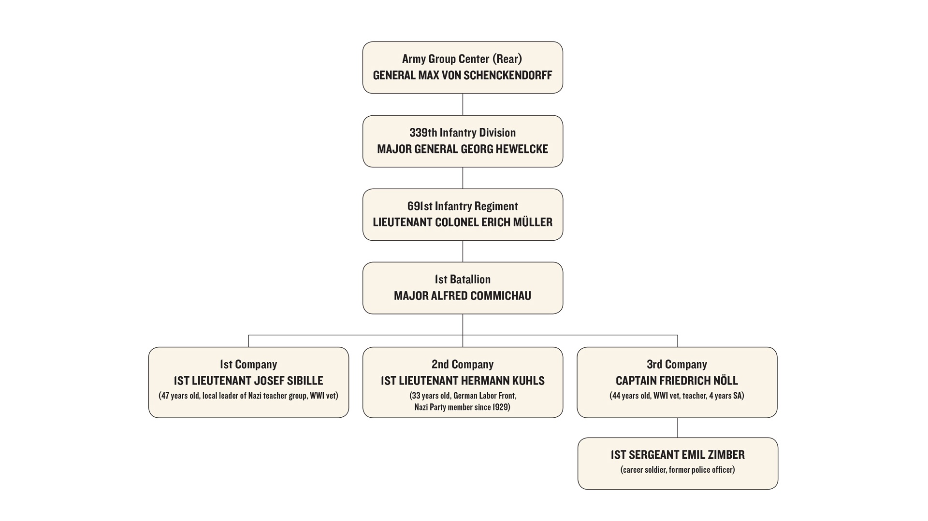
Notes:
Context Sheet: “Case Study: 691st Regiment in October 1941”

Slide 16
Verbal Order Issued
Commander of
1st Battalion, 691st gives order:
Shoot the Jewish population in each company’s area of operation
1st Company Commander
2nd Company Commander
3rd Company Commander
Notes:
Context Sheet: “Case Study: 691st Regiment in October 1941”

Slide 17
Discuss:
What are the most significant factors influencing the changing responsibilities of this military battalion?
What discretion do these company commanders have in responding to the order?

Slide 18
Verbal Order Issued
Commander of
1st Battalion, 691st gives order:
Shoot the Jewish population in each company’s area of operation
1st Company Commander
2nd Company Commander: Carries out order immediately
3rd Company Commander
Notes:
Context Sheet: “Case Study: 691st Regiment in October 1941”

Slide 19
Verbal Order Issued
Commander of
1st Battalion, 691st gives order:
Shoot the Jewish population in each company’s area of operation
3rd Company Commander: Receives written verification; 1st sergeant carries out order
1st Company Commander
2nd Company Commander: Carries out order immediately
Notes:
Context Sheet: “Case Study: 691st Regiment in October 1941”

Slide 20
Verbal Order Issued
Commander of
1st Battalion, 691st gives order:
Shoot the Jewish population in each company’s area of operation
1st Company Commander: Refuses to carry out order: “Good German soldiers don’t dirty their hands with such things.”
3rd Company Commander: Receives written verification; 1st sergeant carries out order
2nd Company Commander: Carries out order immediately
Notes:
Context Sheet: “Case Study: 691st Regiment in October 1941”

Slide 21
How does this case study help us to better understand the events of the Holocaust?

Slide 22
What are the implications of this case study for military officers today?

Slide 23
What questions does it raise about possible pressures on and motivations of commanding officers and their units?

